Slide 1
Fermi GBM Observations of Gamma-Ray Bursts
Michael S. Briggs
on behalf of the Fermi GBM Team
University of Alabama
in Huntsville
NASA
Marshall Space Flight Center
Max-Planck-Institut für
extraterrestrische Physik

Slide 3
GBM Data
TRIGDAT: limited data received in near real-time for triggers.
CSPEC & CTIME: Continuous Spectroscopy and Timing data. Covers 24 hours a day, with improved temporal resolution for triggers.
It is received via delayed playback from the on-board recorder.
TTE: Time-Tagged Events: individual counts for triggers, with typical time coverage of −30 to +300 seconds. Also received by delayed playback.

Slide 4
Ensemble Results: I
GBM Triggers (as of September 29):
552 Gamma-Ray Bursts (GRBs),
170 Soft-Gamma Repeaters (SGRs),
104 Terrestrial Gamma-ray Flashes (TGFs),
33 Solar Flares,
2 short transients
45 GRBs resulted in automatic autonomous repoints of Fermi (more in the next talk by V. Pelassa).

Slide 5
GBM GRB Catalog
PRELIMINARY

Slide 6
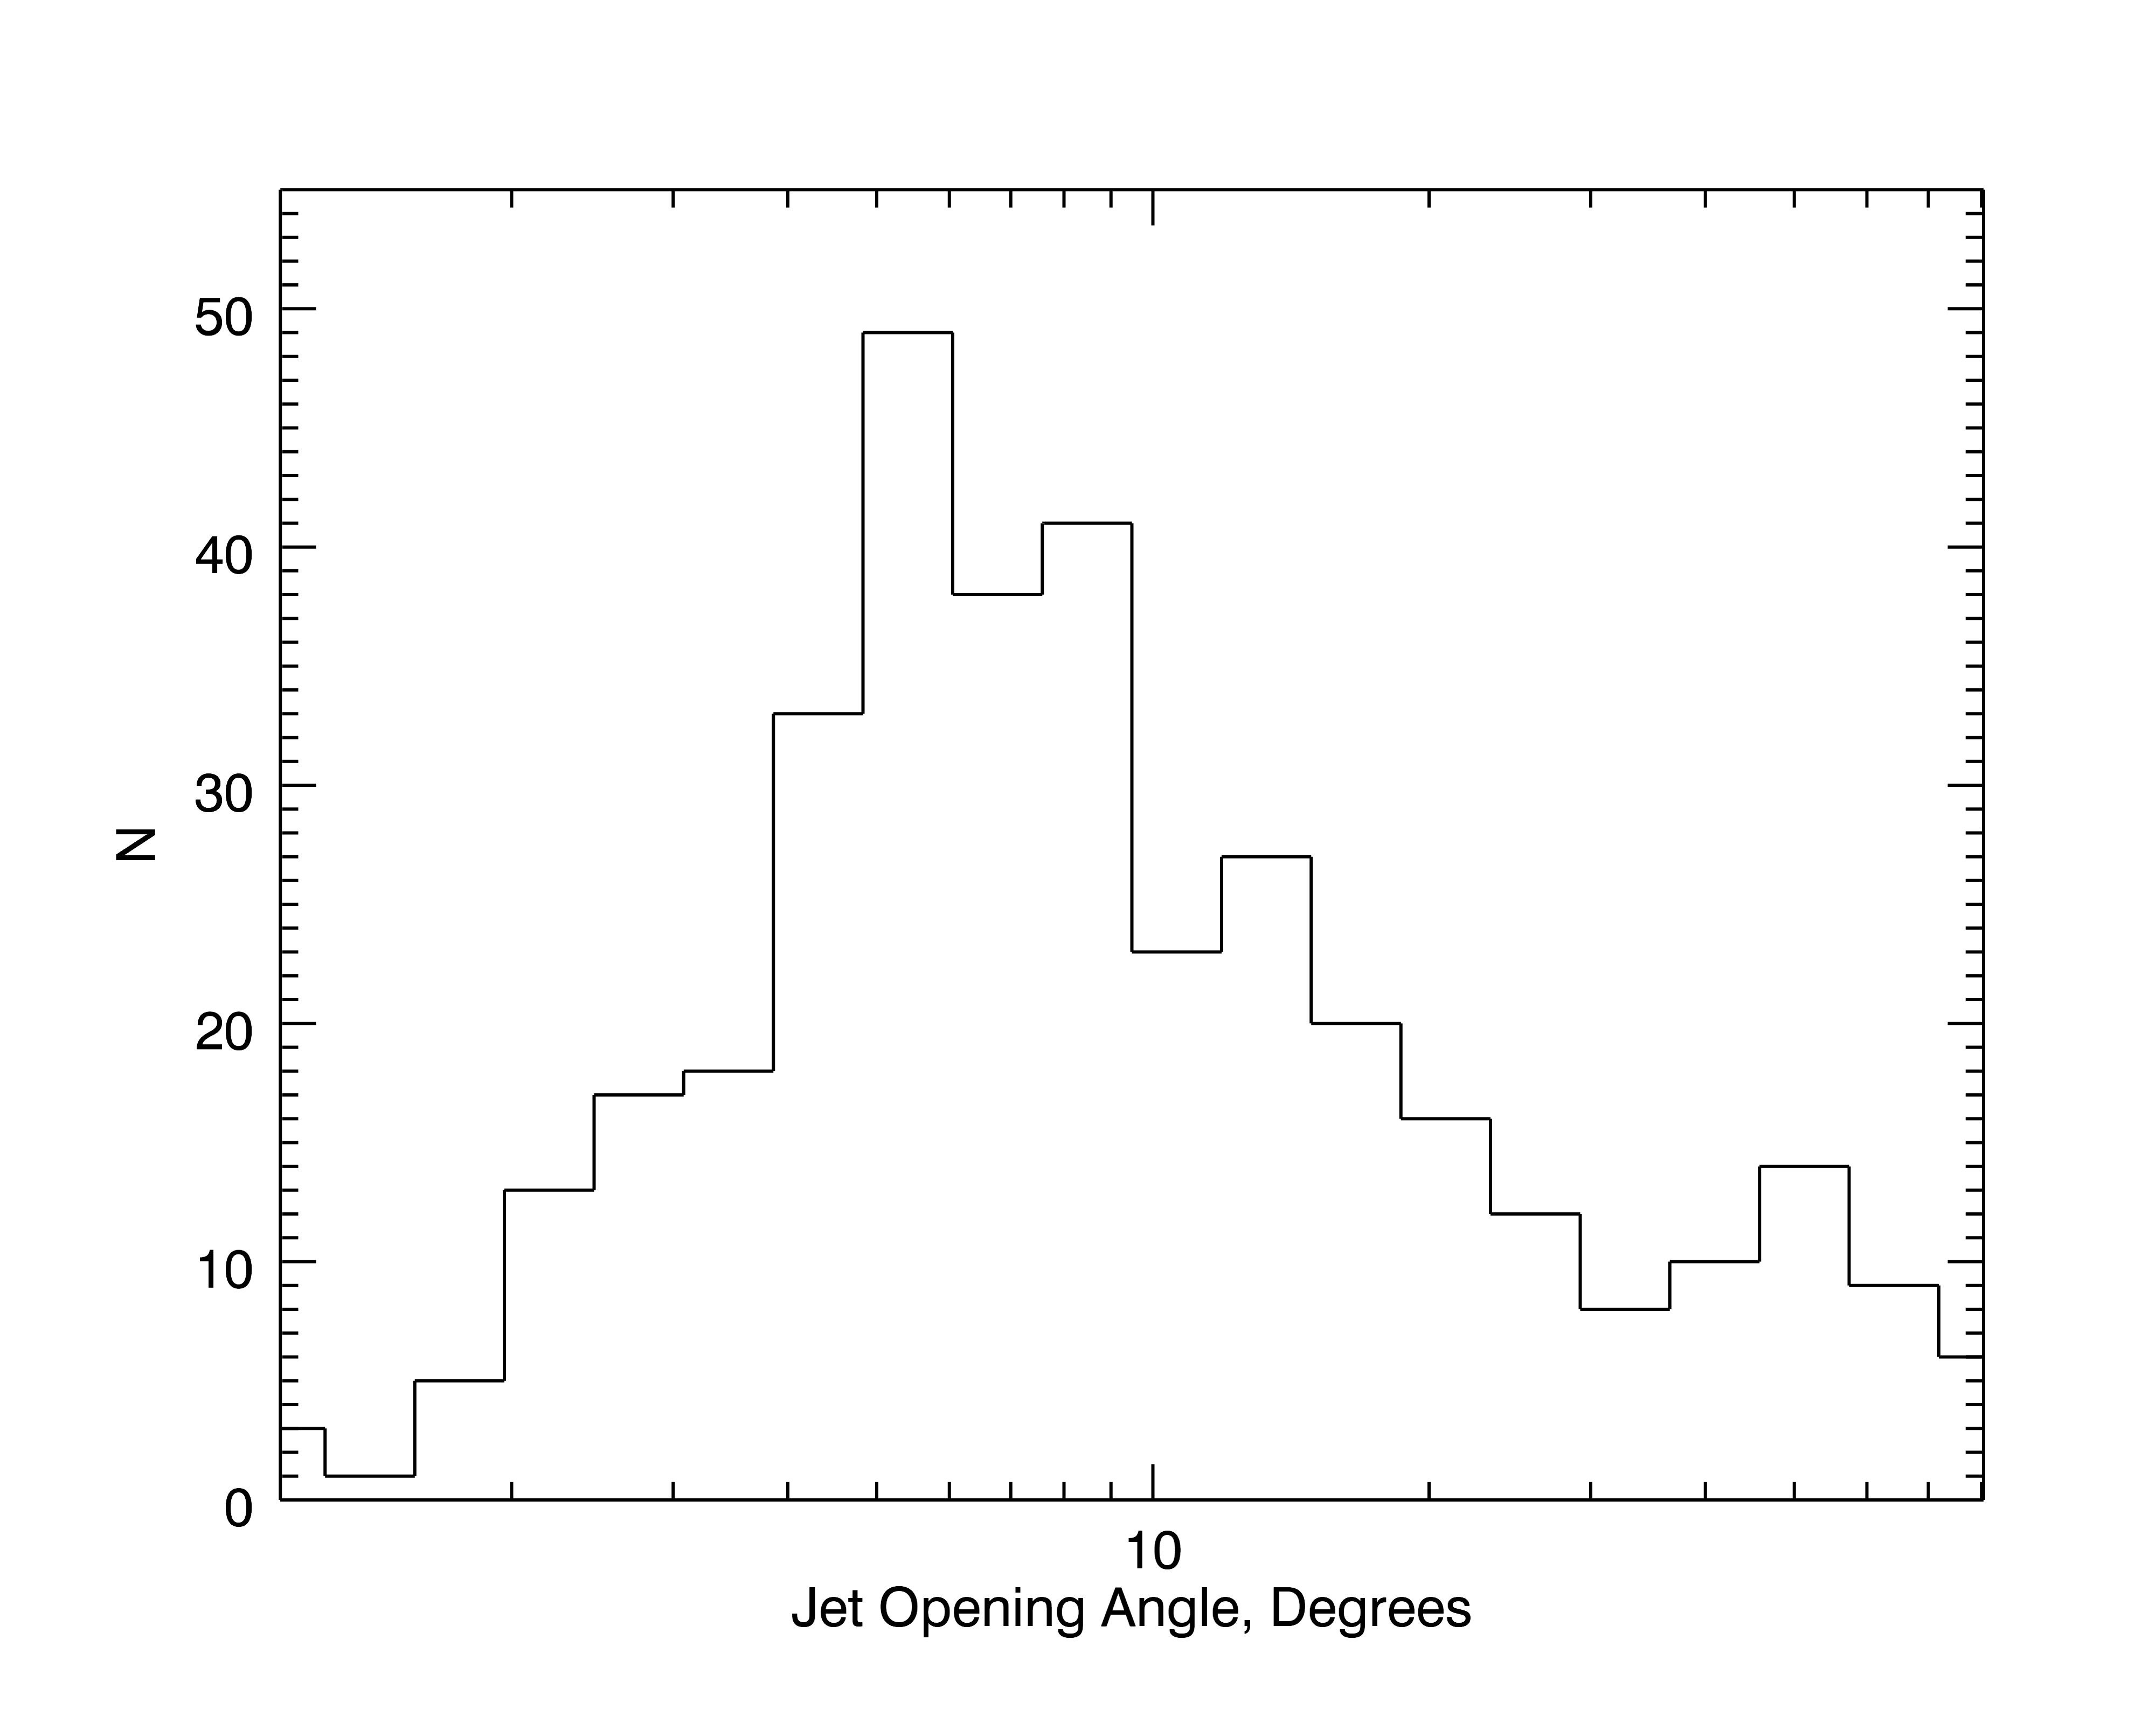
GBM GRB Spectroscopy Catalog
Poster: Energetics of Fermi/GBM GRBs:
A. Goldstein & R. Preece

Slide 7
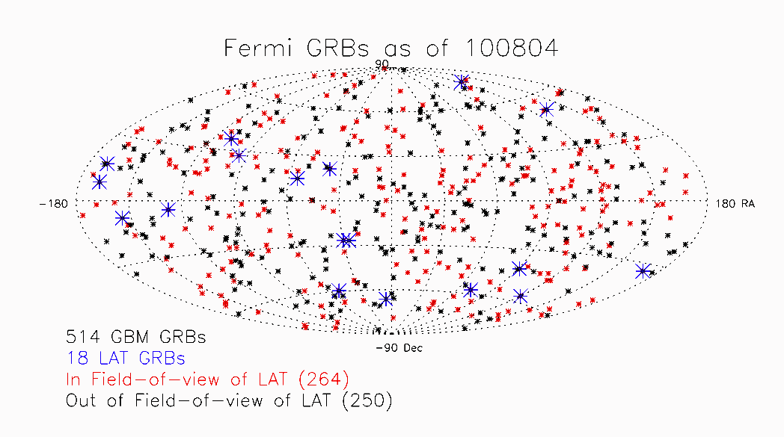
GBM GRB Localizations

Slide 8
GBM GRB Localizations
Localizations are produced in three ways, with increasing accuracy but greater delays.
The location accuracies have been determined by comparing to locations of high accuracy from other instruments using a Bayesian method.
PRELIMINARY
Type | Delay | σ core (degrees) | Core fraction | σ tail (degrees)
Flight SW | from seconds | 9.2
Ground Auto | tens seconds | 3.2 | 0.7 | 9.5
Human guided | many min | 2.8 | 0.7 | 8.4

Slide 9
GBM GRB Localizations − II
All LAT GRBs that have been followed up within a reasonable delay have resulted in X-ray and optical detections and redshifts.
Of the 18 LAT GRBs, only one was observed with the Swift BAT (talk by M. De Pasquale). While GBM has larger location errors, it has the advantage of being co-pointed with the LAT.
Quicker follow-up observations have potential high payoffs: additional GRBs afterglows, and early afterglow and prompt optical emission.
We continue to work to improve the GBM localization speed and accuracy. Soon human-guided localizations will be provided as Notices. We plan to provide rapid predictions of likely LAT detections, based on the results of E. Bissaldi (talk).

Slide 10
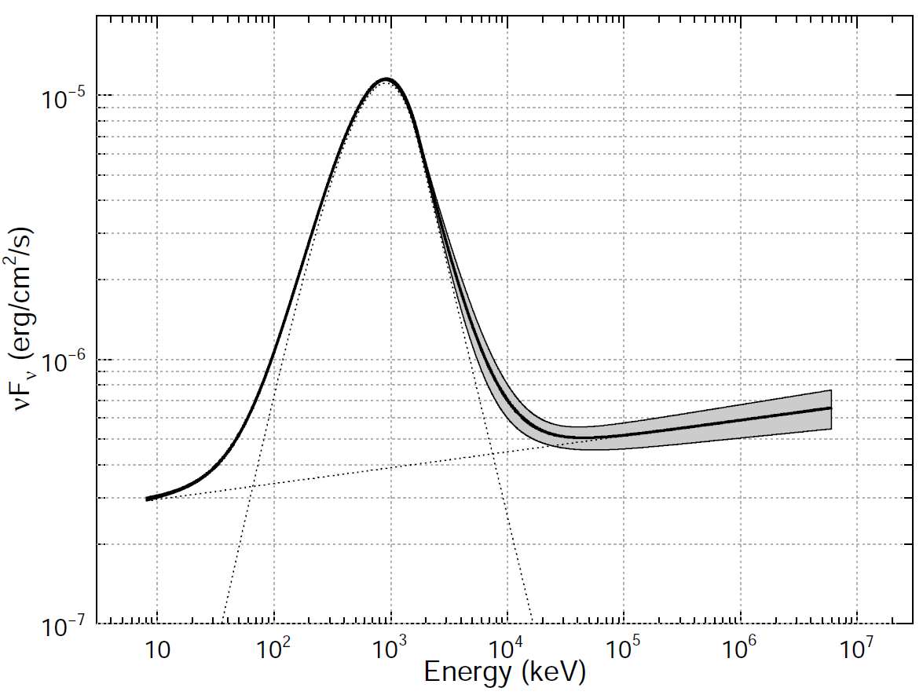
GRB 090902B
Detected in the LAT (more in the next talk by V. Pelassa), including a 33 GeV photon.
Two spectral components – a power law
dominates the Band component at both low (<50 keV) and high (>100 MeV) energies.
The extra-component is significant with just the GBM data!
Abdo et al., ApJL, 706, L138 (2009).

Slide 11
090902B: Most of the observations are based upon the location from the LAT and start from 12.5 hours.
ROTSE-IIIa observed the afterglow at 80 minutes based upon the GBM location. The delay was due to the need to tile and the observation of an unrelated object. Pandey et al., ApJ, 714, 799 (2010)

Slide 12
GRB Spectral Analyses
GBM has a very broad energy range – 8 keV to 40 MeV – extending both lower and higher than BATSE. This spectral information is available at full temporal resolution: the Time-Tagged Event (TTE) datatype provides individual count data. This combination is making new results possible in temporal analysis, time-resolved spectroscopy of short GRBs and in the identification of spectral components.

Slide 13
GRB 090510
EpeaK: from 0 to 12 MeV
Rate over
8 to 200 keV
Rate over
1 to 38 MeV
0.5 s
0.85 s
Guiriec et al., arXiv:1009.5045 / ApJ, in press

Slide 14
The latest GBM spectral results
Simultaneous observations of non-thermal and thermal components in GRB 100724B – talk by Sylvain Guirec.
Fits of GRB 090820A using synchrotron models – late-breaking talk by Michael Burgess.
Spectral lags of short GRBs – S. Foley poster – possible diagnostic for additional components.
pulse fits of long and short GRBs – N. Bhat poster.
Analysis of the very long GRB 091024 – David Gruber.

Slide 15
Conclusions
GBM features:
Very wide Field of View.
Broad spectral coverage at high temporal resolution.
Rapid locations.
GBM services:
Synergy with the LAT for spectra over more than 6 decades of energy (8 keV to 33 GeV).
Providing Autonomous Repoint Requests for bright GRBs to improve LAT observations of GRBs.
Providing parameters of the prompt spectra for correlating with other GRB properties, including Swift and ground-based afterglow observations.
Prompt locations of Fermi GRBs.

