Slide 1
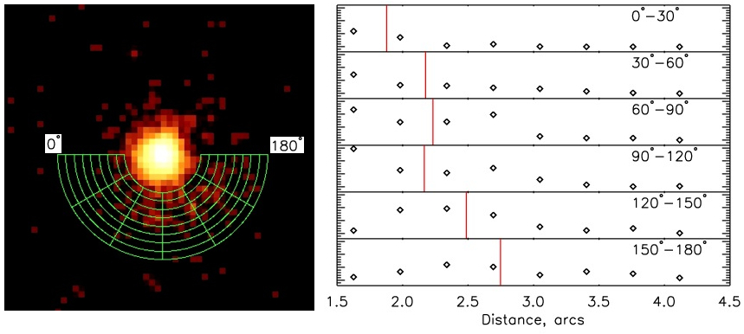
The Cosmic Snail
Jeremy Hare (GWU), Oleg Kargaltsev (GWU), Martin Durant (University of Toronto), George Pavlov (Penn State)
The George Washington University
Abstract
B1259-63 is a binary star system in which a pulsar (neutron star) orbits a massive companion star. Both stars emit energetic winds powered by the rotational kinetic energy of the stars. As these winds collide and interact with each other, the pulsar’s wind is separated from its companion’s wind by an intra-binary shock. This shock causes the pulsar’s wind to form a tail that winds around the high mass star. The wide, highly eccentric orbit of this rare binary allows us to study the interaction between the highly relativistic pulsar wind and much slower and heavier companion wind as a function of separation between the two stars. This provides a way to probe the properties of the winds such as composition and magnetization and learn about the physics of relativistic shock waves. We have obtained X-ray images and spectra of the binary system with the help of Chandra X- Ray Observatory (CXO) – one of the NASA’s flagship space missions. In the current study we focus on modeling the spatial structure of the interacting winds and comparing it to the actual CXO images. Our modeling suggests that the pulsar’s tail shape can be satisfactory describe by a ballistic flow model with the flow speed of 2% of the speed of light. Unlike earlier theoretical models whose results lacked comparison with any imaging data we find that the spiral structure of the flow is not destroyed by the Coriolis force and little mixing between the two winds occurs out to the distance of 5,000 AU (much larger than the size of the orbit – 70 AU). The change in the morphology of the extended X-ray emission seen between the two CXO observations suggests the magnetic field of ~2 mG (in the pulsar wind).Thus, the current analysis of CXO images provides a realistic model for interacting winds in thebinary systems of this type. It also advances our further understanding of pulsar winds, Be starwinds, and shock physics. The study we have undertaken is unprecedented, it can only be forB1259-63 with CXO, and it is the first time when the colliding shock structure in a binary has been resolved in X-rays.
Introduction
B1259 is a binary star system in which a pulsar (neutron star) orbits a massive companion star. Each of these stars have their own energetic wind which is powered by the rotational energies of the stars. When these winds collide they interact and form an intra-binary shock. This shock gives rise to a spiral structure due to the orbital motion of the pulsar around the massive companion (O-type star that weighs about 30 solar masses).
One of the reasons this binary is so interesting is due to the fact that its orbit is highly eccentric. This rare binary allows us to study the interaction between the highly relativistic pulsar wind and slow and heavier companion wind as a function of the separation of the stars. This binary has allowed us the rare opportunity to study the properties of these winds such as the composition, magnetization, flow speed and ascending node angle.
The outstanding resolution of Chandra has made possible detailed studies of pulsar wind nebulae (PWNe), the most fascinating manifestations of pulsar activity. PWNe are formed by the relativistic pulsar wind (PW), which shocks in the ambient medium and emits synchrotron radiation (e.g., Gaensler & Slane 2006; Kargaltsev & Pavlov 2008). The PWN morphology depends on the Mach number, M =v=cs, where v is the pulsar's velocity relative to the ambient medium, and cs is the speed of sound. In particular, when a pulsar moves in the ISM with a supersonic speed, a bow shock is formed ahead of the pulsar, accompanied by a long tail behind the pulsar (Gaensler et al. 2004; Kargaltsev et al. 2008; De Luca et al. 2013).
An interesting modificcation of bow-shock PWNe is expected when the radio pulsar is in a wide high mass binary system. In such a system, the PWN is produced by the collision of the relativistic PW with the dense nonrelativistic wind of the companion (instead of the ISM for a soli-tary pulsar). The properties of such a PWN depend on the wind parameters, such as the ratio of their momentum fluxes, the velocities vw and vp of the companion's wind and the pulsar's binary motion, the temperature and density of the companion's wind, the anisotropy of the out flows, and the separation between the pulsar and the companion (Tavani & Arons 1997 [TA97]). As these parameters vary along the orbit, the PWN's luminosity, spectrum, shape, size, and orientation, should also vary. If such a PWN can be resolved, observations of the varying PWN morphology would be partcularly useful for a definitive study of the wind properties, especially in the case of an eccentric orbit, because it allows one to probe the interaction and shock physics at varying ambient pressure.
Figure 5: Schematic view of the PSR B1259 around the massive O star. The positions of the two existing observations are shown by filled black circles (θ = 182° for ObsID 10089 and θ = 169° for obsID 14205). The observation planned in May 2013 is shown by the grey circle. The numbered empty circles show five proposed observations. The orbital motion is clockwise. Colored sectors show the parts of the orbit when the pulsar is expected to be passing through the equatorial wind of the companion star.
Chandra Observations
Chandra X-ray Observatory observed B1259-63 in two occasions . These were the only imaging Chandra observations of B1259-63 . The data were taken with the ACIS instrument and the exposure times were 28ks and 62ks respectively. The dates of the observations corresponded to 657 days after the periastron passage and 368 days after the periastron passage , respectively. The right panel in Figure 1 shows a tail like structure, “The Snail”, coming from the binary system. This cannot be seen in the left panel due to the low number of counts in the extended emission. Such a pulsar wind nebulae has never been previously seen before.
Methods
For our study we have used X-ray images and spectra of the binary system using the Chandra X-Ray Observatory (CXO). In our study we have focused on modeling the spatial structure of the interacting winds and comparing it to the actual CXO images. To model this we used the equation:
Where R and θ are the radius and the azimuthal angle of a point on the tail’s central line in the reference frame centered at the Be companion, R_{p} and θ_{p} are the radial coordinate and true anomaly of the pulsar, and V_{flow}(θ’) is the flow speed that may vary along the tail.
Figure 2: Model of the pulsar orbiting the companion star. In this image you can see the long tail beginning to create the spiral seen in Figure 4. This spiral is described by the equation given above with a flow velocity of 0.015c. It is also important to note that this image is oriented the way the real star system appears to be oriented in the sky.
Results and Summary
Our model suggests that the pulsars tail shape can be described by a ballistic flow model with a flow speed of approximately 1.5% of the speed of light. By comparing our model to the real images we can see that there is little mixing between the winds and ranges out to a distance of 5,000 AU ( much larger than the size of the orbit which is 70 AU). Our model also suggests a magnetic field of about 2 mG in the pulsar wind. We were also able to calculate a more accurate ascending node from our model, we found this angle to be 75°.
Thus, the current analysis of CXO images provides a realistic model for interacting winds in thebinary systems of this type. It also advances our further understanding of pulsar winds, the massive winds and relativistic shock physics.
Future Research
We have proposed to study this binary at multiple spots in its orbit, once again using CXO. With this new data we will be able to answer some important open questions such as:
What is the cause of the detected large change in the Snail’s luminosity?
What is the flow speed and the magnetic field in the Snail? Does the flow behave as expected from our numerical models?
How many hidden spiral turns are hidden in the unresolved central part of the nebula?
Figure 1: ACIS image of the target binary from two previous observations in the 0.5-1.6 keV band (where the Chandra mirror array provides the sharpest PSF). Each pixel is 0.25” x 0.25”, with no smoothing applied. The black cross shows the peak of the surface brightness profile (determined by centroiding within r = 0.6” circular apperature). Adapted from Durant et al. (2013).
Figure 3: Radial surface brightness profiles of the extended X-ray emission. The profiles are calculated for six sectors spanning different ranges in the azimuthal angle, counterclockwise from the direction toward east. The vertical red lines in the right panel show the center of gravity of the surface brightness distribution for each of the radial profiles. The distance in the right panel is given in arc seconds from the peak of the point source surface brightness distribution. The vertical axes are in arbitrary units but the range is the same for each of the six profiles.
References
Figure 4: Ballistic outflow model shown on top of the two Chandra images (in 0.5-0.8 keV) with counts set to zero in the central r = 1.2” circle. The color bar shows the time, in years, passed since the tail was launched from the pulsar. The colored tail corresponds to 6.13 yr (a cooling time estimate). The tail flow speed is assumed to be v = 0.015c (where c is the speed of light) and the longitude of ascending node Ω = 75°. The insets show a zoomed –in binary orbit with the starting parts of the tail: for ObsID14205 the starting point corresponds to 1004d (-233 d) after periastron, for ObsID 10089 the pulsar is 290 days later in the orbit (57 d after periastron). Note that the nearly-circular (red-colored) end part of the tail in ObsID 14205 panel was ejected when the pulsar was passing through the disk and periastron. It is beyond the 6.13 yr cut-off time (dashed blue-colored line) at the time of the ObsID 10089 observation.
Chernyakova, M., et al. 2006, MNRAS, 387, 1201 (C06)
Chernyakova, M., et al. 2009, MNRAS, 397, 2123
Durant M., et al 2013, to be submitted to Nature
Pavlov, G.G., Chang, C., & Kargaltsev, O. 2011, ApJ, 730, 2

