Slide 1
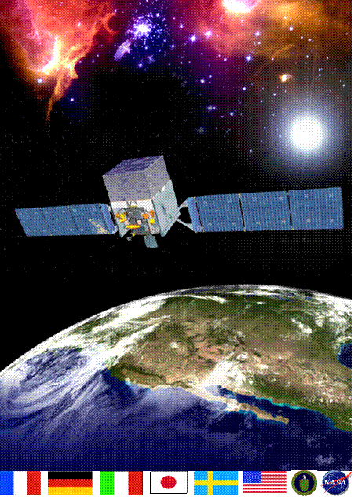
The Fermi Gamma-ray Space Telescope: Spacecraft, operations and mission
Julie McEnery
NASA/GSFC

Slide 2
Gamma-ray Astrophysics
Radio
Microwave
IR
visible
UV
X-ray
Gamma-ray
GBM
LAT
Gamma-rays cover a huge swath of the electromagnetic spectrum
The gamma-ray sky is still very new
High-Energy gamma-rays probe the non-thermal universe
  Explore extreme environments hosting powerful particle accelerators
Notes:
Successor to a great observatory

Slide 3
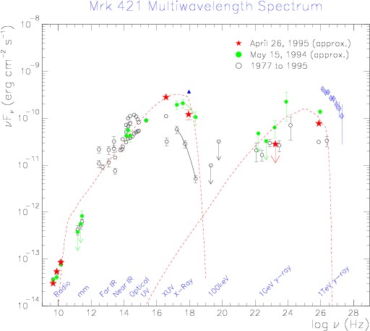
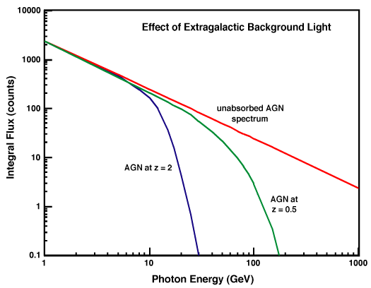
Why High Energy Gamma-Rays?
High energy gamma-rays explore nature’s accelerators - “Where the energetic things are”
  natural connections to UHE cosmic-ray and neutrino astrophysics
High energy photons often produced in a different physical process to the lower energy emission -> Independent handle on the physical conditions.
High energy gamma-rays can be attenuated by pair-production with lower energy photons
Probe conditions in emission regions (gammas need to get out)
Explore the optical/UV diffuse background

Slide 4
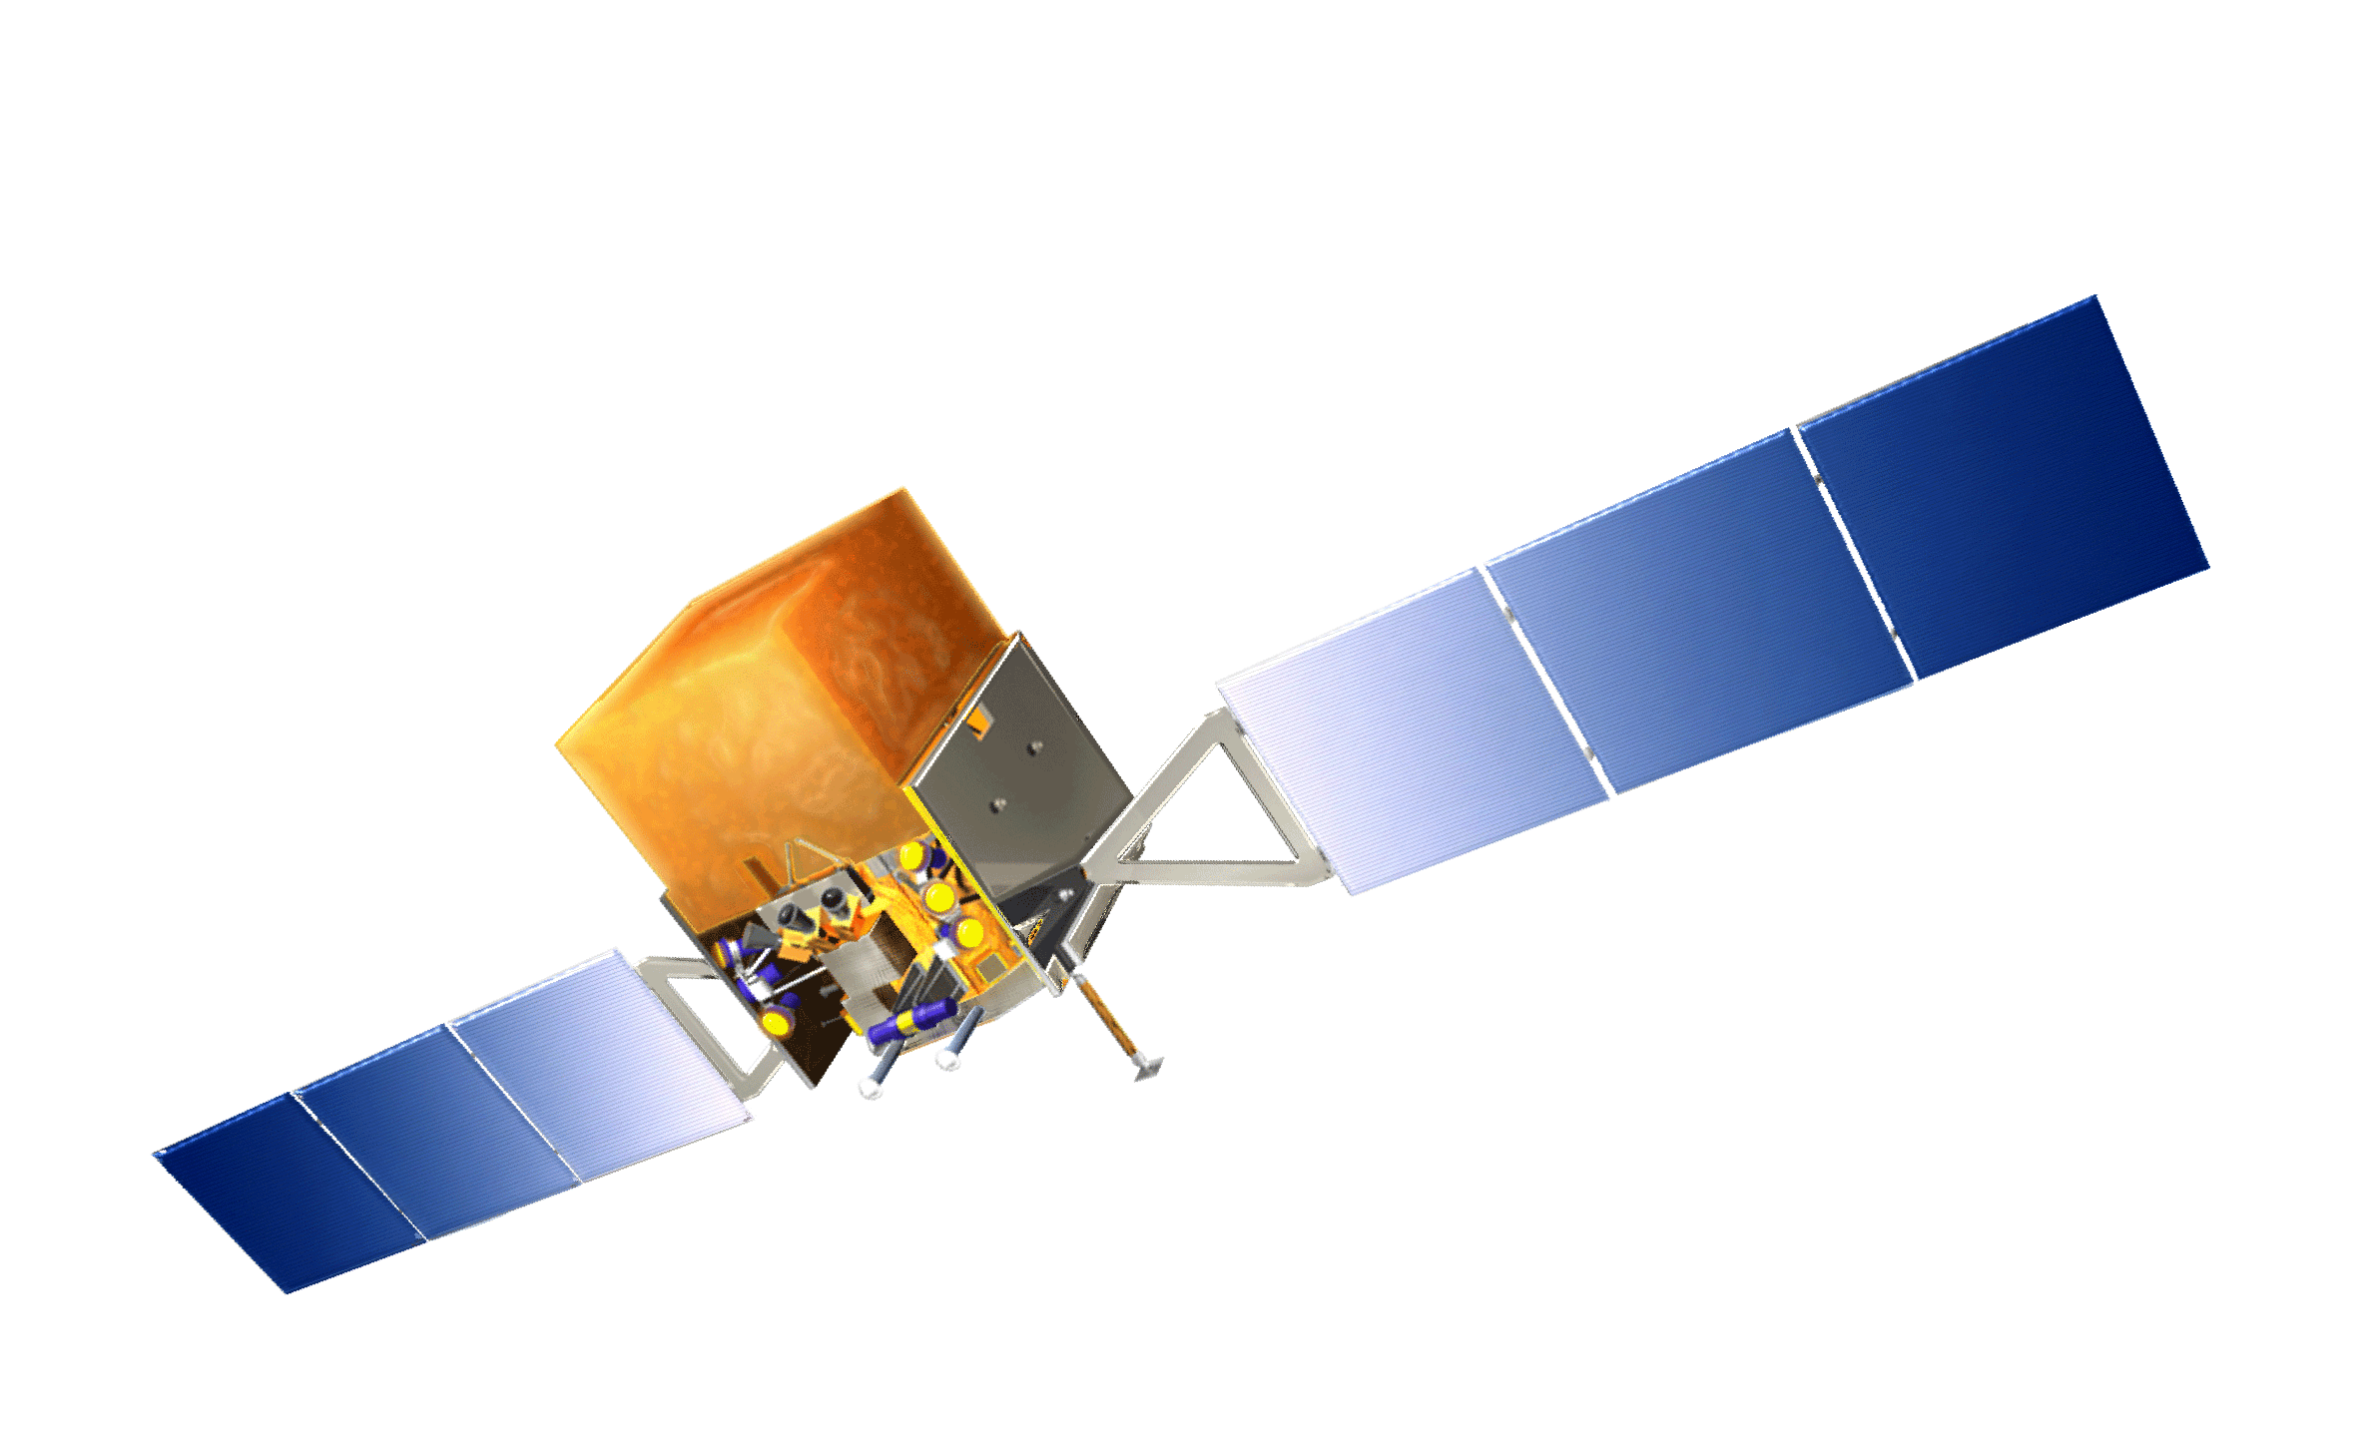
The Fermi Observatory
Large Area Telescope (LAT)
Observes 20% of the sky at any instant, views entire sky every 3 hrs
20 MeV - 300 GeV - includes unexplored region between 10 - 100 GeV
Gamma-ray Burst Monitor (GBM)
Observes entire unocculted sky
Detects transients from 8 keV - 40 MeV
Huge improvement over previous missions in this waveband
  Increased effective area
  Improved angular resolution
  Broader energy range
  Wide field of view

Slide 5
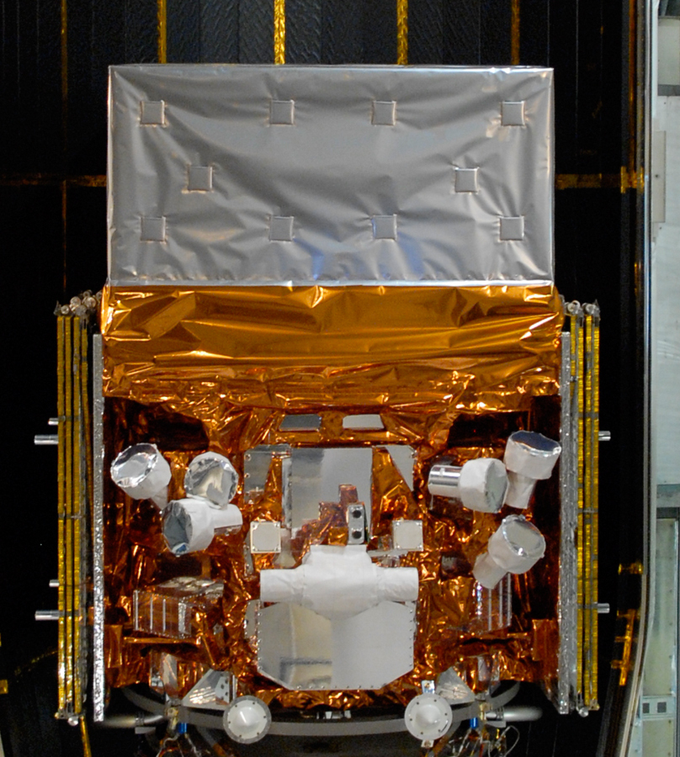
Fermi Observatory
Large Area Telescope (LAT):
20 MeV - >300 GeV
2.4 sr FoV (scans entire sky every ~3hrs)
Gamma-ray Burst Monitor (GBM)
8 keV - 40 MeV
views entire unocculted sky
Launched on June 11, 2008

Slide 6
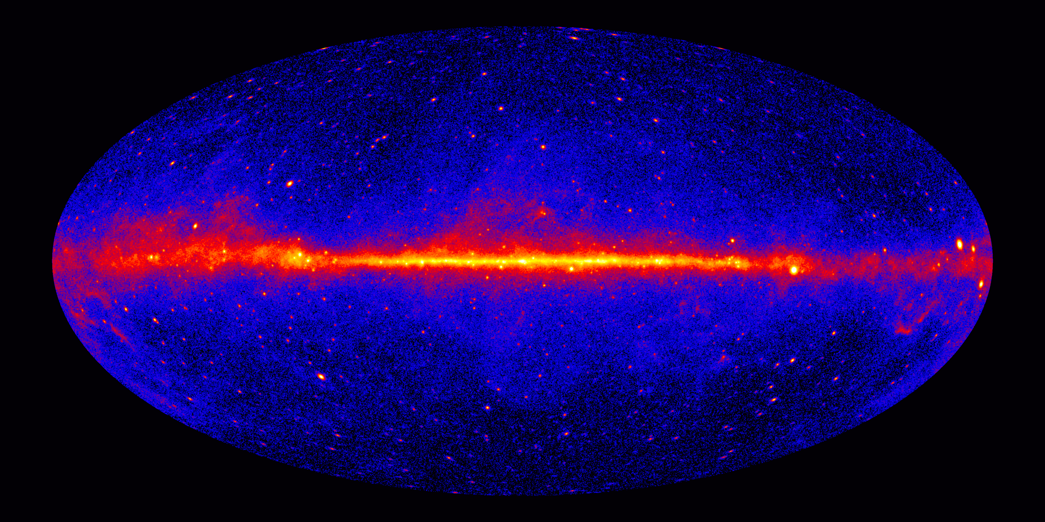
The >1 GeV Sky

Slide 7
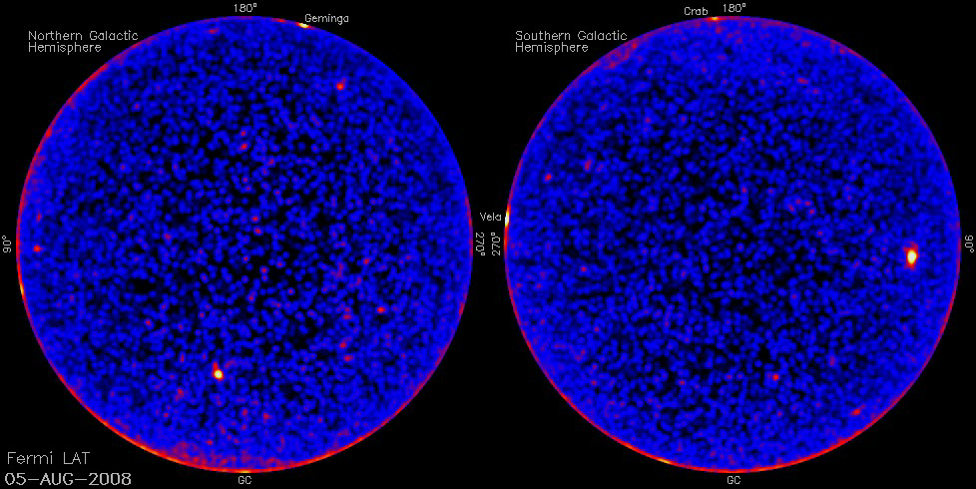
The Variable Gamma-ray Sky

Slide 8
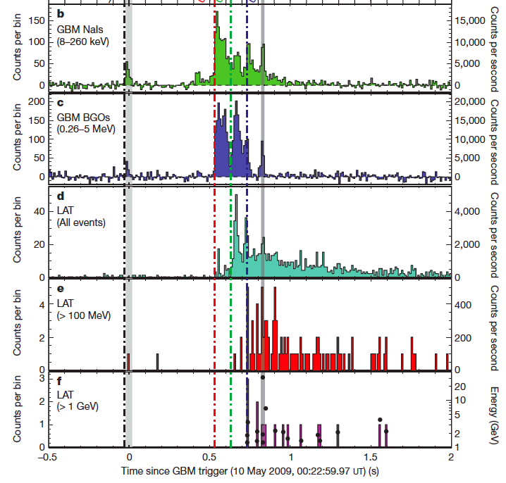
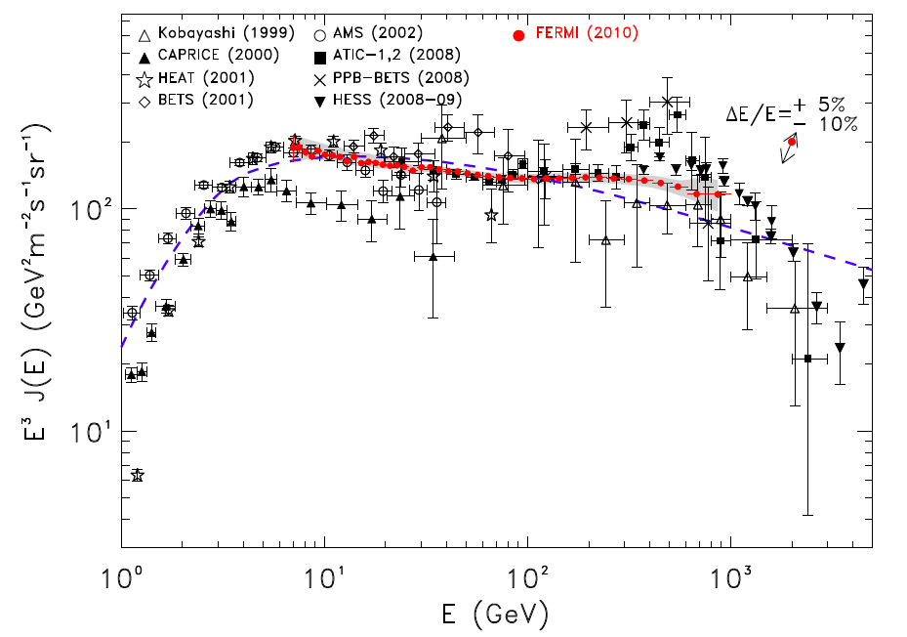
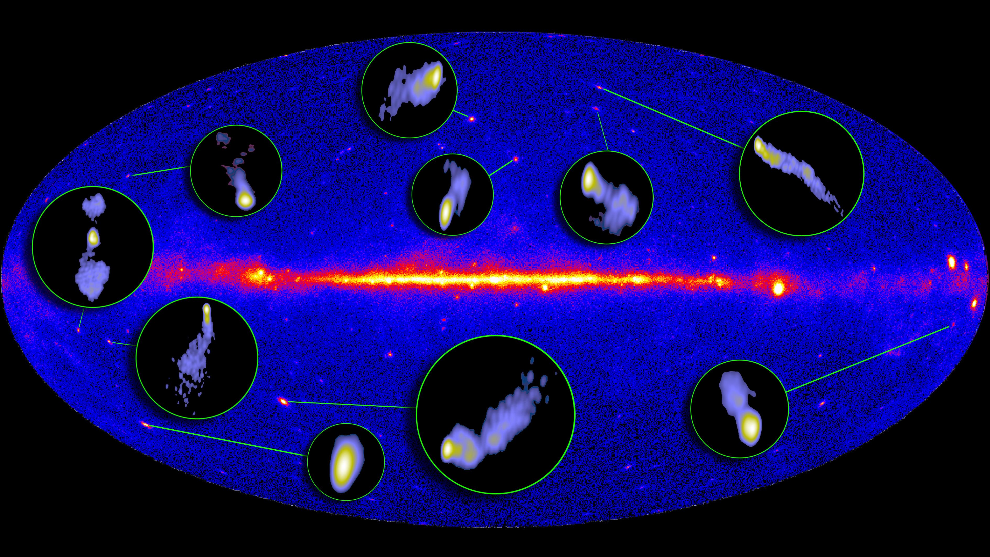
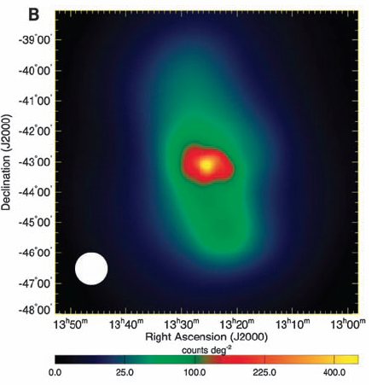
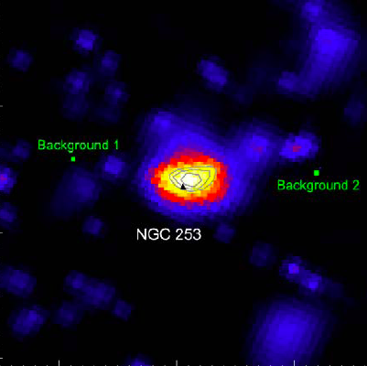
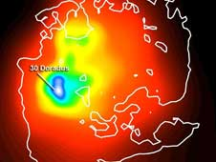
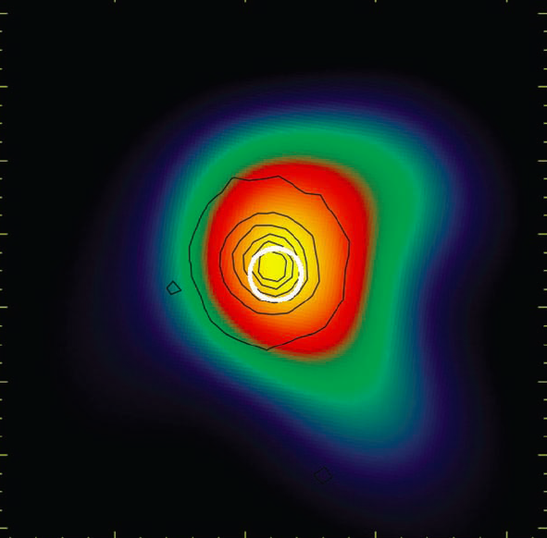
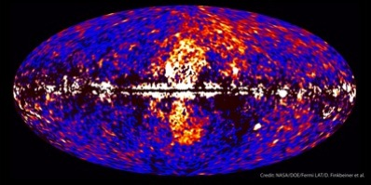
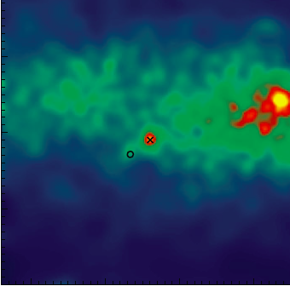
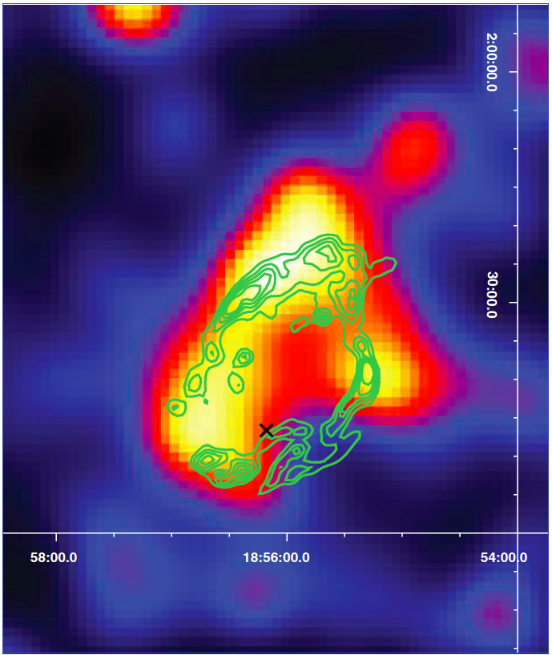
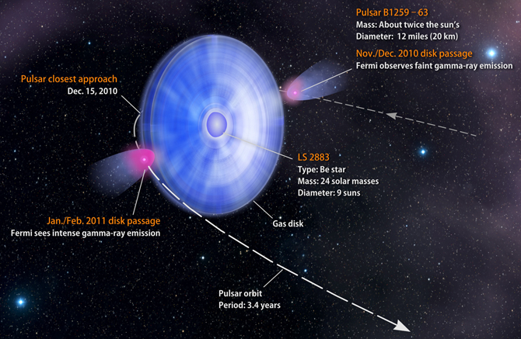
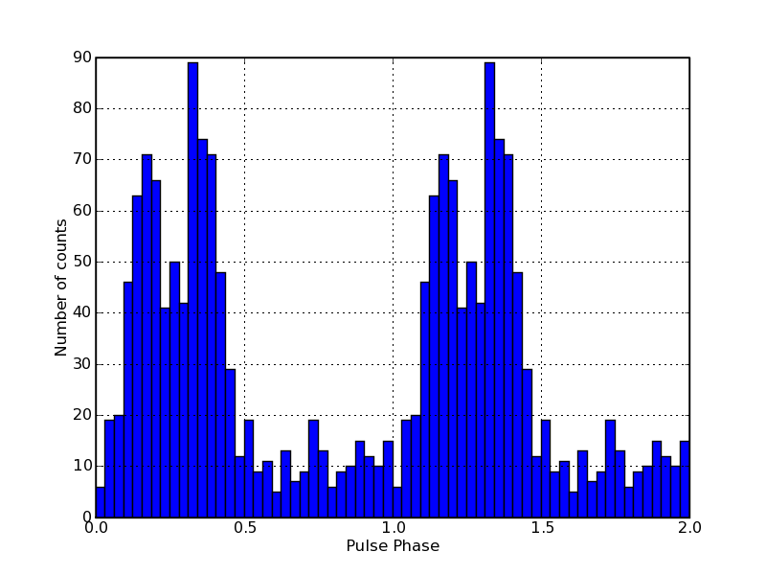
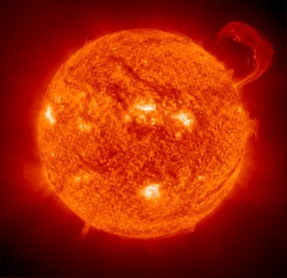
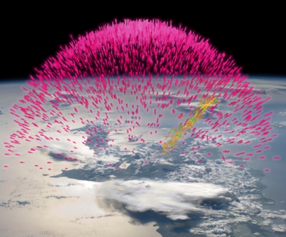
Fermi Highlights and Discoveries
GRBs
e⁺e⁻ spectrum
Blazars
Radio Galaxies
Extragalactic
Starburst Galaxies
LMC & SMC
Globular Clusters
Fermi Bubbles
Nova
SNRs & PWN
Galactic
γ-ray Binaries
Pulsars: isolated, binaries, & MSPs
Sun: flares & CR interactions
Terrestrial γ-ray Flashes
Unidentified Sources (577/1873)
Notes:
Pulsars – more subclasses of a known class

Slide 9
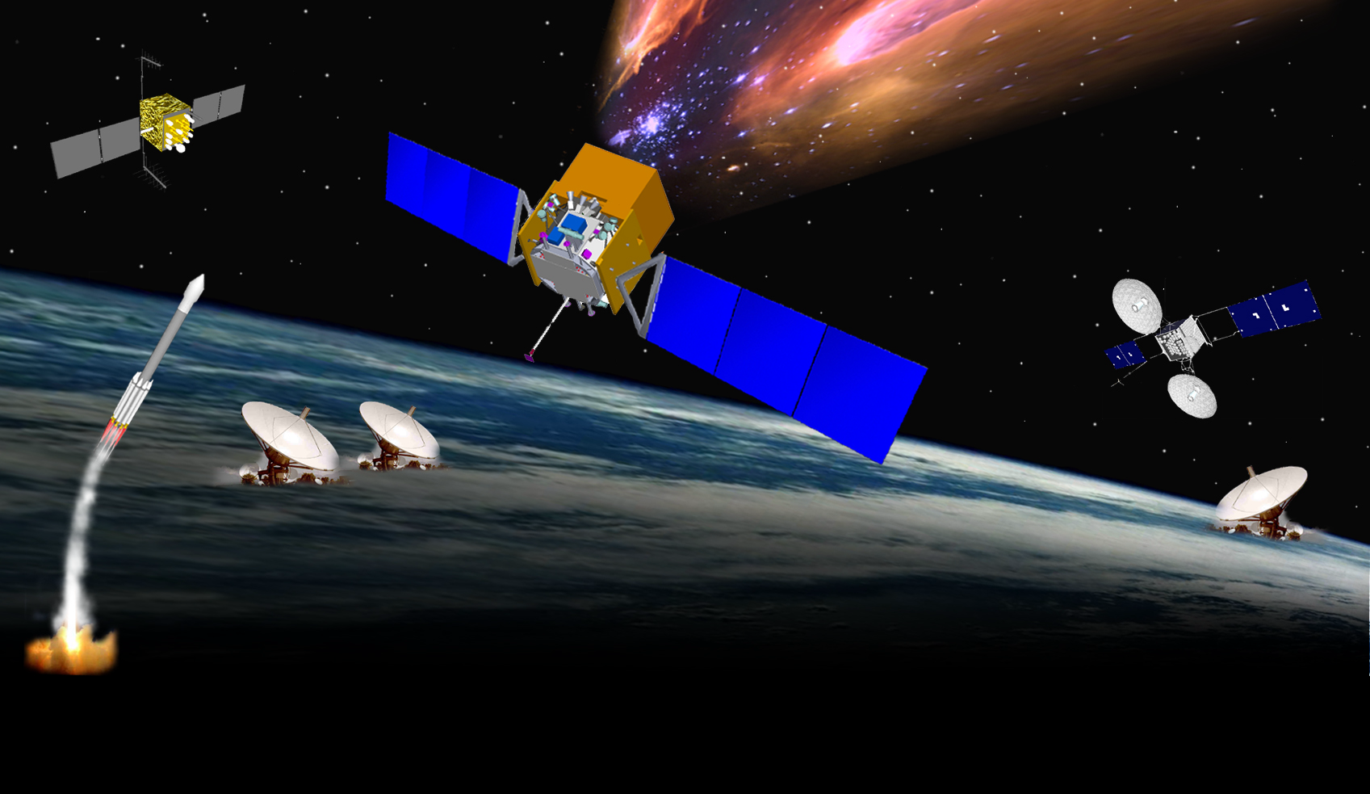
Fermi MISSION ELEMENTS
GLAST MISSION ELEMENTS
GPS
•
μ
sec
Large Area Telescope
& GBM
•
Fermi Spacecraft
•
Telemetry 1 kbps
-
•
TDRSS SN
S & Ku
DELTA
7920H
•
•
-
S
-
•
GN
•
LAT Instrument Science Operations Center (SLAC)
White Sands
Schedules
Mission Operations
Center (GSFC)
Fermi Science
Support Center (FSSC)
HEASARC
GSFC
GRB
Coordinates Network (GSFC)
Schedules
GBM Instrument
Operations Center (MSFC)
Alerts
Data, Command Loads

Slide 10
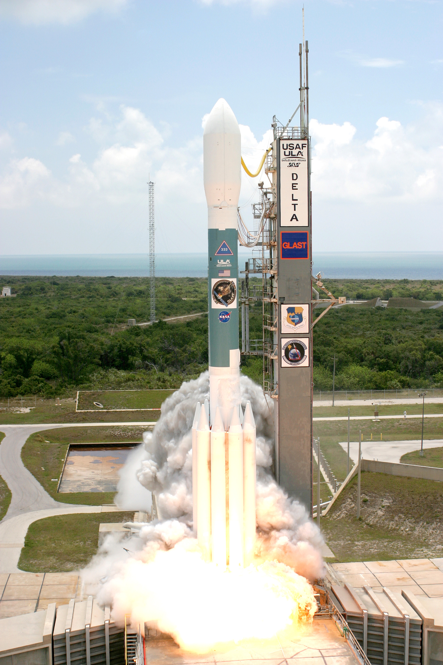
Launch!
Launch from Cape Canaveral Air Station 11 June 2008 at 12:05PM EDT
Circular orbit, 565 km altitude (96 min period), 25.6 deg inclination.
Communications:
  Science data link via TDRSS Ku-band (40 Mbps, 8-10, 10 min contacts per day)
  S-band via TDRSS (8kbps) or ground stations (1.26 Mbps)

Slide 11
Raw Data
Data consists of
  1.5 Mbps LAT data
  0.5 Mbps GBM data
  51 kbps housekeeping data (from SC, LAT and GBM)
The onboard solid state recorder (SSR) has two partitions, read out in parallel
  Science (LAT+GBM data)
  Housekeeping
    Often arrives before science data due to smaller volume

Slide 12
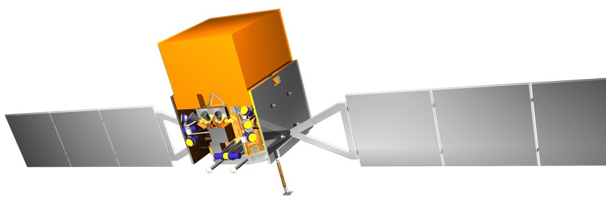
Data Latency
GBM DATA PATH
T 0
T 1
T 2
T 3
T 4
T 5
T 8
T 9
T 12
Mission Operation Center
GBM Instrument Operations Center
Fermi Science Support Center
Fermi
White Sands Complex
GSFC
MSFC/NSSTC
GSFC
180m
+ 12m
+ 70m
+ 120m
+ 4m
+ 20m
+ 8m
+ 60m
= 474m
= 7h54m
LAT DATA PATH
T 0
T 1
T 2
T 3
T 4
T 7
T 10
T 11
T 14
Mission Operation Center
LAT Instrument Science Operations Center
Fermi Science Support Center
Fermi
White Sands Complex
GSFC
SLAC
GSFC
180m
+ 12m
+ 70m
+ 120m
+ 26m
+ 60m
+ 26m
+ 60m
= 554m
= 9h14m
Data sit on SSR
4.3Mbps, unlikely (at the moment) to do much better than this.
Level 0 processing conservative estimate.
sometimes achieve higher bandwidth.
Nominal case, assuming no manual intervention or new calibrations.
Data ingest, conservative estimate

Slide 13
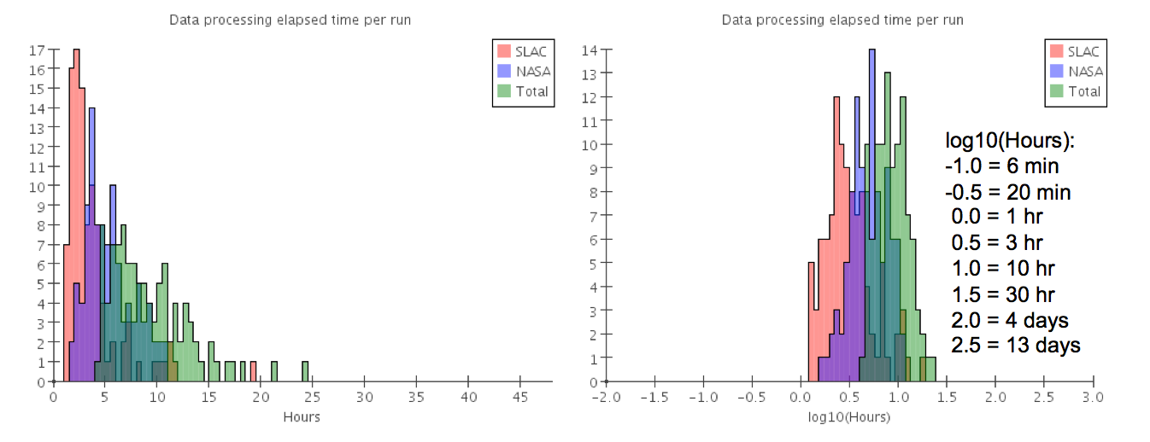
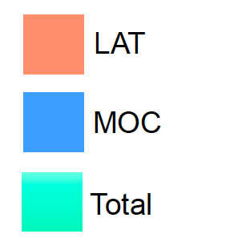
Data Latency
LAT - requirement: <72 hours from detection of gamma-ray photon to availability in public archive
  Typical latency is ~8 hours
  Everyone gets access to the data at the same time.
GBM Data is delivered to FSSC within 24 hours for routine data taking.
  GRB, Solar flares, TGFs - times, fluxes, location delivered in near real time.

Slide 14
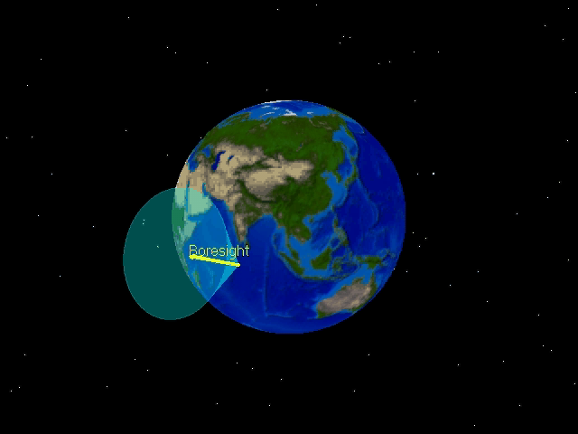
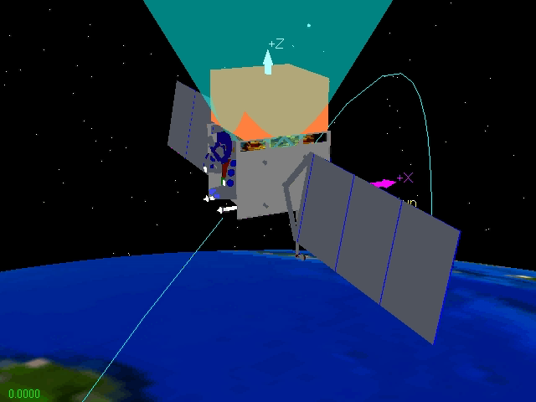
Survey mode
Rock north for one orbit and south for the next
Cover entire sky and always keep LAT FoV away from the Earth limb
Rotate about Z-axis to keep sun off the LAT radiators (on +-Y faces

Slide 15
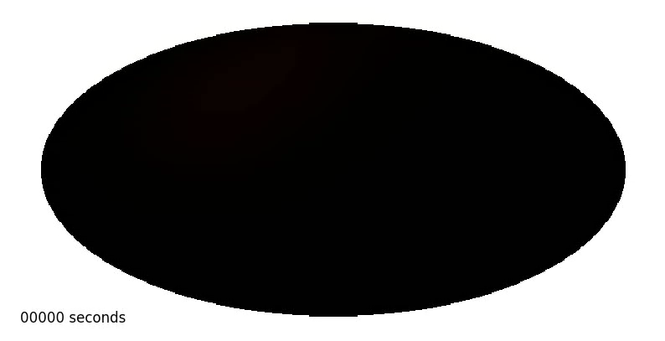
All Sky Coverage
LAT exposure over two orbits
In survey mode, the LAT observes the entire sky every two orbits (~3 hours).
Multiwavelength observations in coordination with the LAT are limited only by the ability to coordinate to other observations in other wavebands.
Can also perform pointed observations of particularly interesting regions of the sky.
  Requirement to be able to slew 75 deg in less than 10 mins (to catch GRB)

Slide 16
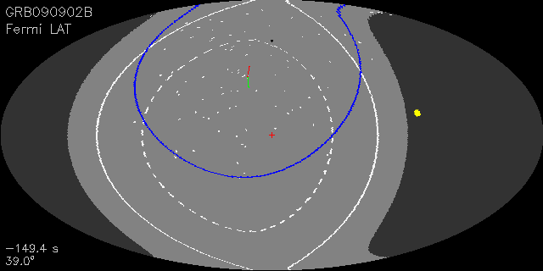
GRB090902B - Autonomous repoint
LAT pointing in celestial coordinates from -120 s to 2000 s
  Dark region = occulted by Earth (z>113°)‏
  Blue line = LAT FoV (±66°)‏, White points = LAT events

Slide 17
Observation modes
Normal Survey mode (default)
  1 orbit rock north, 1 orbit rock south, repeat
  Covers entire sky every two orbits (~3 hours)
  Efficient observing, LAT boresight stays away from the Earth.
Modified survey (improve exposure up to 2x)
  N orbits rock north, M orbits rock south, repeat
  Covers entire sky every N+M orbits
  Efficient observing mode
Target of Opportunity (improve exposure up to 4x)
  Allows rapid initiation of pointed mode observations
  Boresight traces earth limb while target is occulted.
  Least efficient observing mode (Significant occultation of LAT FoV by Earth)
Pointed mode (improve exposure up to 4x)
  Planned pointed mode observation
  Perform small segment of sky survey while target is occulted.
  Somewhat inefficient observing mode (some occultation)

Slide 18
Observations summary
Almost exclusively in nominal data taking in survey mode
  50 deg rocking angle from May 27 2009 onwards
ARRs (~2/month)
  2.5 hours duration (5 hour before Nov 2010)
Target of Opportunity/pointed mode observations
  Crab nebula, Sun, flaring blazars, galactic center
Modified survey mode observation
  PSR B1259 periastron, sun
LAT Calibrations
  ~<12 hours/year
For past and planned future observations see:
  http://fermi.gsfc.nasa.gov/ssc/observations/timeline/posting/

Slide 19
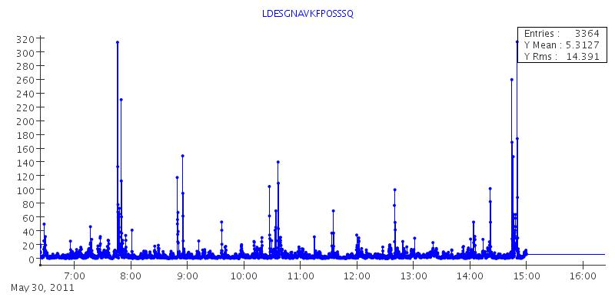
How do we know where we are?
GPS
  Propagate orbit model, refine orbit solution using GPS location data, data lying close to predicted location given higher weight (Kalman filter)
    Filtered solution robust against outliers or GPS outages
    Filtered solution more accurate than any individual GPS meas.
  Orbit location (from filter) reported at 1 Hz

Slide 20
Where are we pointing
3 star trackers (2 active, 1 spare)
  Acquires, tracks and identifies up to 6 bright stars in its FoV
Also have set of 4 gyroscopes that measure angular rates of the spacecraft
  Used to propagate attitude solution during star tracker outages (and between updates)
Propagated solution from the gyros is corrected by attitude measurements from the star trackers (similar to orbit location)
  Solution is robust to outliers and outages in star tracker measurements
  Track the residuals between star tracker measurements and propagated solution (always tiny compared with LAT psf)
Attitude solution reported at 5 Hz
This defines the spacecraft attitude, NOT the LAT
  Before use, correct for offset between the spacecraft and the LAT

Slide 21
Spacecraft files (aka FT2 files)
These combine the orbit position and attitude information from the spacecraft.
  Entries spaced every 30 s
LAT_MODE – describes spacecraft observation mode
  3: pointed mode
  4: Maneuver mode
  5: survey mode

Slide 22
Absolute timing and orbit location
GPS also provides an absolute timestamp
  Used to calibrate an onboard oscillator.
Absolute timestamps are accurate to <300 ns (verified in ground test, and on orbit).
Orbit position determination good to ~<20 m
Both of these are important when considering very short timescales
  Millisecond pulsars!

Slide 23
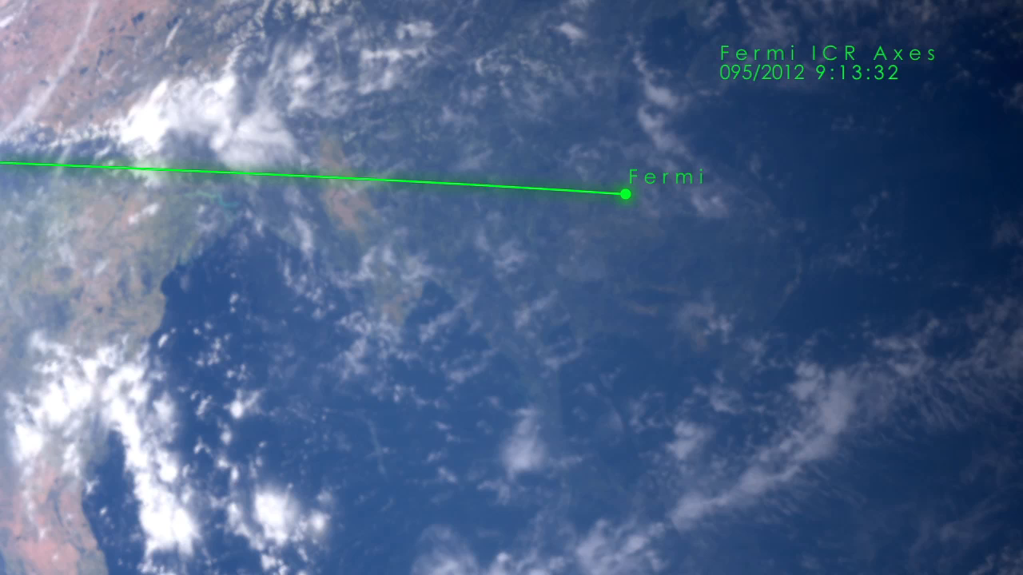
April 2012

Slide 24
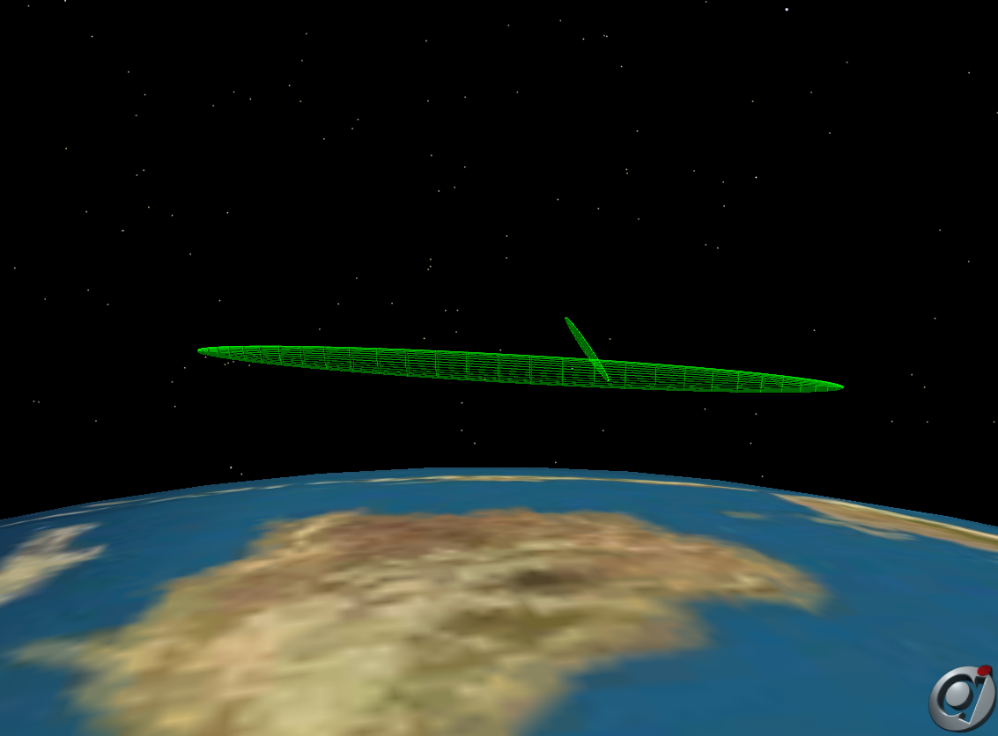
We moved out of the way

Slide 25
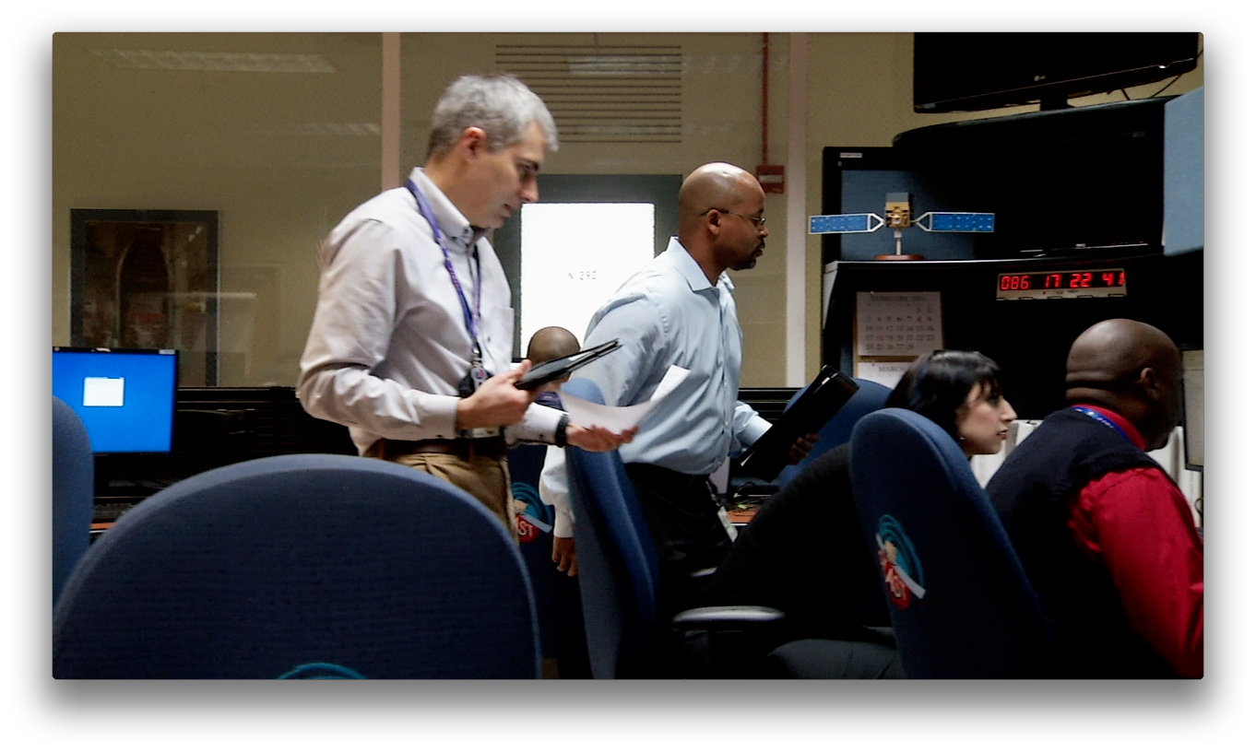
Flight Operations Team
7 people
  Responsible for operating the observatory and monitoring the health and performance of Fermi

Slide 26
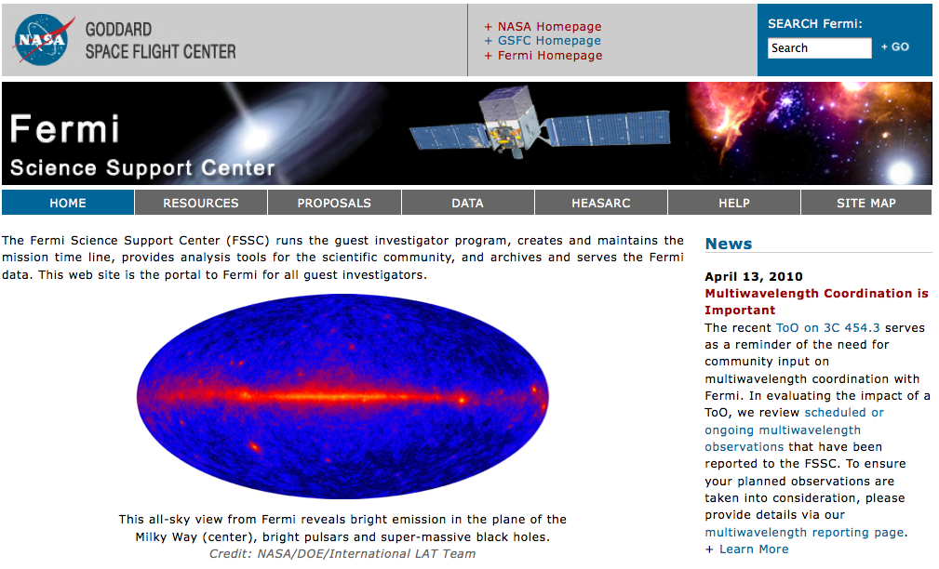
Fermi Science Support Center
Public data and extensive support for science Analysis Tools
http://fermi.gsfc.nasa.gov/ssc/
FSSC Supports Guest Investigator Analysis

Slide 27
Science Support Center Team
6 scientists and 4 programmers/support staff
  Planning/scheduling observations (including target of opportunity)
  Software development
  Data/software repository
  User support
    Documentation
    Help desk
    …

Slide 28
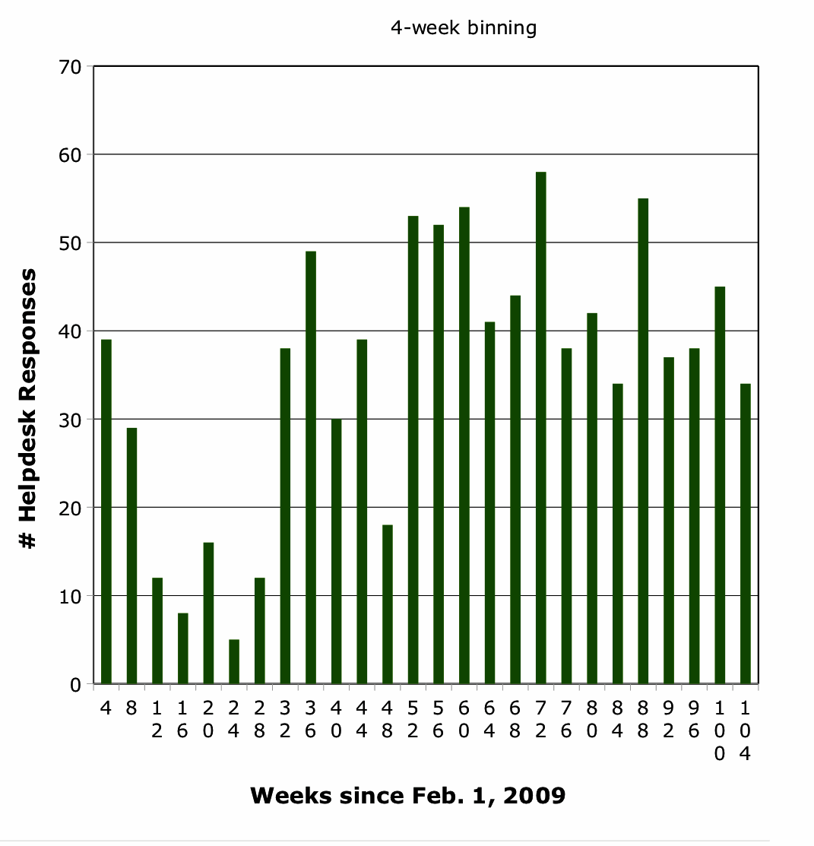
Queries to FSSC Helpdesk

Slide 29
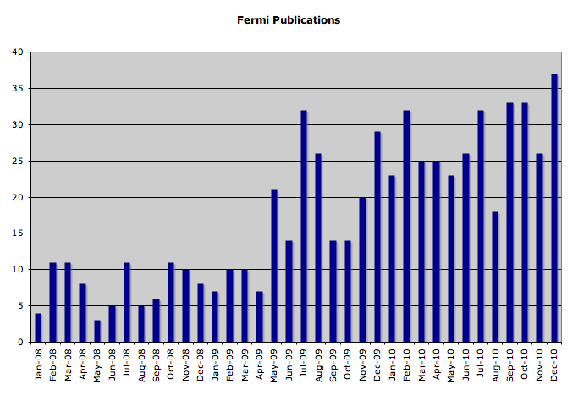
Published Refereed Papers
See: http://fermi.gsfc.nasa.gov/cgi-bin/bibliography_fermi for a full list of Fermi-related publications

Slide 30
Questions?

