Slide 1
GBM Data Analysis with OSPEX
Why OSPEX?
Extensibility – adaptable
New Instruments
New Models: BremThick, Albedo, Nuclear Templates, Pileup-Mod
Temporal Evolution
Integrates with other objects
FERMI Solar Workshop at GSFC, 22-23 August 2012 richard.schwartz@nasa.gov
Notes:
Use a consistent data model over a wide variety of instruments to solve the same fundamental problem: Find the best physical model of solar processes consistent with the data. And for solar analysis, temporal morphology is critical to scientific understanding. And, use tools that can integrate data, both spectra and image cubes, from multiple sources.

Slide 2
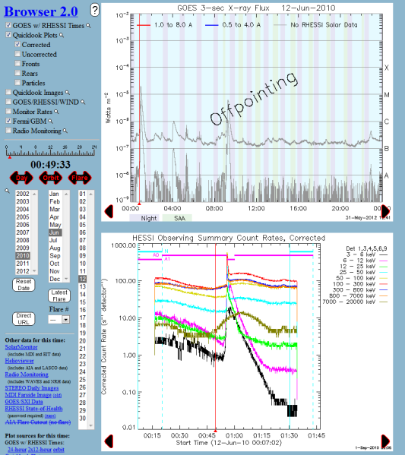
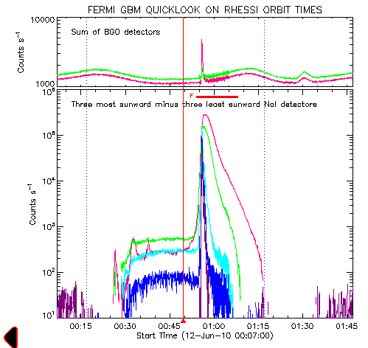
GBM Data Analysis with OSPEX
Flare Analysis – Identify and Determine Context
Browser Comes First
FERMI Solar Workshop at GSFC, 22-23 August 2012 richard.schwartz@nasa.gov
Notes:
Identify and preview: Browser, GOES, RHESSI (Albert’s talk)

Slide 3
Background Modeling by Energy Band
Lightcurves with Background Models
Higher order at higher energy
Notes:
First do the global background with a constant model and then higher energies tightening the window and increasing the polynomial order

Slide 4
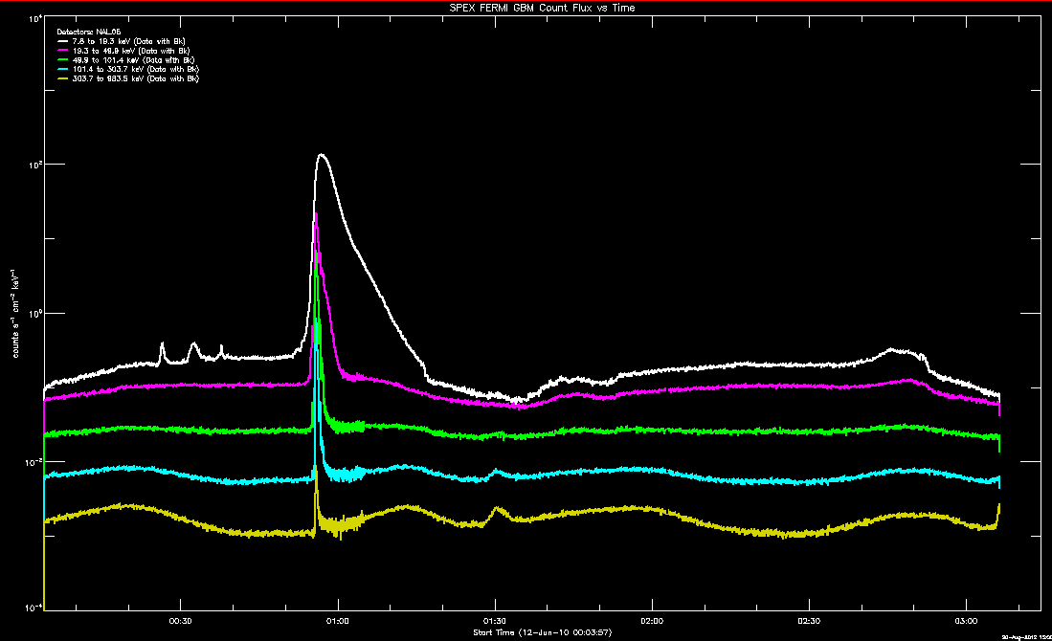
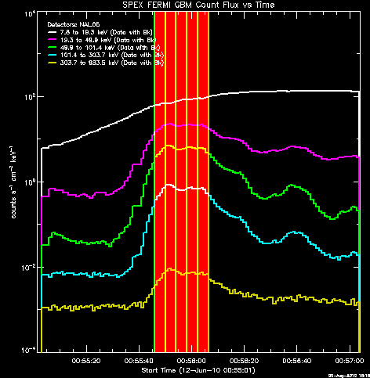
Interval Selection
FERMI Solar Workshop at GSFC, 22-23 August 2012 richard.schwartz@nasa.gov

Slide 5
Parametric Models – Your Choice
Physics – Thick-target Brem
Generic – Broken Powerlaw
FERMI Solar Workshop at GSFC, 22-23 August 2012 richard.schwartz@nasa.gov
Notes:
p

Slide 6
Finally, Physical Parameters vs Time

Slide 7
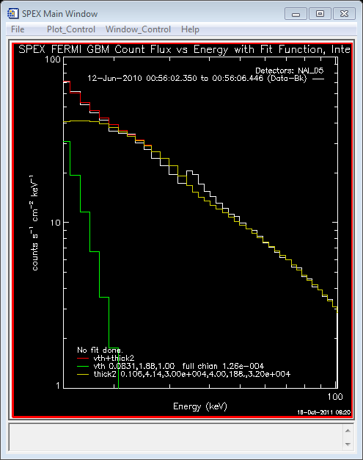
False Feature at 33 keV Results from GBM Response Matrix

Slide 8
GBM Data Analysis with OSPEX
What about Pileup? Look for inverted count rates – low energy goes down while high energy goes up.
Compare photon spectra vs detector angles
FERMI Solar Workshop at GSFC, 22-23 August 2012 richard.schwartz@nasa.gov

Slide 9
GBM Data Analysis with OSPEX Exercises
Extend the NaI analysis in time
Try NaI 2, 3, or 4
Find and analyze a flare on 7 June 2011
FERMI Solar Workshop at GSFC, 22-23 August 2012 richard.schwartz@nasa.gov

