Slide 1
Fermi GBM (and LAT) Solar Flare Science: 2010 June 12th flare
Michael S. Briggs
(UAHuntsville)
Notes:
Introduce myself. Huntsville from shortly after the launch of CGRO. GBM co-I from the proposal. FSW lead.

Slide 2
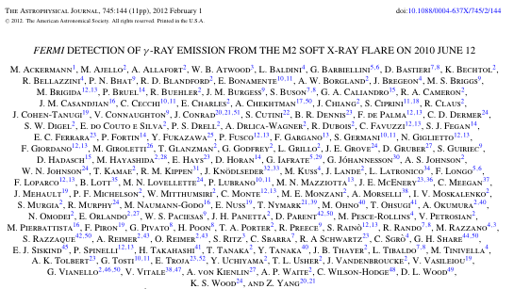
Fermi paper: Ackermann et al., ApJ, 745, 144, 2012.

Slide 3
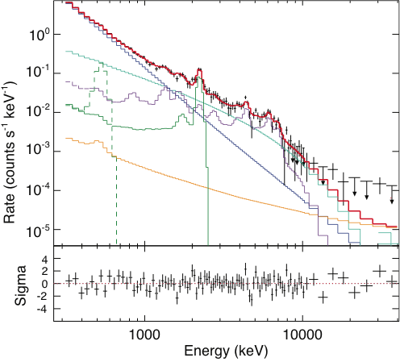

Slide 4
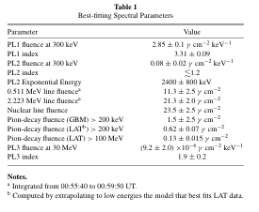

Slide 5
