Slide 1
Fermi GBM for Solar Flares
Michael S. Briggs
(UAHuntsville)
Notes:
Introduce myself. Huntsville from shortly after the launch of CGRO. GBM co-I from the proposal. FSW lead.

Slide 2
University of Alabama
in Huntsville
NASA
Marshall Space Flight Center
Max-Planck-Institut für
extraterrestrische Physik
University College
Dublin
The current GBM Team: Narayana Bhat, Michael Briggs, Michael Burgess, Vandiver Chaplin, Bill Cleveland, Valerie Connaughton, Roland Diehl, Steve Elrod, Mark Finger, Jerry Fishman, Gerard Fitzgerald, Suzanne Foley, Lisa Gibby, Misty Giles, Adam Goldstein, Jochen Greiner, David Gruber, Alexander van der Horst, Andreas von Kienlin, Pete Jenke, Marc Kippen, Chryssa Kouveliotou, Emily Layden, Sheila McBreen, Sinead McGlynn, Chip Meegan, Bill Paciesas, Veronique Pelassa, Rob Preece, Arne Rau, Dave Tierney, Colleen Wilson-Hodge and Shaolin Xiong.
Others before launch: Giselher Lichti, Fred Berry, Ron Cantrell, Al English, Fred Kroeger, …

Slide 3
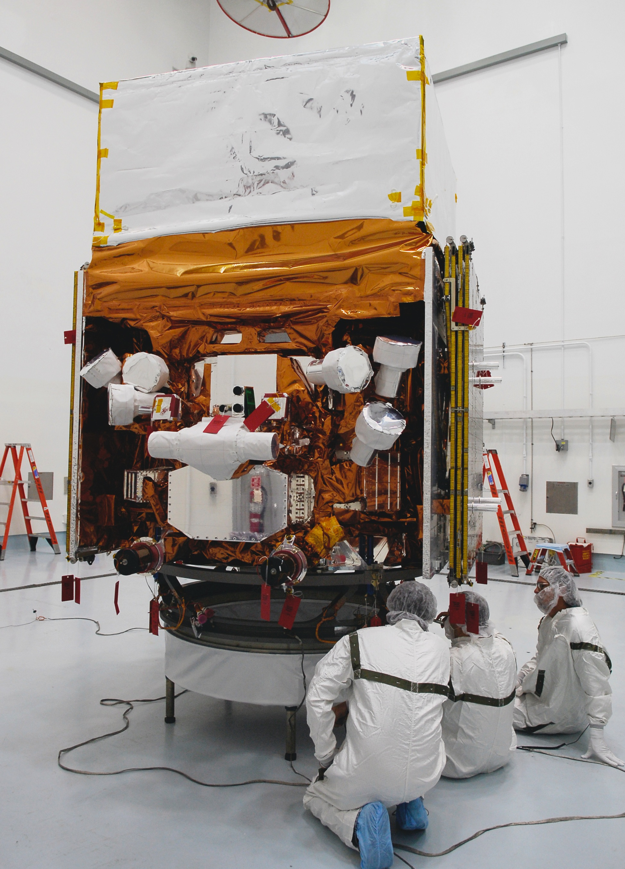
Notes:
GBM. View unocculted sky. Advantages: wide field of view. Relatively low cost. Limitations: non-imaging. High-background. SO: generally best for fast transients.

Slide 4
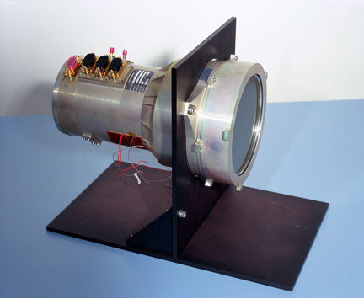
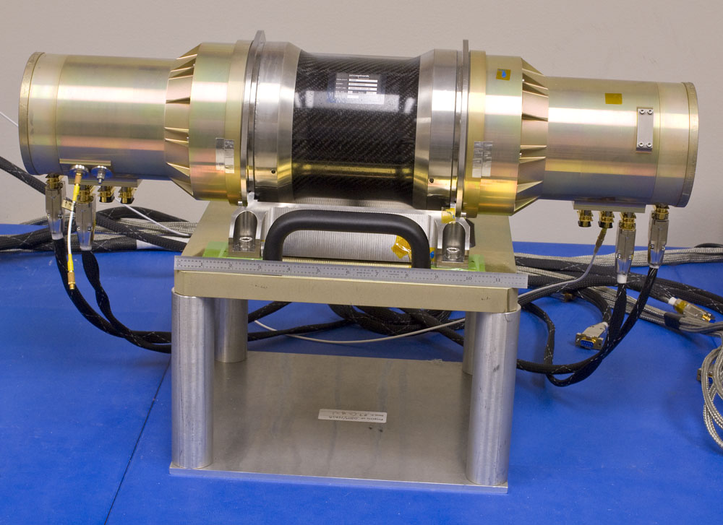
Sodium iodide (NaI)
12.7 cm diameter X 1.27 cm thick
8 keV to 1 MeV
Bismuth germanate (BGO)
12.7 cm diameter X 12.7 cm long
200 keV to 40 MeV
Notes:
Properties of the two detectors. How they work.

Slide 5
Very wide field-of-view / non-imaging / high background.
Well suited for transients such as GRBs, solar flares, SGRs, and TGFs.
Persistent or long-timescale sources can be detected by timing analysis (pulsars) or detecting Earth occultation steps.

Slide 6
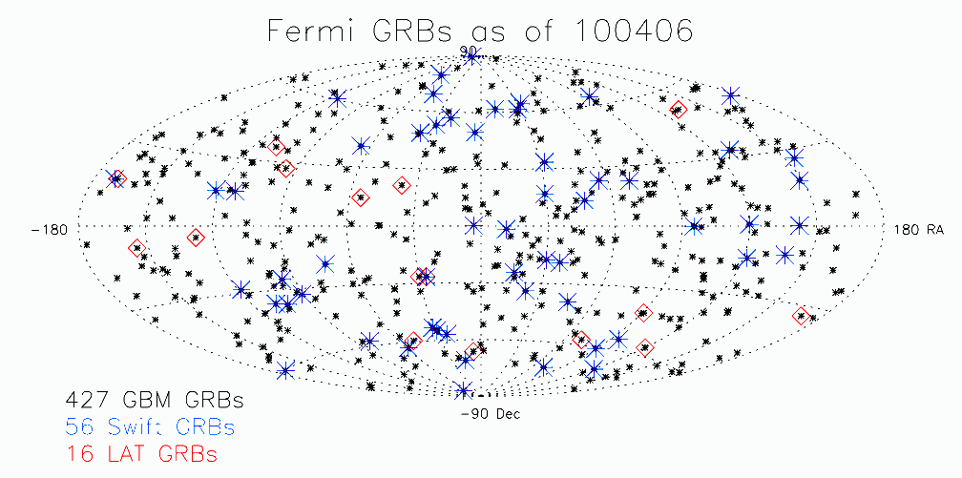

Slide 8
Mass attenuation coefficient μ:
T/T0 = exp (-μx), where
x is the column density of NaI traversed
in g cm⁻².
Notes:
Photoelectric. K-edge jump. Compton scattering. Pair production.

Slide 9
Notes:
20, 50, 500 keV

Slide 10
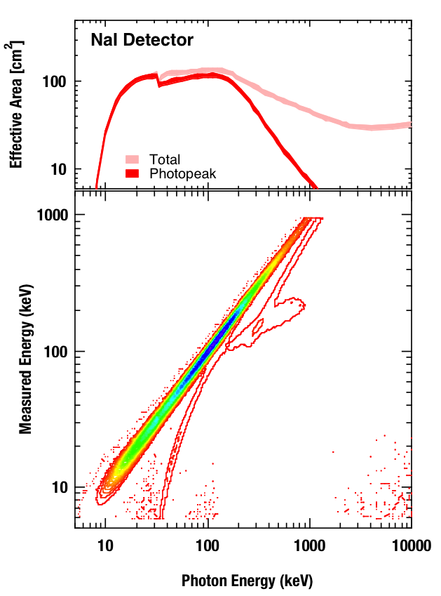
R. M. Kippen
Compton scatter
Backscatter
Iodine K X-ray escape
Notes:
DRM or IRF. No PSF for GBM. We don’t separate effective area and energy redistribution.

Slide 11
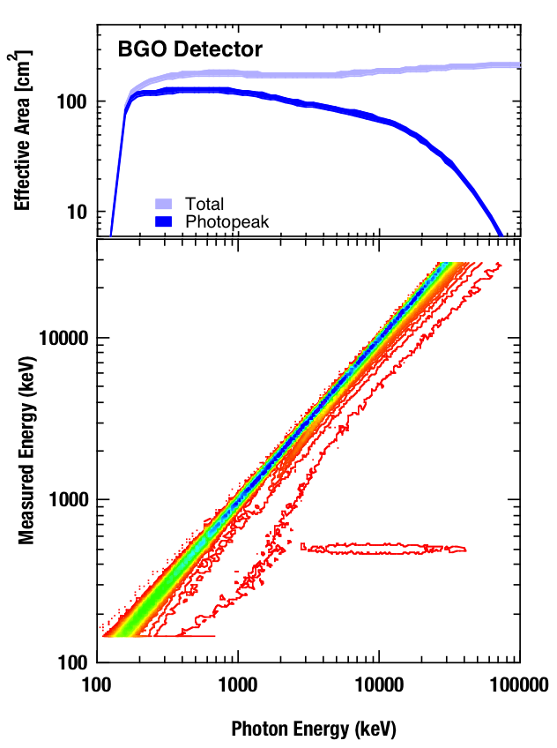
R. M. Kippen
Annihilation escape
Annihilation capture
Compton Scatter

Slide 12
Count spectrum (binned)
=
DRM X photon model
so:
Photons = DRM⁻¹ X Data ?

Slide 13
Forward-folding fitting
Assume a parameterized photon model.
Select a fitting statistic – likelihood or C-Stat (or χ²)
Calculate the count model using the DRM / IRF,
Calculate the fitting statistics,
Change the photon model parameters to improve the fitting statistic,
Repeat steps 3 to 5 to optimize the model.
The answer is based upon the model that you assumed – the process cannot automatically find the true model.

Slide 14
GBM Datatypes
GBM datatypes: designed to meet a stringent telemetry requirement. Currently 2% of the mission volume.
Triggered:
CSPEC: 128 channels, binned at 1.024 s
CTIME: 8 channels, binned at 0.064 s
TTE: 128 channels, individual counts at 2 μs
Continuous / daily:
CSPEC: 128 channels, binned at 4.096 s
CTIME: 8 channels, binned at 0.256 s
NEW: TTE: 128 channels, individual counts at 2 μs

Slide 15
GBM’s “best” datatype: individual photon data: Time Tagged Events (TTE)
BUT NOT FOR Solar Flares!

Slide 17
Tips for Solar Flare Analysis
The continuous datatypes are likely to be useful because flares can be long and triggered data normally lasts only 330 s.
Use NaI data with high caution: the combination of intense thermal spectra and the low-energy threshold may cause high-deadtime (not perfectly corrected) and even pulse pileup (spectral distortions).
TTE is likely to reach its bandwidth limit and not report the true rate.
Large DRMs are needed, at least for line fits. Standard 128 channels x 140 input photon bins cause slight broadening of lines.

Slide 18
Documentation: the tutorial by Valerie Connaughton:
vc_rmfit_tutorial.pdf
rmfit features: …
The non-virtual OS version does not require a IDL license:
idl –vm=“path/rmfit.sav”

Slide 19
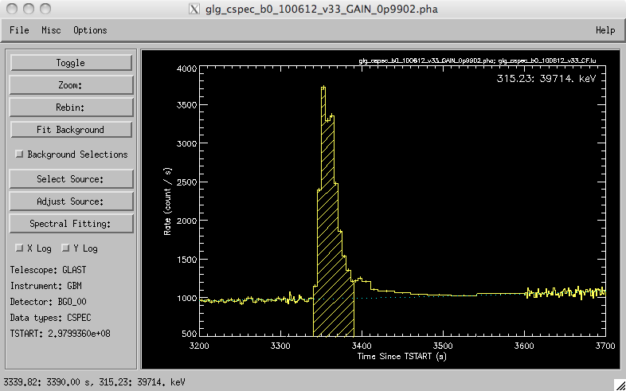
Notes:
XSPEC, rmfit. Rmfit: GUI. Designed for time-resolved spectroscopy.

Slide 20
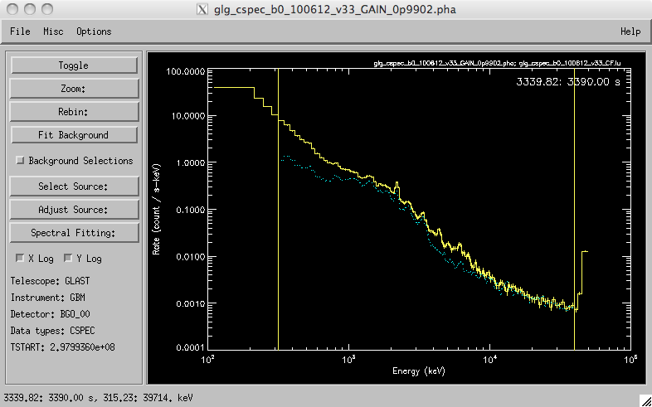

Slide 21
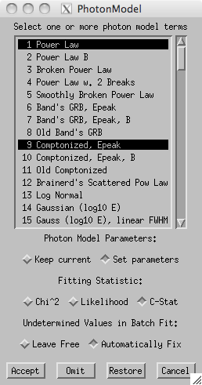
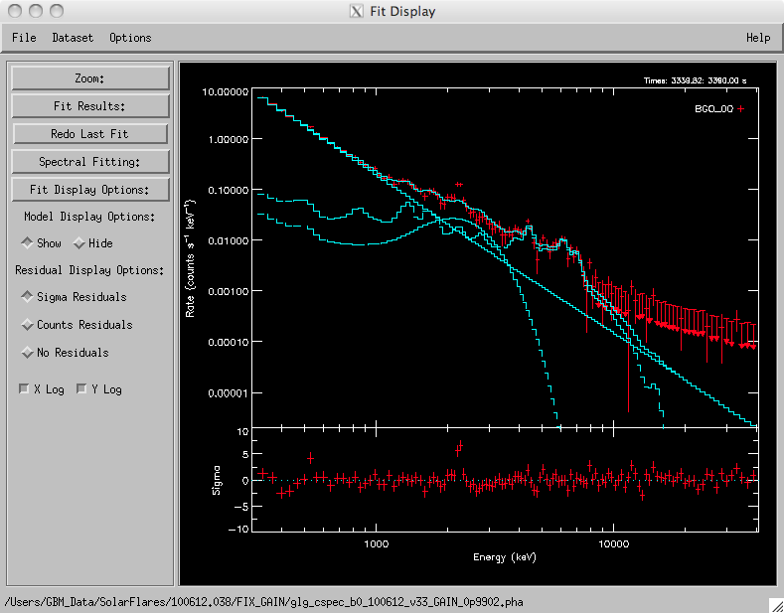

Slide 22
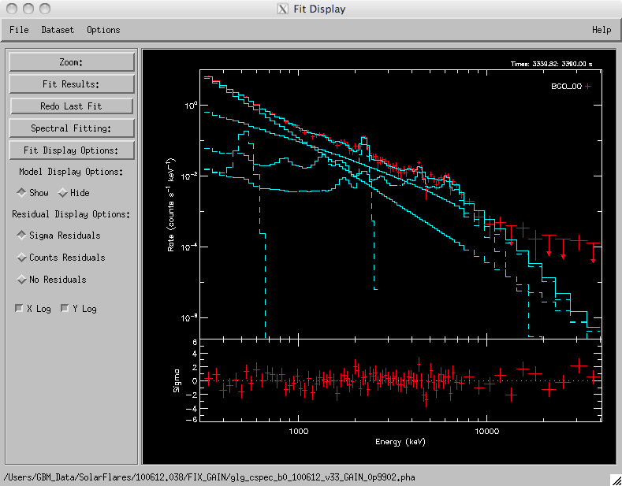

Slide 23
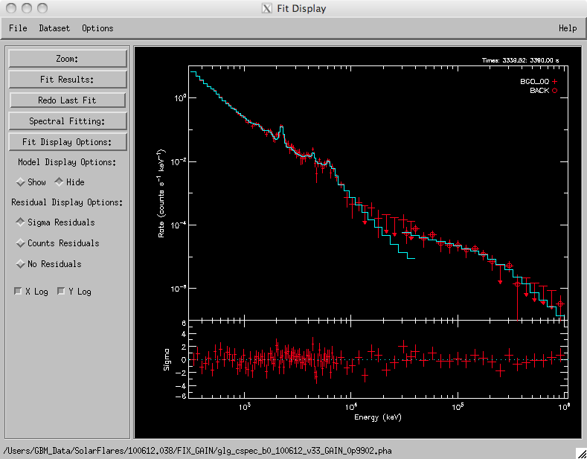

Slide 24
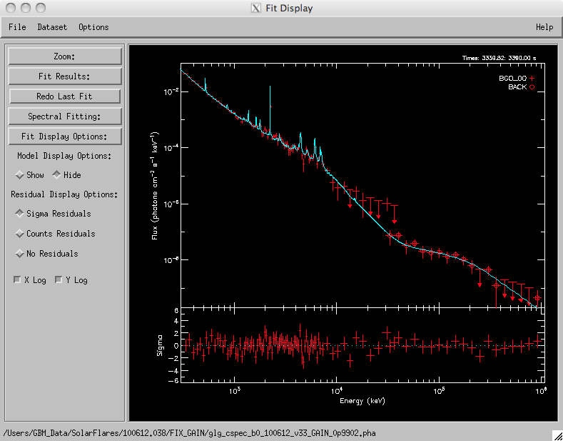

Slide 25
