Slide 1
Fermi LAT Overview
Fermi Solar Workshop
August 2012

Slide 2
The Large Area Telescope
The LAT is a particle physics detector we’ve shot into space
We analyze individual events (one photon at a time) with high energy physics techniques to get photon sample
Lots of hard work to get (RA,DEC,E) behind the curtain
Huge variations in response to different types of events
Bandpass = 4-5 decades in energy (< 20MeV to > 300 GeV)
Field of View = 2.4 sr (some response up to 70° off-axis)
Several High Energy Astrophysics topics explored by the LAT
Notes:
m

Slide 3
Outline
Overview of LAT & LAT Event Processing
Detector Subsystems
TRK
CAL
ACD
Trigger and Filter
Event Reconstruction
Sub-systems reconstruction
Event level analysis
Instrument Response Functions (IRFs)
Overview of Use Cases

Slide 4
Overview

Slide 5
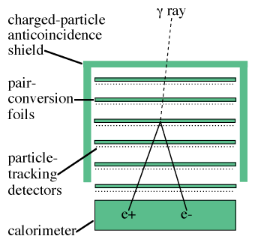
A typical Gamma-ray Telescope

Slide 6
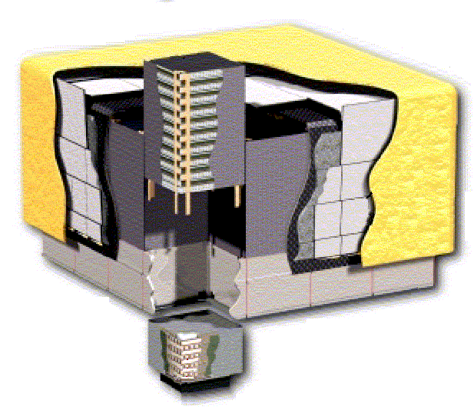
Salient Features of the LAT
Anti-Coincidence Detector (ACD):
ε = 0.9997 for MIPs
Segmented: less self-veto when good direction information is available
Tracker (TKR):
18 Si bi-layers
Front- 12 layers (~60% X_{o})
Back- 6 layers (~80% X_{o})
Angular resolution ~2x better for front
Many EM showers start in TKR
Calorimeter (CAL):
8 layers (8.6 X_{o} on axis)
ΔE/E ~ 5-20%
Hodoscopic, shower profile and direction reconstruction above ~200 MeV
Trigger and Filter
Use fast (~0.1 μs) signals to trigger readout and reject cosmic ray (CR) backgrounds
Ground analysis uses slower (~10μs) shaped signals

Slide 7
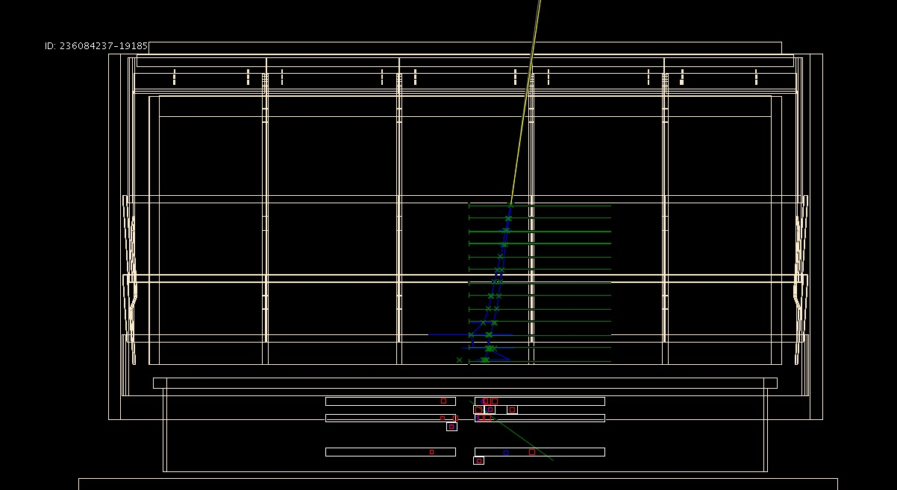
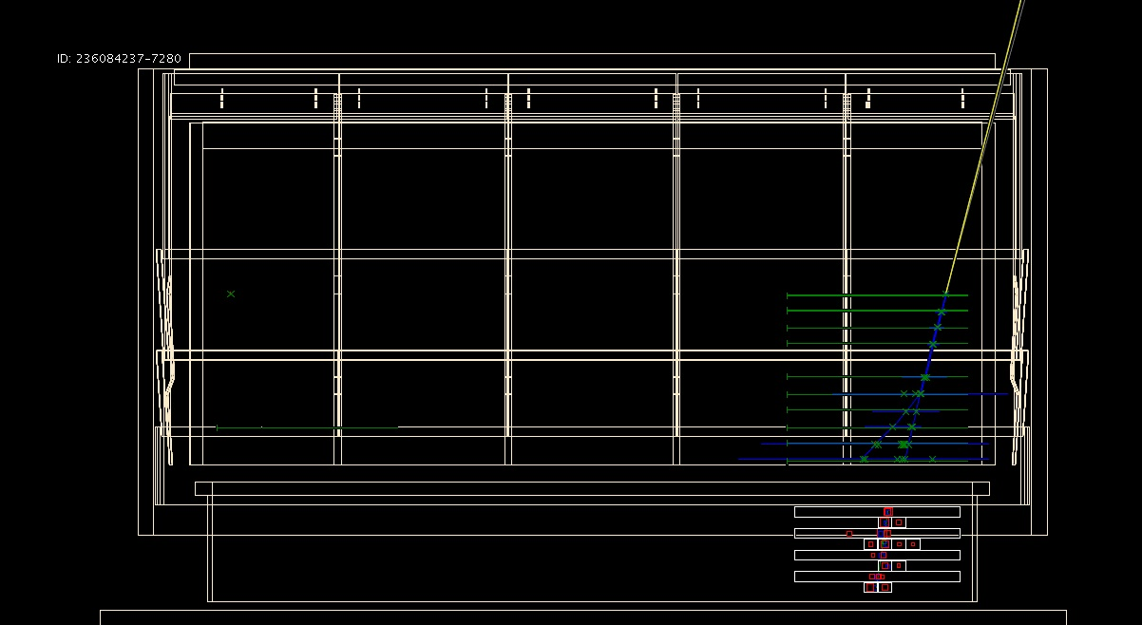
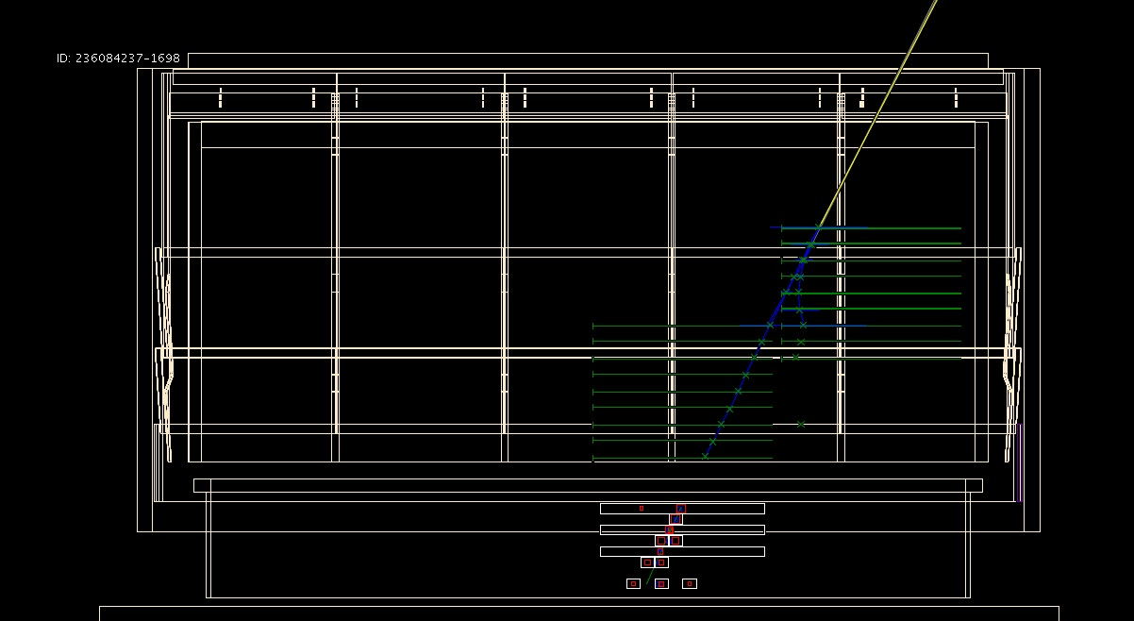
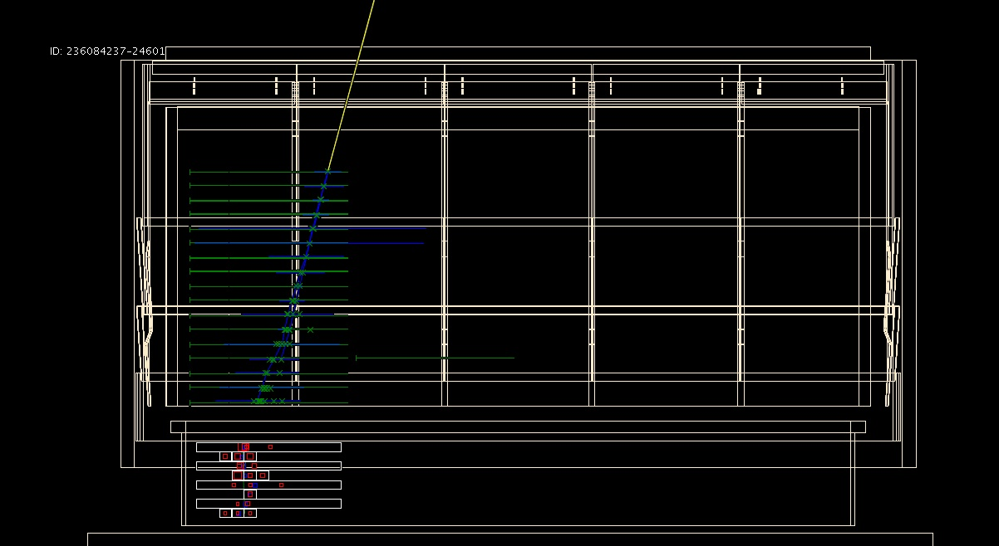
Single Event Gallery
Green Lines = Strip hits , Green Crosses = TKR hits on track, Blue lines = TKR trajectories
Grey Boxes = CAL log hits , Red crosses = Reconstructed CAL energy deposits
Yellow Line = Incoming photon direction

Slide 8
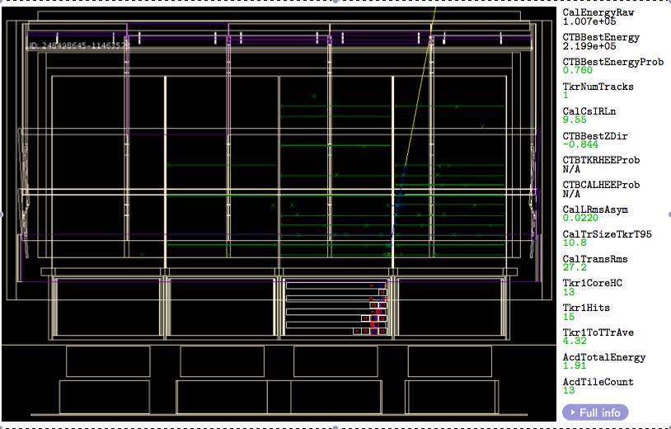
A good photon event
Track starts in middle of TKR
Calorimeter topology highly
consistent with EM Shower
Only small signals in ACD

Slide 9
Overview of the Photon Selection Process
Onboard
Trigger Request:
Minimal signal in LAT
TKR 3 layers in a row OR
CAL log > 1 GeV (5-10 kHz)
Trigger Accept:
Veto ACD TKR coincidence if
no CAL log > 100 MeV
prescale
Periodic Trigger Sample
Onboard Filter:
Flight software uses fast signals to reduce CR rate (~400Hz)
prescale
Flight Software
Photon Sample
(FSW_GAM)
Diagnostic
Sample
(DGN)
Event Selections:
Ground software uses all
signals and detailed analysis to reject CR (~few Hz)
prescale
Validation Sample
Event Reconstruction:
Track finding and fiducial cuts
Photon Event Classes
Several pre-scaled samples
of events rejected at various stages of analysis

Slide 10
Instrument Response Functions
Provide a description of the instrument
Done in context of likelihood fit
Can extract information needed for aperture photometry
Effective Area:
Area x efficiency for physicists
Aperture size x effic. for astronomers
A_{eff}(E,θ,φ)
Point Spread Function
Direction resolution for physicists
Image resolution for astronomers
P(θ’,φ’ ; E, θ, φ) = P(δv ; E, v)
Energy Dispersion
Energy resolution for physicists
Spectral resolution for astronomers
D(E’ ; E,θ,φ) = D(ΔE/E ; E,θ,φ)
Residual Particle Background
Not really an IRF, absorbed into template for isotropic γ-ray flux
νF(ν) or E dN(E)/dE

Slide 11
Silicon Tracker

Slide 12
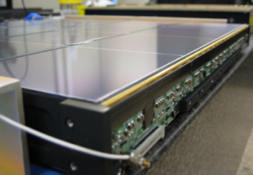
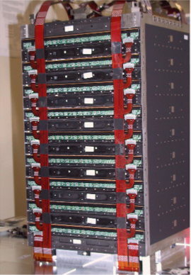
Images of the TKR
18 bi-layers, (x,y planes)
12 Layers thin (0.03 X₀) Tungsten
4 Layers thick (0.12 X₀) Tungsten
2 Layers no Tungsten
Width: 400μm, Pitch 256 μm
Point Resolution ~ pitch / sqrt(12)

Slide 13
TKR Roles
Primary Roles:
Direction reconstruction
Main event trigger
Other roles:
Projection to CAL, ACD
Background rejection
pair-conversion
conversion vertex found?
(pre-)shower topology, e⁺e⁻ versus hadrons
specific backgrounds
backsplash from CAL
Up-going heavy ions stopping in TKR

Slide 14
CsI Calorimeter

Slide 15
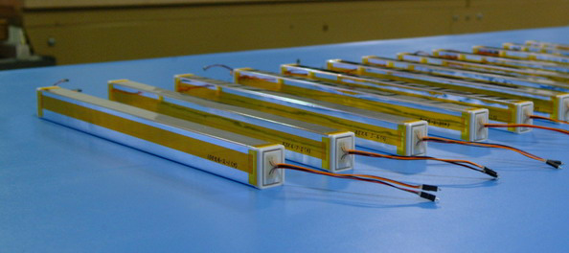
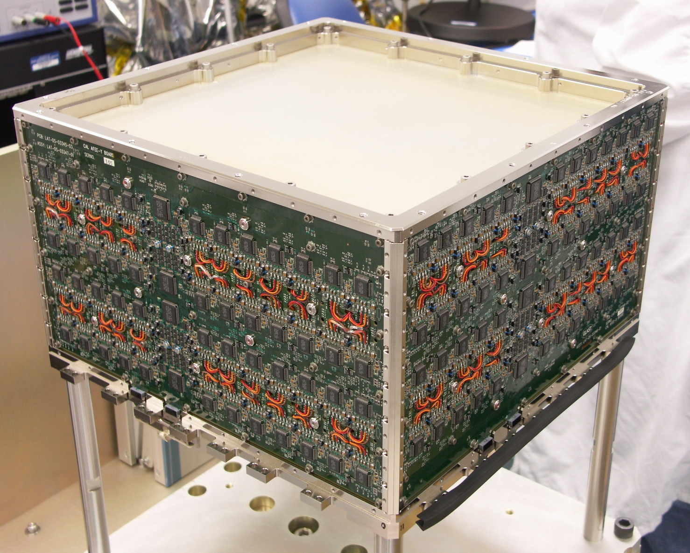
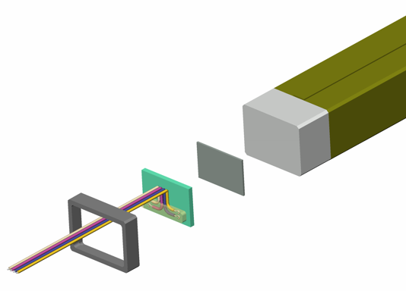
Images of the CAL
12 * 8 * 16 logs
Light readout at both ends, get long. position to ~cm from light ration
4 readout ranges (2 MeV – 100 GeV)
Optical Wrap
CsI(Tl) Crystal
Bond
Wire leads
PIN Diode
End Cap

Slide 16
CAL Roles
Primary Roles:
Energy reconstruction
Contributes to event trigger
Other Roles:
“Energy Flow” axis at high energy
Seeds tracker pattern-recognition in complicated events
Background rejection
Shower topology e⁺e⁻ versus hadrons
Specific backgrounds
Up-going particles
Backsplash
Projection to ACD

Slide 17
Anti-Coincidence Detector

Slide 18
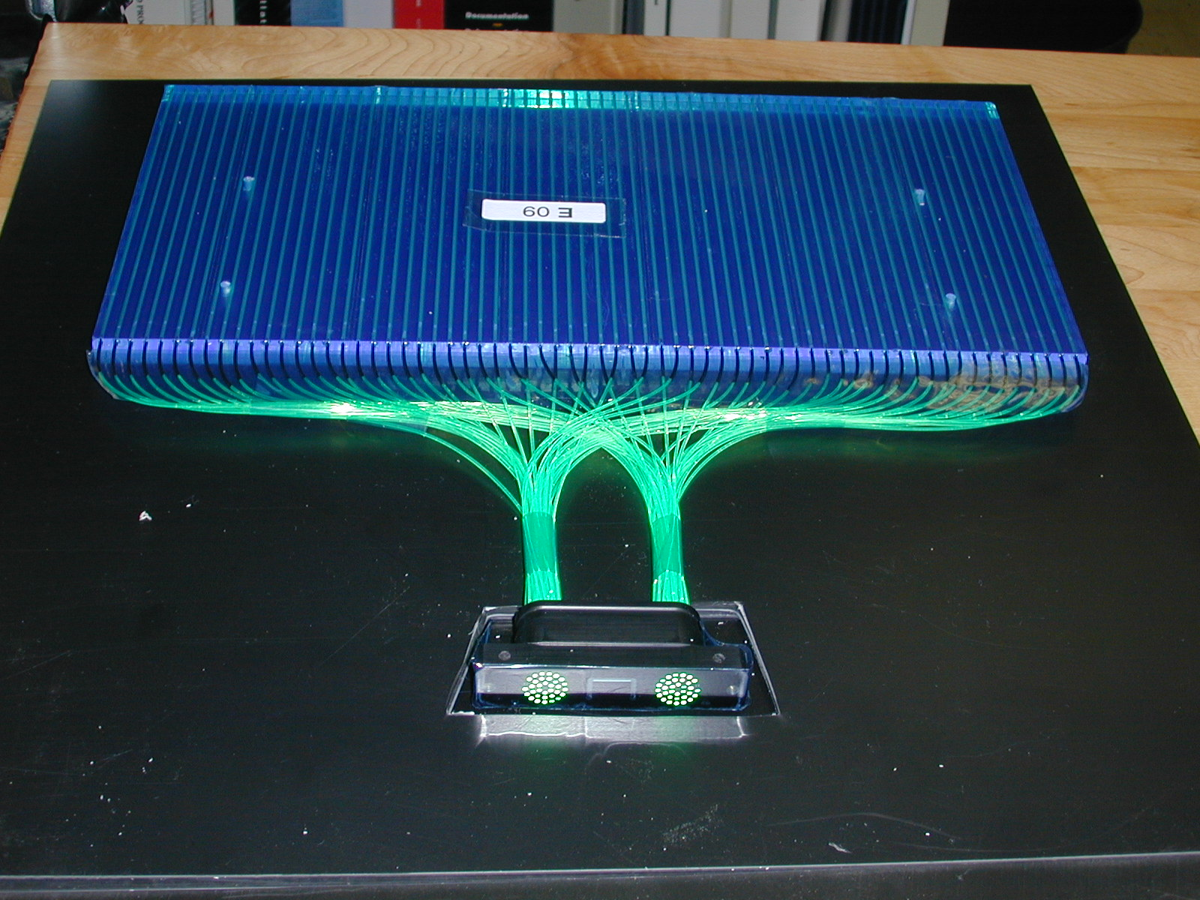
Images of the ACD
89 Tiles (25 + 4 * 16)
8 Ribbons to cover gaps
2 PMT for each tile/ ribbon
Tiles (~20 p.e.)
Ribbons (~3-8 p.e.)
2 readout ranges
< 0-8 MIP (Standard)
> 8-1000 MIP (Heavy Ions)

Slide 19
ACD Roles
Primary Roles:
Offline background rejection
Hardware & onboard filter veto
Other Roles
Identifying Heavy Ion (C,N,O + up) calibration events

Slide 20
Trigger and Filter

Slide 21
Roles of the Trigger and Filter
Primary Role:
Trigger readout of the LAT
Hardware trigger: Reduce readout rate to be manageable
From 5-10 kHz down 1-2 kHz
Onboard filter: Reduce downlink rate
From 1-2 kHz down to 300-500 Hz
Other Roles:
Provide calibration and diagnostic samples
MIPs, Heavy Ions, periodic triggers, leaked prescalers

Slide 22
Hardware Trigger Components
TKR: Tracker 3 in a row
Three consecutive tracker layers
have a signal.
Active above about 10-30 MeV
Generates Trigger Request
ROI: ACD Veto
TKR && ACD tile in tracker ROI has signal above 0.4 x MIP.
CNO: ACD Heavy Ion (C,N,O)
ACD tile in tracker ROI has
signal above 30 x MIP.
CAL-HI: High Energy CAL
Any single CAL channel has energy about 1 GeV.
Active above about 10 GeV
Generates Trigger Request
Periodic: 2 Hz cyclic
Min. bias instrument sample
Software: FSW trigger
Calibrations & bookkeeping
CAL-LO: Low Energy CAL
Any single CAL channel has energy about 100 MeV.
Active above about 1 GeV
External:
Really shouldn’t happen on orbit

Slide 23
ACD Region of Interest definitions

Slide 24
FSW Onboard Filter
GEM
CAL
Calculates the energy in the event before applying cuts
No cuts currently applied at this stage, High Energy Pass is 2% of total events
ACD
Checks that ACD information is consistent with the energy in the CAL
Rejects 9% of total events in the nominal configuration
Rejects 47% of total events in nominal configuration
Uses only information contained in the Trigger contribution
DIR
Reassembles event into a form that allows further processing
ATF
At this point can veto events with TEM error events (Though they’re leaked)
Fast technique to match TKR and ACD information using gross topology
Rejects 2% of total events in the nominal configuration
TKR
Full 2D track reconstruction matched to ACD tile hits
Rejects 7% of total events in the nominal configuration

Slide 25
Data rates

Slide 26
Event Reconstruction

Slide 27
Event Reconstruction and Selection
Reconstruction:
Developed with simulated data. Simulations validated in beamtests.
Event Classification:
Developed with simulated + flight data
Validated primarily with flight data
CAL Reconstruction:
Sum signals in CAL, analyze topology, correct for energy lost in gaps, out sides and in TKR pre-shower
Classification Analysis:
Use combined subsystem information to get best estimates of direction, energy.
Reject particle background and select highest quality events
TKR Reconstruction:
Find tracks & vertices. If possible use CAL shower axis as a directional seed
Photon Samples and IRFs:
Build descriptions of Instrument Response for each selection of events
ACD Reconstruction:
Project tracks to ACD, look for reasons to reject event.

Slide 28
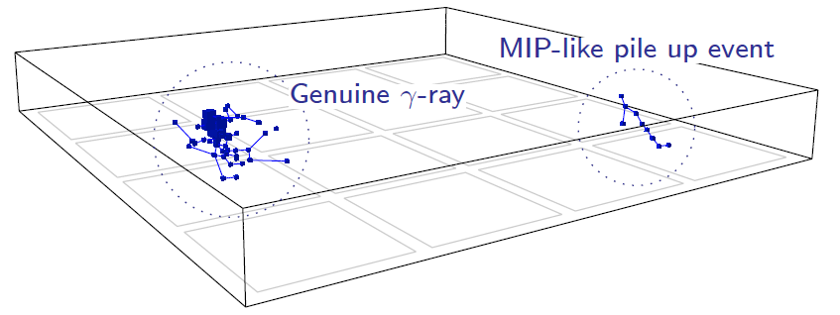
CAL Reconstruction
Apply per-crystal calibration
Clustering: group hits into clusters (TBD)
Up to now treat whole CAL as single cluster
Moments analysis
Iterative procedure, minimize RMS w.r.t. shower axis
Cluster centroid (x,y,z)
Cluster axis (v_{x},v_{y},v_{z})
Cluster moments and spread
Transverse, longitudinal RMS
Energy Reconstruction (Multiple Methods)
Parametric correction for leakage out sides and gaps
Fit to cluster profile
Likelihood fit for event energy

Slide 29
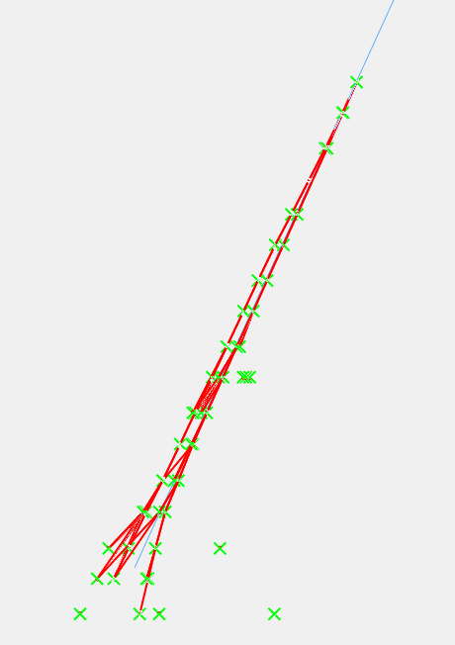
TKR Reconstruction
Hit clustering
combine adjacent hit strips in clusters
Start with CAL direction, if available
useful seed for high energy events, which are complicated
Combinatoric search for straight(ish) lines
Propagate lines to next plane, add hits as possible
Kalman fit/filter technique
Combine information (hits) with loss of information (multiple scattering)
Requires energy estimate to handle multiple scattering
Order tracks by “quality”
Favor longest, straightest track
Most likely to come from event origin
Vertexing: try to combine 2 best tracks into single item

Slide 30
ACD Reconstruction
Apply tile calibrations
Look for reason to veto event
Track extrapolation to ACD hit?
Compare ACD energy to CAL energy
Catches events where TKR direction is bad
Vector of Closest Approach
(VOCA)
Point of Closest Approach
(POCA)
Point track
crosses tile plane
3D active distance is
magnitude of VOCA
2D active distance is
defined using point
track crosses tile plane
ACD Tile
Track

Slide 31
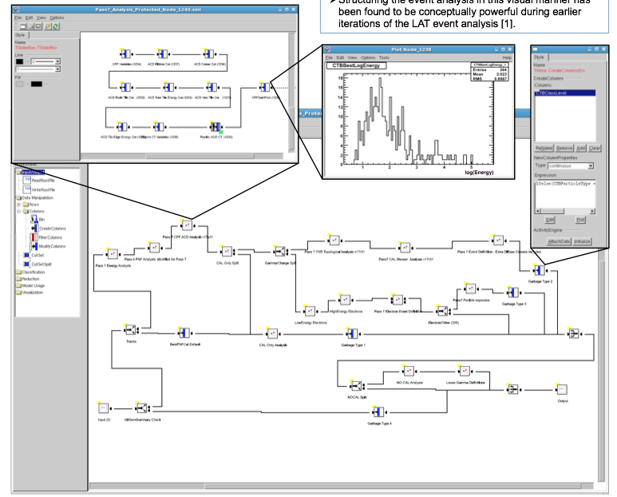
Event Level Analysis
Complex multivariate
analysis
Uses Classification
Trees (CT) in
conjunction with cuts
30+ individual cuts,
in addition to CTs
Broken into many
sub-sections

Slide 32
Outputs of the event level analysis
Direction Analysis:
Decides which direction solution (vertex or non-vertex, TKR or TKR + CAL) is best
Gives estimate of quality of direction estimate
P_{CORE} = “prob.” that direction is within R68%
Photon Analysis
Combine everything
P_{ALL} = “prob.” that event is a photon
Energy Analysis
Decides which energy method (Parametric or Profile) is best
Gives estimate of quality of energy estimate
P_{BestEnergy} = “prob.” event is within P68%
Photon Samples
Apply cuts tuned to for particular samples
Might require good direction, energy recon in addition to
high photon “prob.”
Charged Particle Analysis
Reject charged particles using ACD,TKR,CAL
P_{CPFGAM} = “prob.” event is a photon
Topology Analysis
Reject hadrons using TKR, CAL
P_{TKRGAM}, P_{CALGAM} = “prob.” event is a photon

Slide 33
Data Processing Pipeline
We require 150-200 cores processing full time to
keep up with data
Done in a pipeline which does all the bookkeeping
Pipeline also does routine science analysis and GRB searches

Slide 34
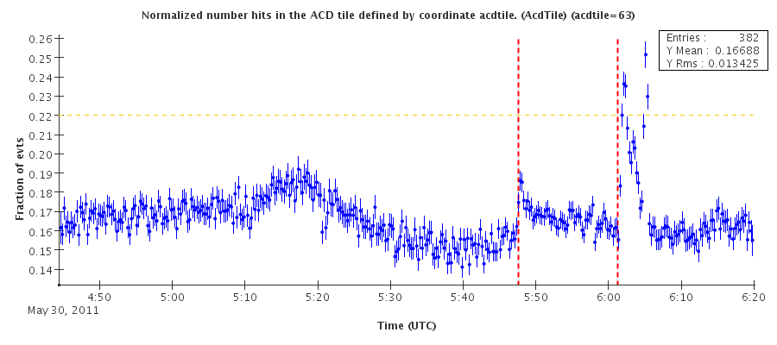
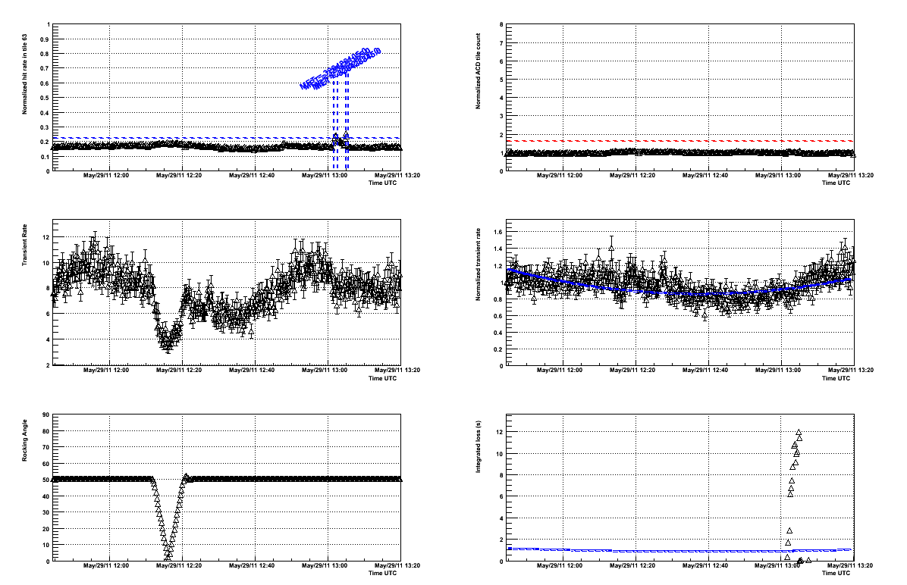
Data Monitoring: Solar Flare
ACD tile 63 faces the sun and is large
ACD tile 63 rate
ACD total tile rate
Photon rate
Normalized Photon rate
Rocking angle

Slide 35
Instrument Response Functions

Slide 36
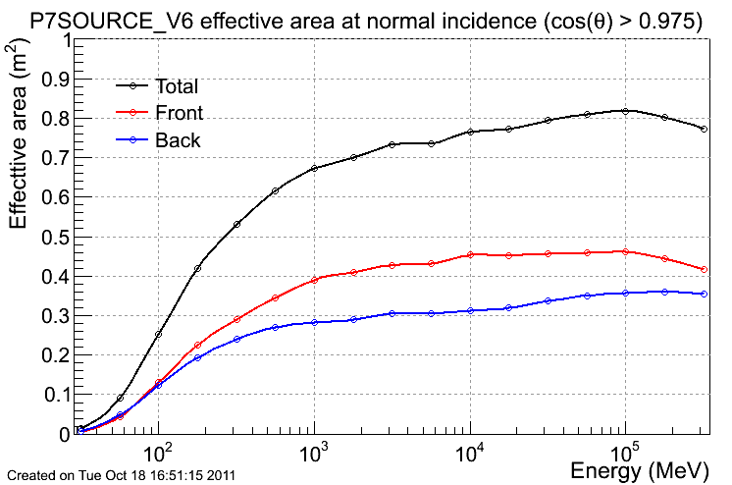
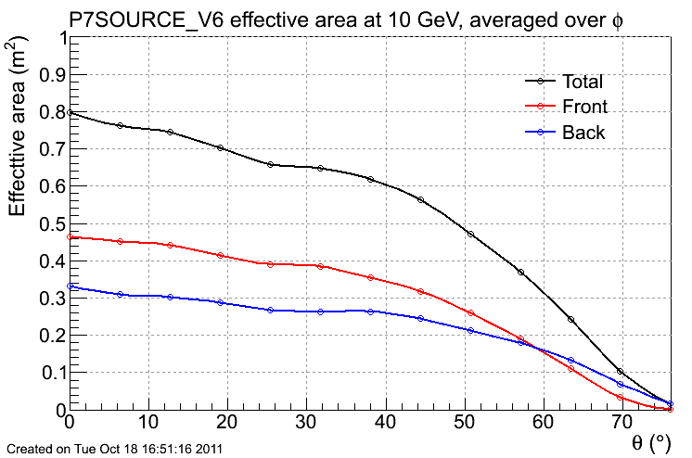
Effective Area (A_{eff})
< 100 MeV limited by 3-in a row requirement
< 1 GeV limited discriminating information
> 100 GeV self-veto from backsplash
Off-axis: more material, less cross section
Shift from front/back events as we go off-axis
http://www.slac.stanford.edu/exp/glast/groups/canda/lat_Performance.htm

Slide 37
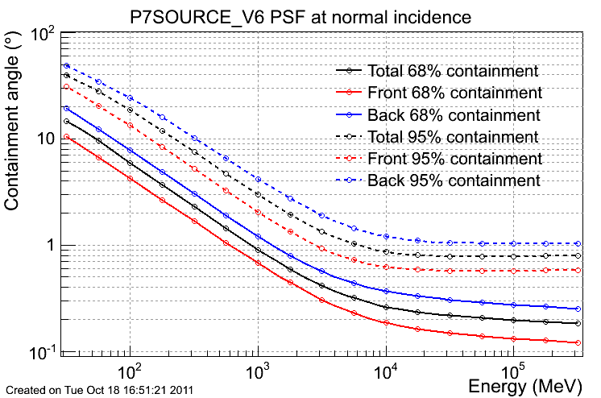
Point Spread Function (P)
Low energy: dominated by MS
High energy: dominated by strip pitch
http://www.slac.stanford.edu/exp/glast/groups/canda/lat_Performance.htm

Slide 38
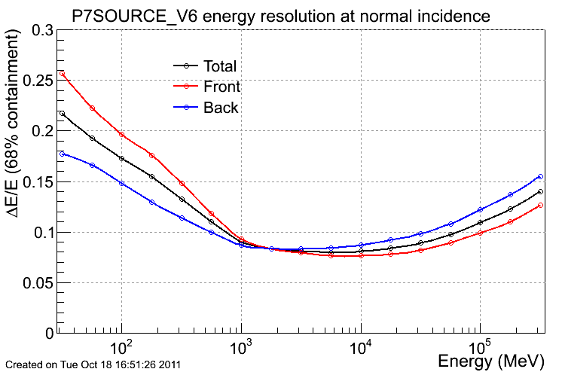
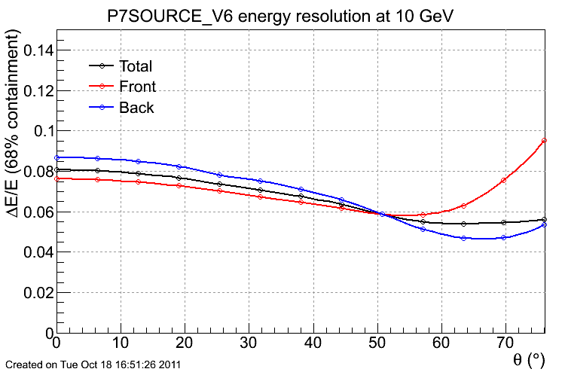
Energy Dispersion (D)
Low energy: energy lost in TKR
High energy: energy lost out back of CAL
Off-axis: more material, more MS
at low energy
More pattern recognition confusion off-axis at high energy
http://www.slac.stanford.edu/exp/glast/groups/canda/lat_Performance.htm

Slide 39
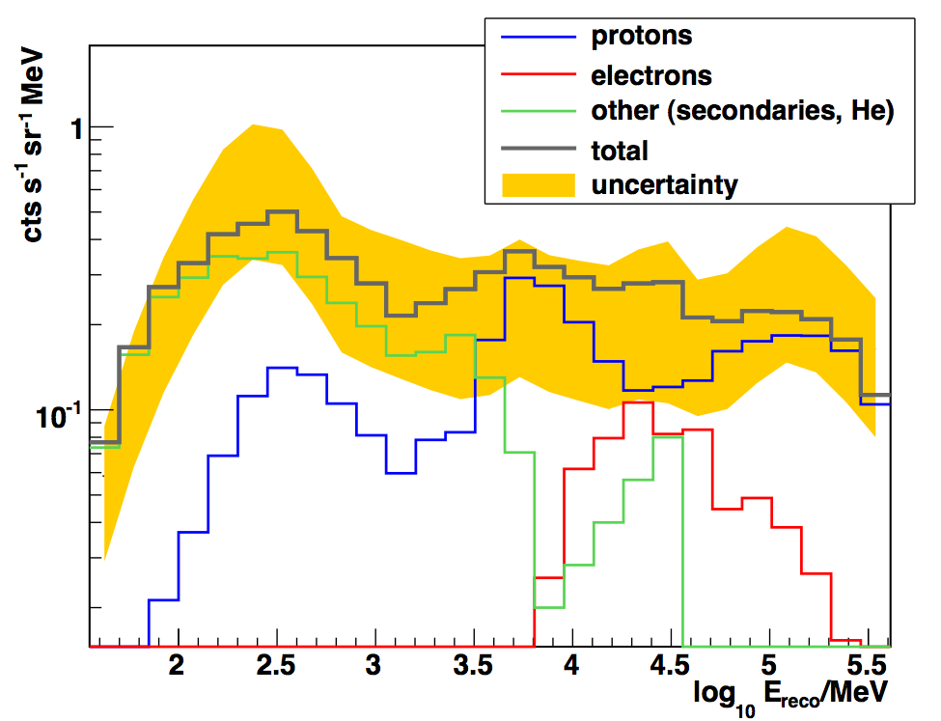
Particle Background Contamination
Estimate particle background leakage from very large MC simulations
Need to generate 10⁹ events to have ~few hundred passing cuts
Fit for isotropic component in sky
with different event samples
Sky does not change, difference is
instrumental
E.Charles: Fermi Summer School 2011

Slide 40
Caveats and Use Cases

Slide 41
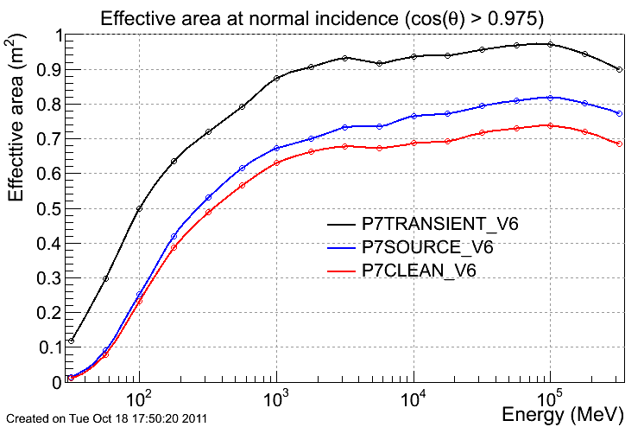
Event Classes
P7TRANSIENT: event class has large non-photon backgrounds and is only appropriate for the study of short transient events with a duration of less than 200s. (for energies > 100 MeV)
P7SOURCE: photons for all point source analyses as well as for the analysis of bright diffuse sources.
P7CLEAN: photons for studies of diffuse emission at high energies.
http://www.slac.stanford.edu/exp/glast/groups/canda/lat_Performance.htm
http://fermi.gsfc.nasa.gov/ssc/data/analysis/LAT_caveats.html

Slide 42
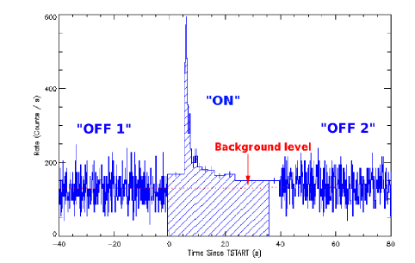
LLE data
arXiv:1002.2617
The LAT Low Energy analysis (LLE) is a new type of analysis developed by the Fermi-LAT and Fermi-GBM teams for increasing the effective area of the Large Area Telescope at low energy, and it is suitable for studying transient phenomena, such as Gamma-Ray Bursts and Solar Flares. The LLE analysis filters event data with a very loose event selection, requiring only minimal information, such as the existence of a reconstructed direction.
http://fermi.gsfc.nasa.gov/ssc/data/analysis/LAT_caveats.html

Slide 43
GRB science
Piron : GRB2012

Slide 44
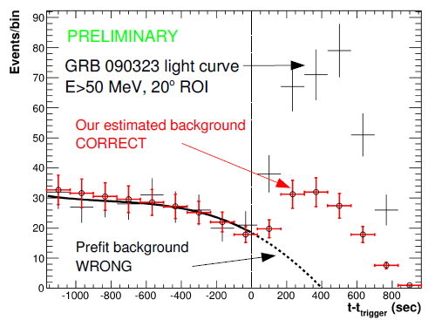
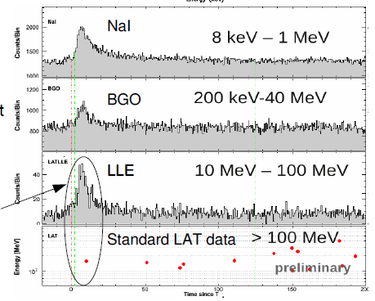
Short Transient Analysis
LAT LowEnergy Detection
Proper Background estimation for TRANSIENT events
Piron : GRB2012

Slide 45
Pulsar Science
Ray : Fermi Summer School 2012

Slide 46
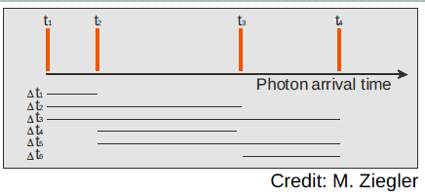
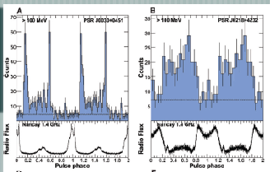
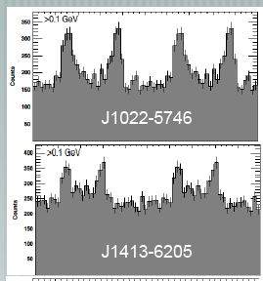
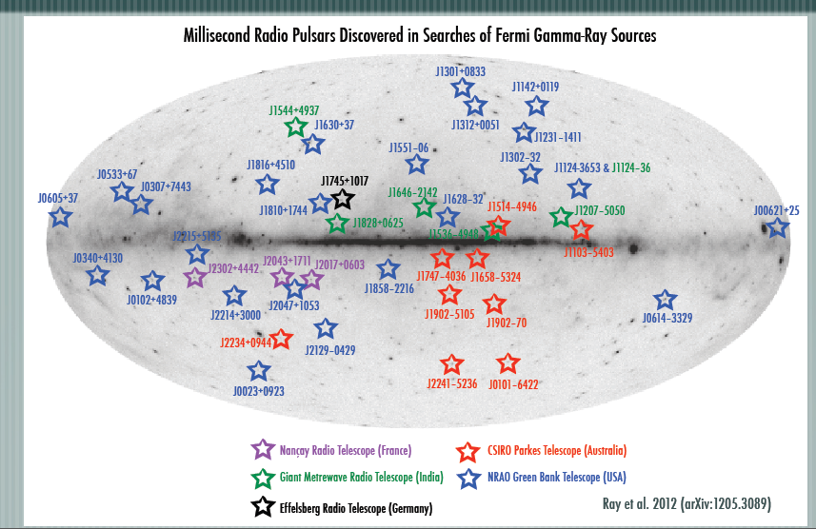
Periodic Analysis (eg. Pulsars)
Folding with known ephemeridis
Blind searches
Radio follow up on Fermi LAT sources
Atwood et al. 2006
Abdo et al. 2009
Saz Parkinson et al. 2010
Ray : Fermi Summer School 2011/12

Slide 47
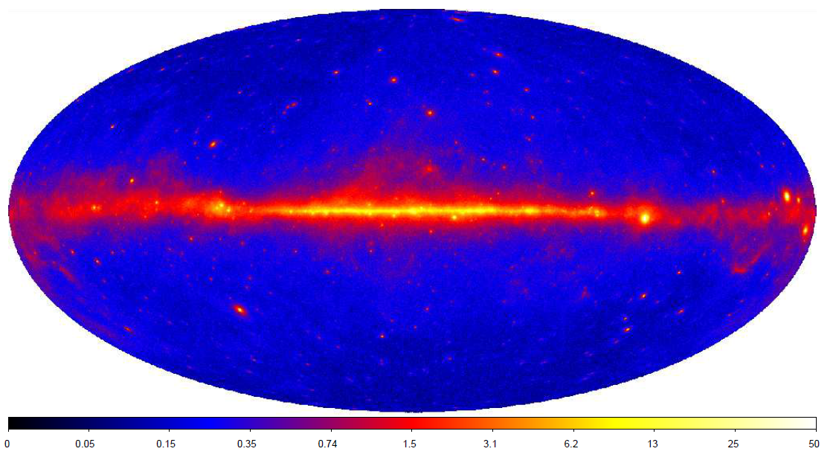
The LAT sky
Nolan et al. 2012

Slide 48
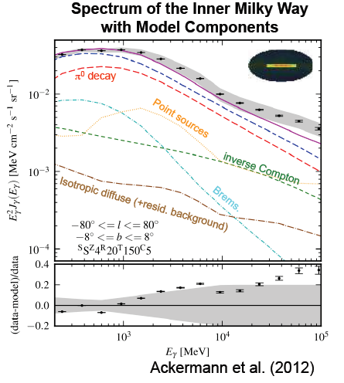
The Diffuse emission

Slide 49
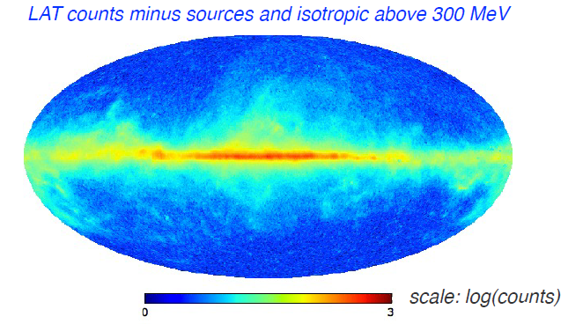
Diffuse Analysis
Cosmic rays
Interstellar gas (molecular, atomic, ionized)
Interstellar radiation field
Casandjian: Fermi Symposium 2011
Digel: Fermi Summer school 2012

Slide 50
The 2FGL catalog
Nolan et al. 2012

Slide 51
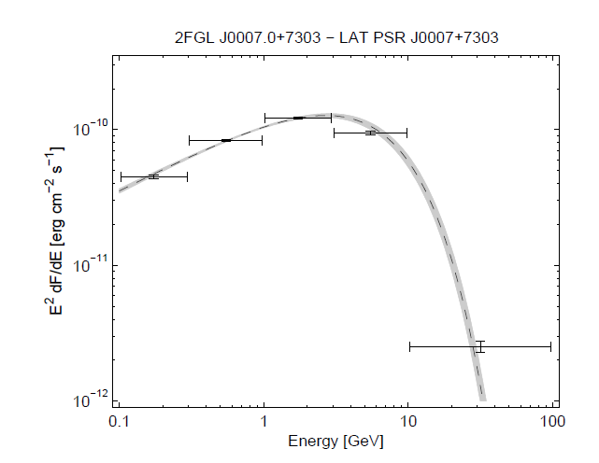
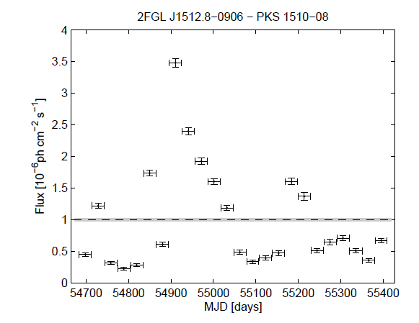
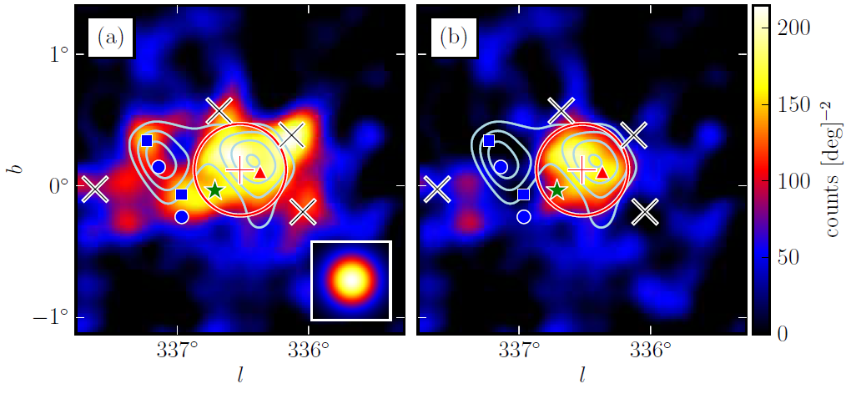
Source Analysis
Source detections algorithms
Spectral analysis
Association studies
Variability studies
Source extension
Abdo et al. 2011, Nolan et al. 2012
Lande et al. 2012

Slide 52
Summary

Slide 53
The Large Area Telescope
The LAT is a particle physics detector we’ve shot into space
We analyze individual events (one photon at a time) with high energy physics techniques to get photon sample
Lots of hard work to get (RA,DEC,E) behind the curtain
Huge variations in response to different types of events
Bandpass = 4-5 decades in energy (< 20MeV to > 300 GeV)
Field of View = 2.4 sr (some response up to 70° off-axis)
Several High Energy Astrophysics topics explored by the LAT
Notes:
m

