Slide 1
Joint data analysis with non-Fermi instruments
Albert Y. Shih
2012 August 23

Slide 2
What’s out there
A quick overview of (some) solar missions

Slide 3
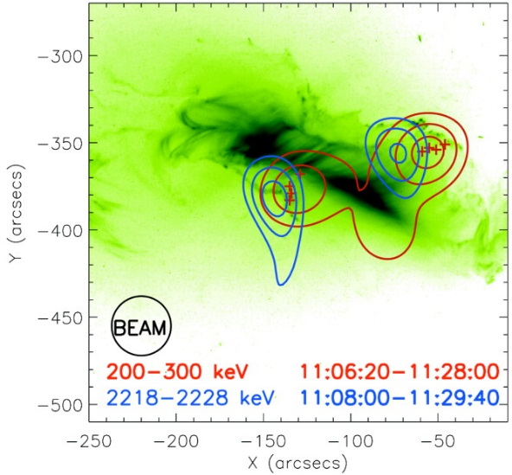
Reuven Ramaty High-Energy Solar Spectroscopic Imager (RHESSI)
X-ray and gamma-ray imaging spectroscopy using germanium detectors
Spectroscopy: 3 keV to 17 MeV, < few keV resolution
Angular resolution: >2” (X-rays) or >35” (gamma rays)

Slide 4
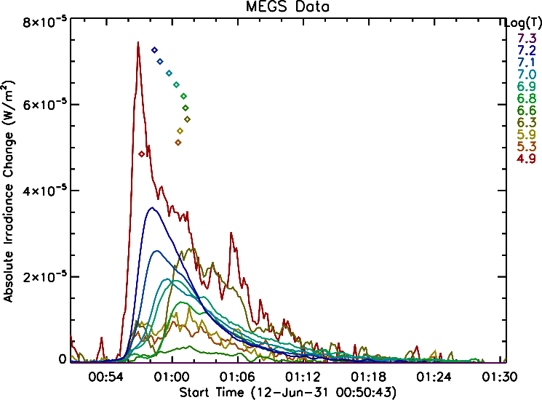
Solar Dynamics Observatory (SDO)
Atmospheric Imaging Assembly (AIA)
Full-Sun images with ~1” angular resolution
10 different wavelengths (photospheric to coronal temperatures)
Extreme Ultraviolet Variability Experiment (EVE)
Sun-integrated spectropscopy
6–106 nm with 0.1 nm resolution
Helioseismic and Magnetic Imager (HMI)
Magnetograms

Slide 5
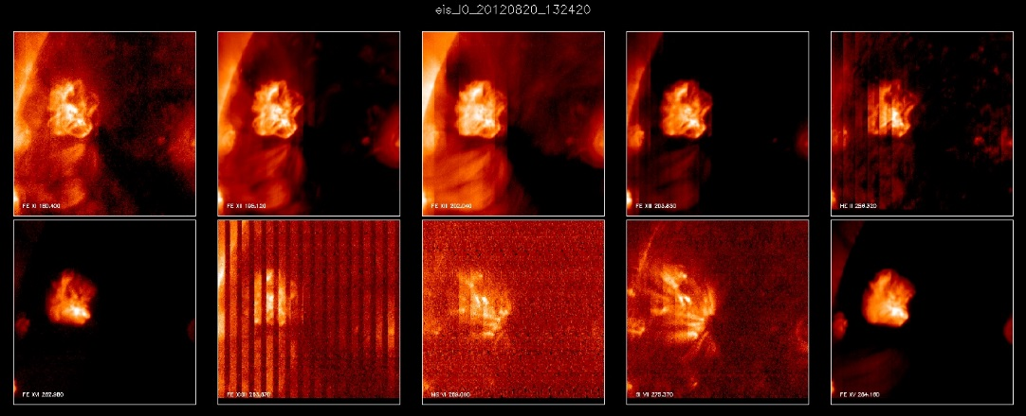
Hinode (formerly Solar-B)
X-Ray Telescope (XRT)
Full-Sun soft X-ray images with 2” angular resolution
Extreme-Ultraviolet Imaging Spectrometer (EIS)
17–21 nm and 25–29 nm with 0.1 nm resolution
Slit: 1”, 2” wide
Slot: 40”, 266” wide
Solar Optical Telescope (SOT)

Slide 6
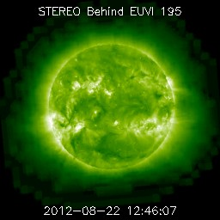
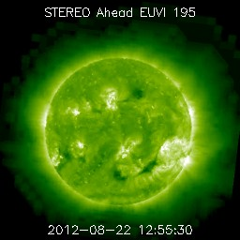
Solar TErrestrial RElations Observatory (STEREO)
Two spacecraft drifting away from Earth along its orbit at ~22°/year
SECCHI/EUVI
Full-Sun images with ~4” angular resolution
4 different wavelengths
STEREO/WAVES (SWAVES)
HFR: 16 MHz to 125 kHz
and more!

Slide 7
Where to start
Resources to sift through the wealth of data

Slide 8
RHESSI Browser
http://sprg.ssl.berkeley.edu/~tohban/browser/
Primarily focuses on RHESSI, but also has GOES, Fermi, and radio data
Matches up plots by date and time
Provides links to other data-browsing resources (e.g., SolarMonitor)
Examples:
http://sprg.ssl.berkeley.edu/~tohban/browser/?show=grth1+qlpcr+gbmd+gbmo
http://sprg.ssl.berkeley.edu/~tohban/browser/?show=grth3+qlpcr+qlifs+qli04+qli06&date=20050120&time=064530&bar=1
http://sprg.ssl.berkeley.edu/~tohban/browser/?show=grth2+qlpcr+rms4b&date=20110215&time=015256&bar=1

Slide 9
SolarMonitor
http://solarmonitor.org/
An assortment of daily full-Sun images:
SDO/AIA, SDO/HMI, Hinode/XRT, STEREO/EUVI, Global H-alpha Network (GHN), and more
Examples:
http://www.solarmonitor.org/index.php?date=20050120
http://www.solarmonitor.org/index.php?date=20110215&region=11158

Slide 10
Helioviewer.org
http://helioviewer.org/
Full-Sun and coronagraph images from SDO and STEREO, as well as SOHO and PROBA2
Overlays different data sets and matches the time
Can share images and movies
Example:
http://helioviewer.org/?date=2011-02-15T01:51:05.000Z&imageScale=19.363527&centerX=0&centerY=0&imageLayers=%5BSDO,AIA,AIA,171,1,100%5D,%5BSOHO,LASCO,C2,white-light,1,100%5D,%5BSOHO,LASCO,C3,white-light,1,100%5D

Slide 11
JHelioviewer
http://jhelioviewer.org/
Similar functionality to Helioviewer.org, but is based on Java and runs locally on your computer
Can correct for solar rotation

Slide 12
Heliophysics Event Knowledgebase (HEK)
http://www.lmsal.com/isolsearch
Database of flares, active regions, and other coronal features
Example:
http://www.lmsal.com/isolsearch?hek_query=http://www.lmsal.com/hek/her?cosec=2&cmd=search&type=column&event_type=ar,ce,cj,cw,ef,fi,fe,fa,fl,os&event_region=all&event_coordsys=helioprojective&x1=-5000&x2=5000&y1=-5000&y2=5000&result_limit=120&event_starttime=2011-02-15T00:00:00&event_endtime=2011-02-16T00:00:00

Slide 13
Virtual Solar Observatory (VSO)
http://virtualsolar.org/
Lots of data!

Slide 14
How to take the next step

Slide 15
Software
SolarSoftWare (SSW)
Primarily built on IDL
Large amount of developed software
http://www.lmsal.com/ssw/
SunPy
Built on Python
Being actively developed, but so far can do only a small fraction of what SSW can do
http://www.sunpy.org/

Slide 16
Data analysis guides/tutorials
RHESSI: http://sprg.ssl.berkeley.edu/~tohban/wiki/index.php/RHESSI_Software
SDO: http://www.lmsal.com/sdouserguide.html
Hinode/XRT: http://xrt.cfa.harvard.edu/science/tutorials.php
Hinode/EIS: http://msslxr.mssl.ucl.ac.uk:8080/eiswiki/Wiki.jsp?page=DataProAnalysis

Slide 17
Good luck!

Slide 18
A two-instrument example (part 1/4)
Type “sswidl” in a terminal to start SSW
In SSW, type:
search_network,/enable
hessi
In the RHESSI GUI, click “File” -> “Select Observation Time Interval...”
In the text box following "Set times to start/end of flare:”, type “2022619” and hit return
Click “Plot Observing Summary Data” (1.8 MB download)
Click “Set Obs Time and Close”

Slide 19
Example (part 2/4)
In the RHESSI GUI, click “File” -> “Retrieve/Process Data” -> “Image...”
Keep the default settings
Click “Make Plot/Image(s)” (111 MB download)
Click “Close”

Slide 20
Example (part 3/4)
In the RHESSI GUI, click “File” -> “Retrieve/Process Data” -> “Synoptic...”
In the drop box following “remote sites ->”, select “SOHO/EIT (level 0)”
Click “Search”
Select “efz20020226.102438” in middle list
Click “Download” (2.1 MB download)
Select “efz20020226.102438” in bottom list
Click “Display”
Click “Done”

Slide 21
Example (part 4/4)
In the RHESSI GUI, click “Plot_Control” -> “Image Display Options...”
Click “Color” (near the top)
Select “0 - B-W LINEAR” in the list and click “Accept”
In the drop box following “Contour #1:”, select the image that starts with “HESSI Image”
Click “Accept and Close”
Click and drag a box over the flare to zoom in

