Slide 1
FERMI Solar Data Availability and Quicklook Plots
Kim Tolbert
The Catholic University of America
And
Goddard Space Flight Center

Slide 2
FERMI Solar Flare Observations
Guest Investigator project to catalog the solar data observed by Fermi's GBM and LAT, and make them available for analysis by the solar community
Brian Dennis, PI (GSFC)
Nicola Omodei (Stanford/KIPAC)
Rob Preece (UAH)
Richard Schwartz (GSFC/CUA)
Gerry Share (UMd)
Kim Tolbert (GSFC/CUA)

Slide 3
Fermi Solar Web Site
GBM Flare Catalog
Quicklook Plots
Response Files
OSPEX Software Guide
Useful Fermi Pages
http://hesperia.gsfc.nasa.gov/fermi_solar/

Slide 4
GBM Flare List
GBM CSPEC files are scanned daily
Flare Identification (Richard Schwartz algorithm):
Use difference between sunward and anti-sunward rates
Smallest flare ~ GOES C2
~1400 flares so far
Text and FITS files online
http://hesperia.gsfc.nasa.gov/fermi/gbm/qlook/fermi_gbm_flare_list.txt
Read using cat = gbm_read_cat() in SSWIDL

Slide 5
GBM Quicklook Plots
Time profiles
BGO and NaI
PNG files online at
http://hesperia.gsfc.nasa.gov/fermi/gbm/qlook/
View through RHESSI Browser
http://sprg.ssl.berkeley.edu/~tohban/browser/?show=grth+qlpcr+gbmo+gbmd

Slide 6
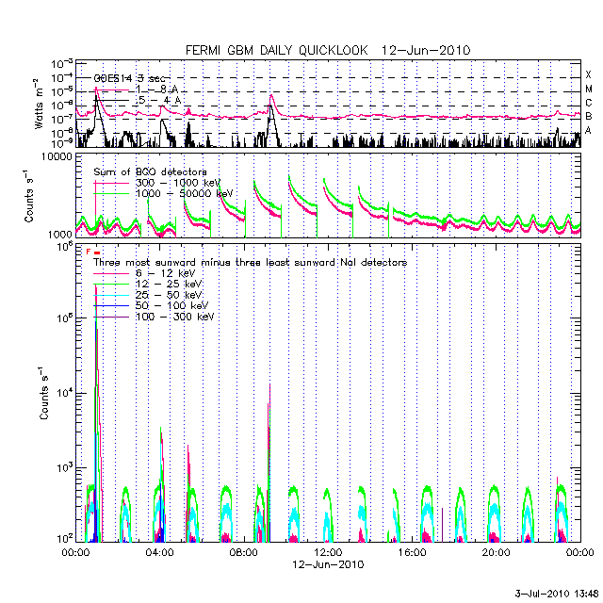
Daily plot
Top: GOES
Middle: BGO in 2 energy bands
Bottom: Sunward minus anti-sunward NaI in 5 energy bands

Slide 7
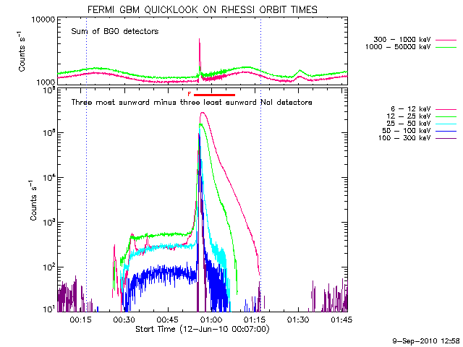
Orbital plot
Top: BGO in 2 energy bands
Bottom: Sunward minus anti-sunward NaI in 5 energy bands
Red bar indicates flare
Dotted blue vertical lines show day/night

Slide 8
Software
Utility routines
Convert between Fermi MET and recognizable time
Find and copy GBM data and response files
Read flare catalog
Get detector angle information
OSPEX
Comprehensive IDL/SSW Spectral Analysis Package
Interactively view time profiles and spectra
More discussion this afternoon

Slide 9
GBM Response Files
Convert count rate to photon flux
Created using Fermi Science Tools
For every GBM flare
For all NaI and BGO detectors
Archived at http://hesperia.gsfc.nasa.gov/fermi/gbm/rsp/
OSPEX finds and copies response files

Slide 10
Links
Fermi Solar Web Site
http://hesperia.gsfc.nasa.gov/fermi_solar
GBM Flare List
http://hesperia.gsfc.nasa.gov/fermi/gbm/qlook/fermi_gbm_flare_list.txt
Daily and Orbital Quicklook Plots
http://hesperia.gsfc.nasa.gov/fermi/gbm/qlook/
RHESSI Browser with GBM plots
http://sprg.ssl.berkeley.edu/~tohban/browser/?show=grth+qlpcr+gbmo+gbmd
Utility Software Routines
http://hesperia.gsfc.nasa.gov/fermi_solar/fermi_sw_utilities.htm
OSPEX Guide
http://hesperia.gsfc.nasa.gov/ssw/packages/spex/doc/ospex_explanation.htm
Response Files
http://hesperia.gsfc.nasa.gov/fermi/gbm/rsp/

Slide 11
The End

