Slide 1
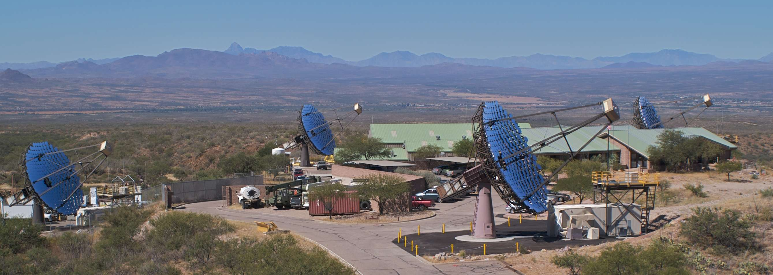
VERITAS Observations of Galactic TeV Sources
Jamie Holder¹ for the VERITAS Collaboration²
1. Bartol Research Institute/ University of Delaware
2. http://veritas.sao.arizona.edu
GeV and TeV Sources in the Milky Way
Aspen Summer Workshop June 2010

Slide 2
Galactic Sources with VERITAS
General Observation Strategy:
Limited Blind Survey
Pointed Observations
Both of these have led to detections.
This talk:
VERITAS Overview
Survey
Galactic Binaries
Brian Humensky:
SNR and PWN

Slide 3
VERITAS: Fall 2007
Smithsonian Astrophysical Observatory
Purdue University
Iowa State University
Washington University in St. Louis
University of Chicago
University of Utah
University of California, Los Angeles
McGill University, Montreal
University College Dublin
University of Leeds
Adler Planetarium
Argonne National Laboratory
Barnard College
DePauw University
Bartol Research Institute/ University of Delaware
Grinnell College
University of California, Santa Cruz
University of Iowa
University of Massachusetts
Cork Institute of Technology
Galway Mayo Institute of Technology
National University of Ireland Galway
~25 Associate Members
http://www.youtube.com/watch?v=ucP1dAXfYtQ

Slide 4
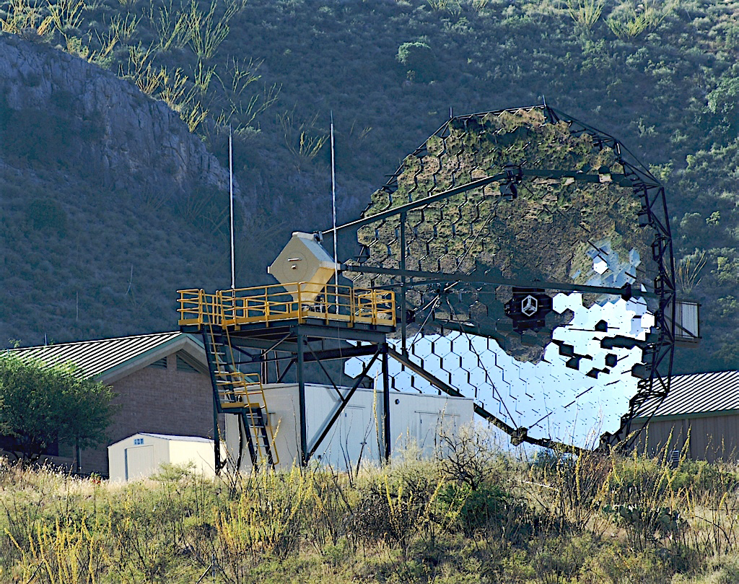
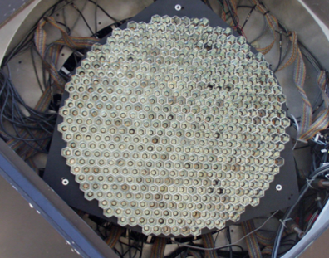
VERITAS
Situated at 1250m altitude at the Whipple Observatory near Tucson
111m² tessellated mirror
Recoated every ~2 years
499 PMTs with lightcones
500 MHz sampling FADCs
3-level trigger
12m
3.5°

Slide 5
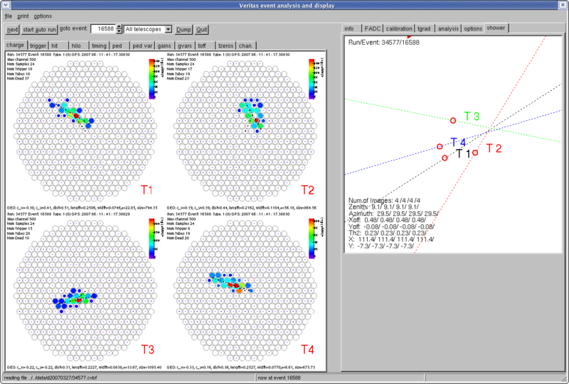
Data
Arrival direction from the sky
Core position on the ground
PMT signals digitized
With 500MSPS FADCs

Slide 6
VERITAS: Fall 2007
Smithsonian Astrophysical Observatory
Purdue University
Iowa State University
Washington University in St. Louis
University of Chicago
University of Utah
University of California, Los Angeles
McGill University, Montreal
University College Dublin
University of Leeds
Adler Planetarium
Argonne National Laboratory
Barnard College
DePauw University
Bartol Research Institute/ University of Delaware
Grinnell College
University of California, Santa Cruz
University of Iowa
University of Massachusetts
Cork Institute of Technology
Galway Mayo Institute of Technology
National University of Ireland Galway
~25 Associate Members

Slide 7
VERITAS: Fall 2009
Smithsonian Astrophysical Observatory
Purdue University
Iowa State University
Washington University in St. Louis
University of Chicago
University of Utah
University of California, Los Angeles
McGill University, Montreal
University College Dublin
University of Leeds
Adler Planetarium
Argonne National Laboratory
Barnard College
DePauw University
Bartol Research Institute/ University of Delaware
Grinnell College
University of California, Santa Cruz
University of Iowa
University of Massachusetts
Cork Institute of Technology
Galway Mayo Institute of Technology
National University of Ireland Galway
~25 Associate Members

Slide 8
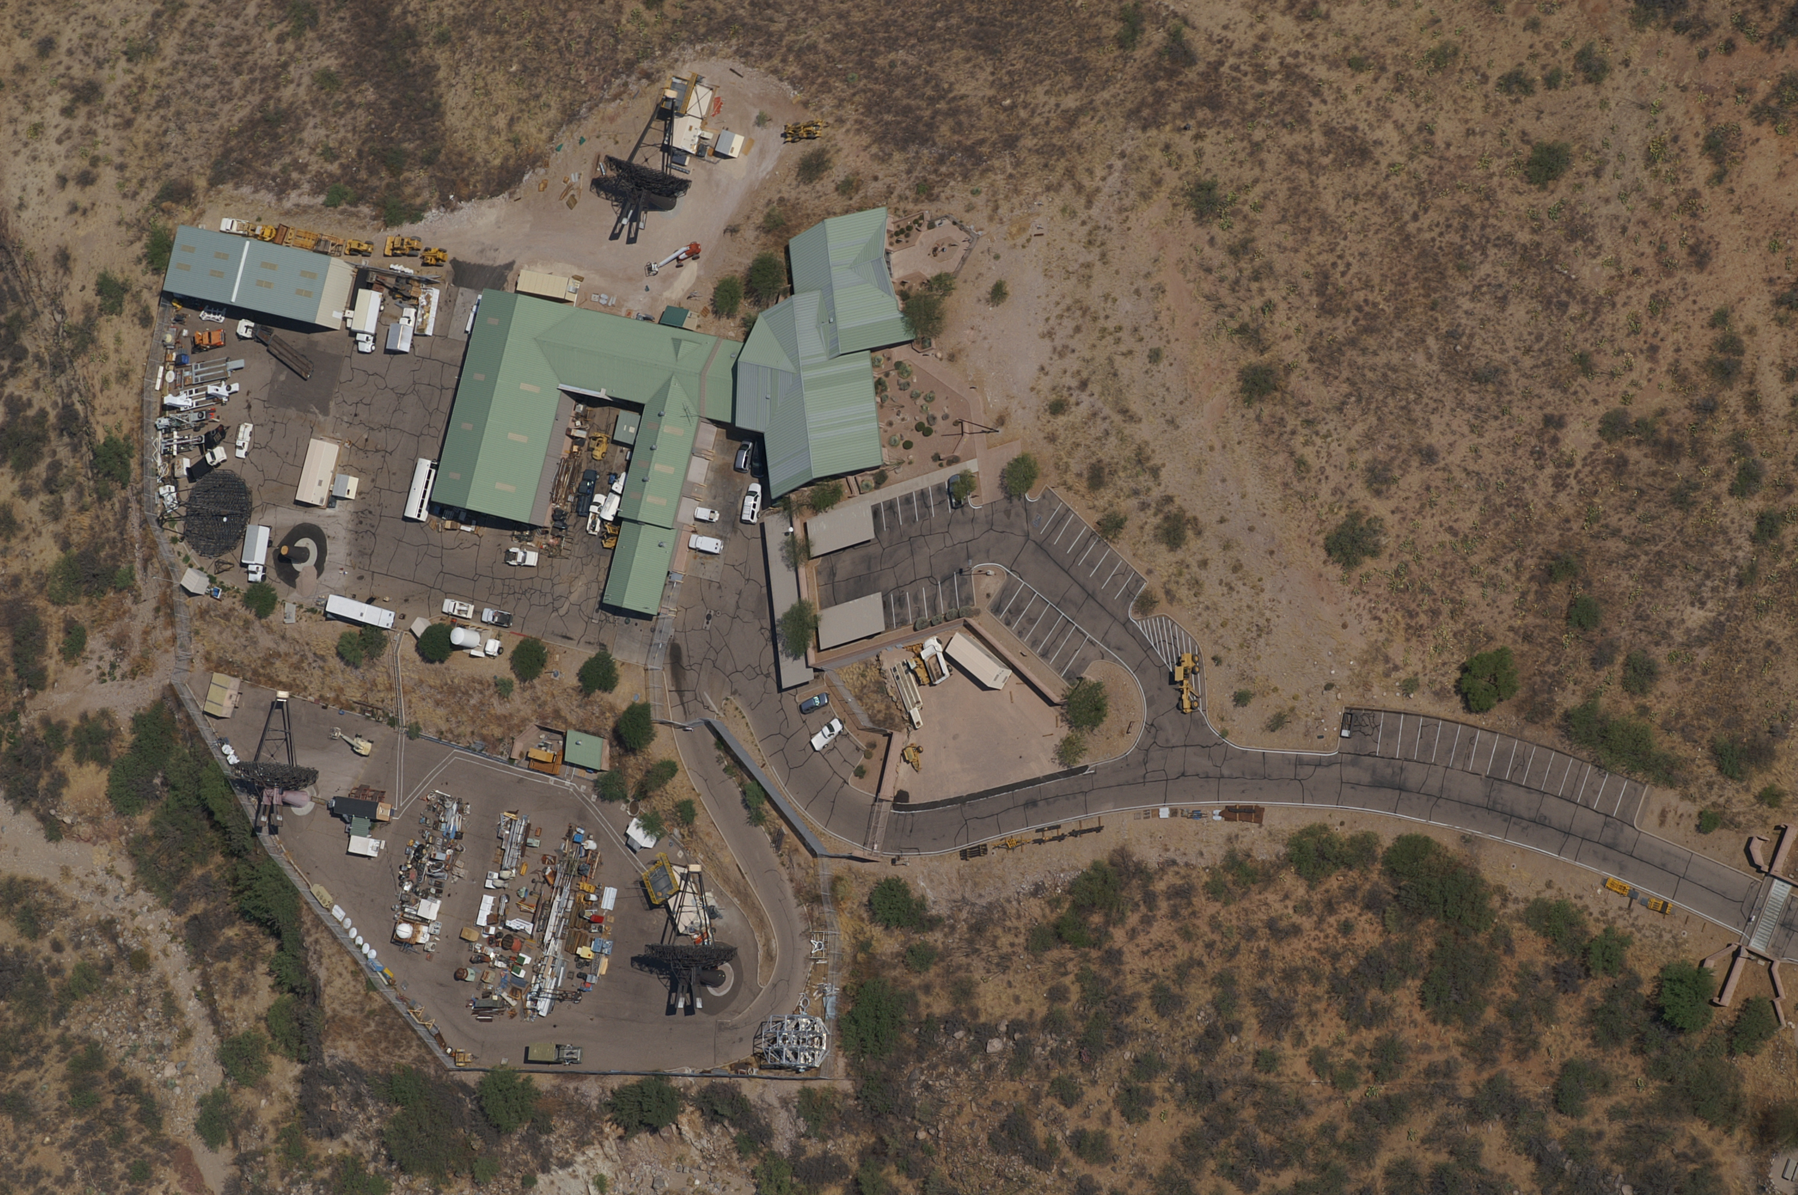
T3
Fall 2006
T4
Spring 2007
108m
T1
Spring 2005
T2
Spring 2006

Slide 9
T3
Fall 2006
T4
Spring 2007
T1 relocated
Fall 2009
T2
Spring 2006

Slide 10
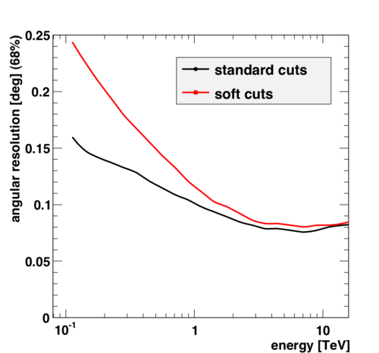
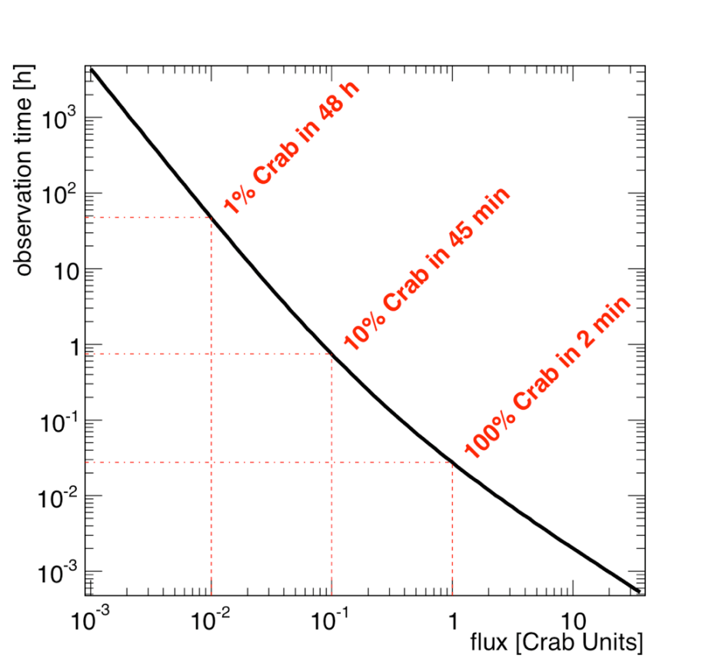
VERITAS Technical Performance
Sensitivity improved from 1% Crab in 50 hours to 1% Crab in 30 hours
Currently the most sensitive in the world;
Recently received MRI-R² funding for a further upgrade.
Angular resolution ~0.1° (68% containment)

Slide 11
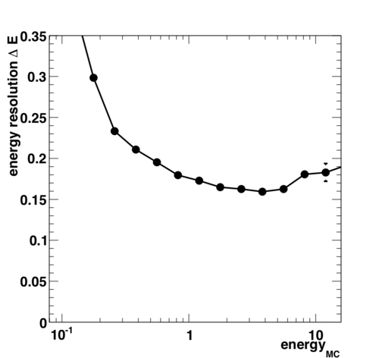
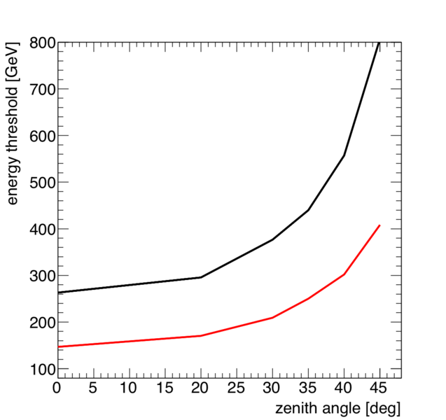
VERITAS Technical Performance
Energy resolution ~15-20% >300GeV
Energy threshold ~150 GeV

Slide 12
VERITAS Skymap
30 Sources in 6 Source Classes
(including Tycho’s SNR!)
tevcat.uchicago.edu

Slide 13
VERITAS Sky Survey
Cygnus Survey
HESS Survey
Location based on material distribution and density of potential TeV γ-ray emitters. Size based on FOV, duty cycle and sensitivity.

Slide 14
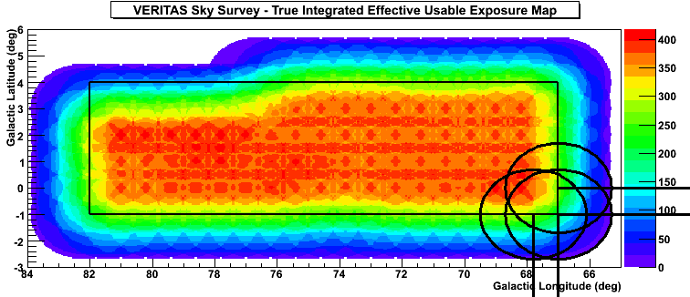
VERITAS Sky Survey II
1.75˚
Exposure Map
2007-2009, 112 base hrs with 56 hrs of follow-up studies
Cygnus Region Coverage: 67˚ < l < 82˚, -1˚ < b < 4˚
4 pre-defined cut-sets (hard/soft, point-like/extended)
Depth: <3% Crab above 200 GeV [99% CL] for point-like sources

Slide 15
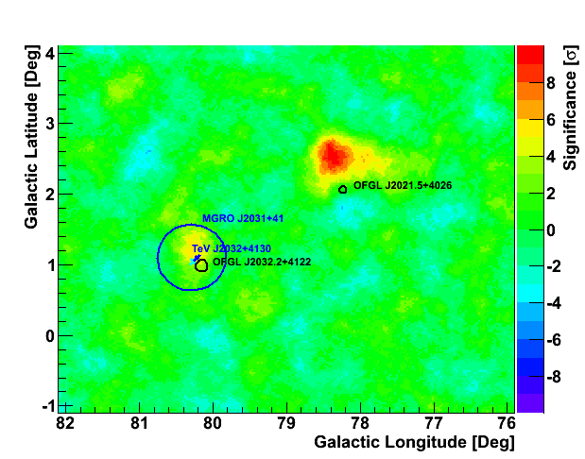
One Particularly Interesting Region
Significance Map
Subset of Survey
Hard/Extended cuts
TeV J2032+4130
Known source, first detected by HEGRA
Possible Associations:
CYG OB2
MGRO J2031+41
1FGL J2032.2+4127/0FGL J2032.2+4122
VERITAS Detection is >5σ at nominal position (no trials)
New Source!
VER J2019+407
PRELIMINARY

Slide 16
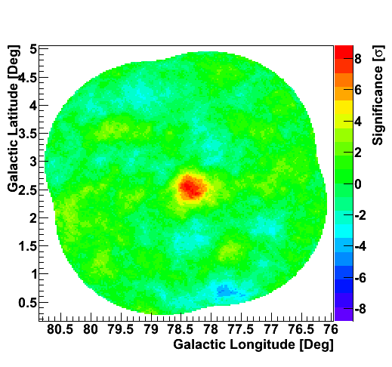
VER J2019+407
Significance Map
Early Follow-up candidate
Independent data set from Fall 2009 confirms existence of a new source at ~7.5σ.
Preliminary Flux level above 1 TeV: ~ 3% Crab
Preliminary Extension:
~0.2˚ Symmetric Gaussian Fit
PRELIMINARY

Slide 17
VER J2019+407 II
N
VERITAS Excess Map
Peak in NW corner of G78.2+2.1 (γ-Cygni)
Distance ~ 1.5 – 1.8 kpc
Age ~ 5-10 kyr
TeV Mechanism?
Is it the PWN of Fermi PSR J2021+4026?
Is it shock-matter interactions?
CO? Lots to the SE, not as much in the NW.
Partial HI shell to NW?
Shock overtaking cavity wall?
PRELIMINARY
LAT PSR J2021+4026
W
PSF
Ladouceur &
Pineault 2008
Black Contours –1.4 GHz (CGPS)

Slide 18
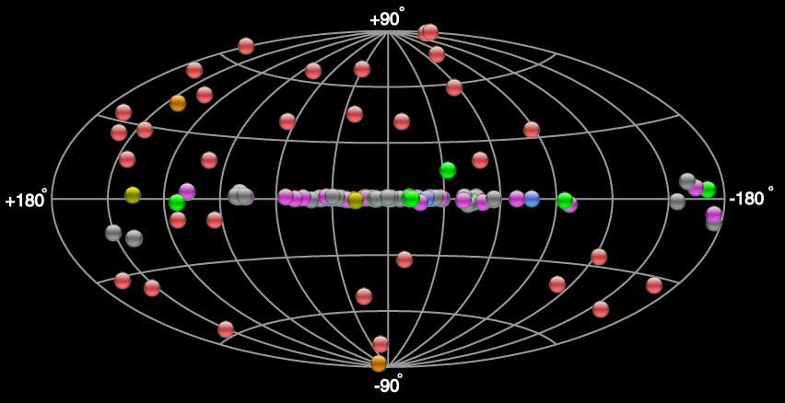
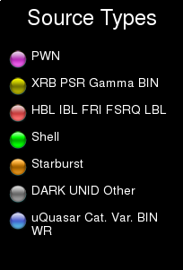
The TeV Sky, circa June 2010

Slide 19
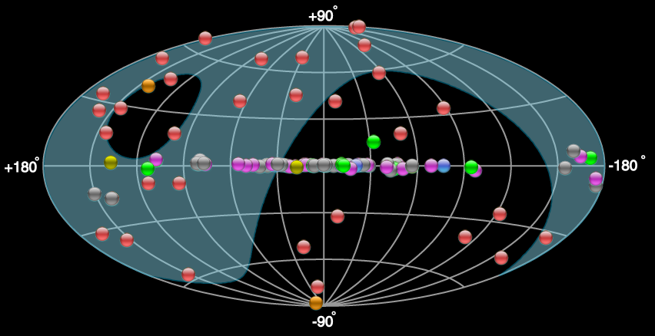
The TeV Sky, circa June 2010

Slide 20
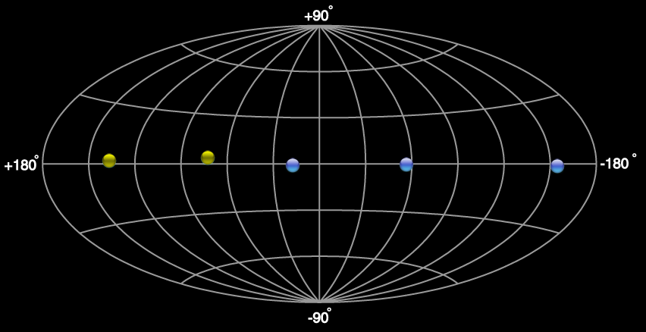
+ Eta Car?
Gamma-ray
Binaries
Cyg X-3
LS 5039
Cen X-3
LS I + 61 303
Cyg X-1
PSR B1259-63
HESS J0632+057

Slide 21
Why are these few so interesting?
Binaries are the only variable galactic TeV sources
They are natural particle accelerators operating under varying, but regularly repeating, environmental conditions
Provide a constraining laboratory for models of particle acceleration, and gamma-ray production, emission and absorption processes
May provide the keys to an understanding of astrophysical jets
Each system is unique – and the population, as well as the data quality, is increasing

Slide 22
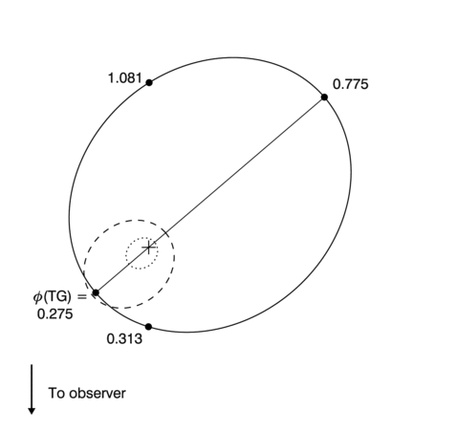
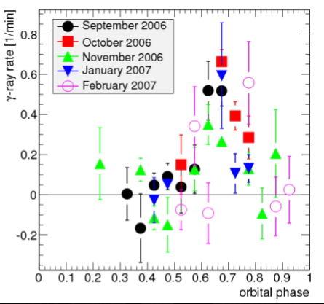
LS I +61° 303
Compact object (Black hole or Neutron star) orbiting an B0Ve companion (12M)
26.5 day, inclined orbit, e=0.54, circumstellar disk
extended radio structures; microquasar? but radio imaging shows morphology modulated by orbital position; pulsar wind.
Whipple limits, detected by MAGIC, then VERITAS (8.4σ, Γ=2.4±0.16_{stat}±0.2_{sys})
Strong emission only detected near apastron (ϕ=0.5-0.8)
Superior
conjunction
VERITAS
Apastron
0.7 AU
Peri-
astron
0.1 AU
Inferior
conjunction
Aragona et al. ApJ 2009

Slide 23
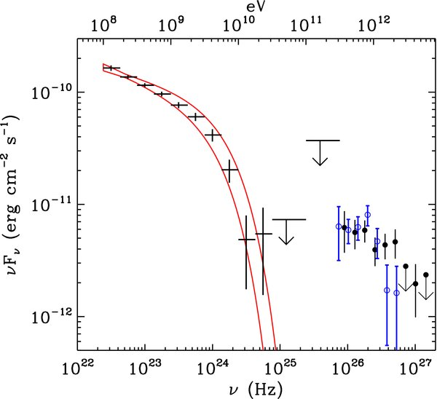
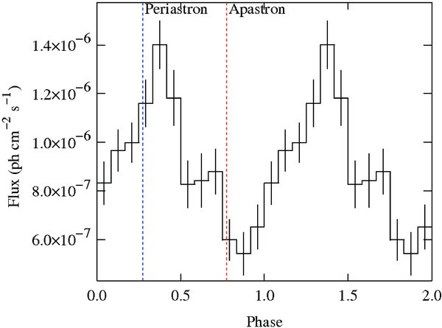
LS I +61° 303
Superior
conjunction
Apastron
0.7 AU
Detected by Fermi-LAT (BSL)
Orbital modulation well measured
Emission peaks near periastron
Cut-off at 6 GeV observed between LAT and TeV - but not contemporaneous data
Peri-
astron
0.1 AU
Inferior
conjunction
Aragona et al. ApJ 2009
Fermi
Fermi
MAGIC/VERITAS

Slide 24
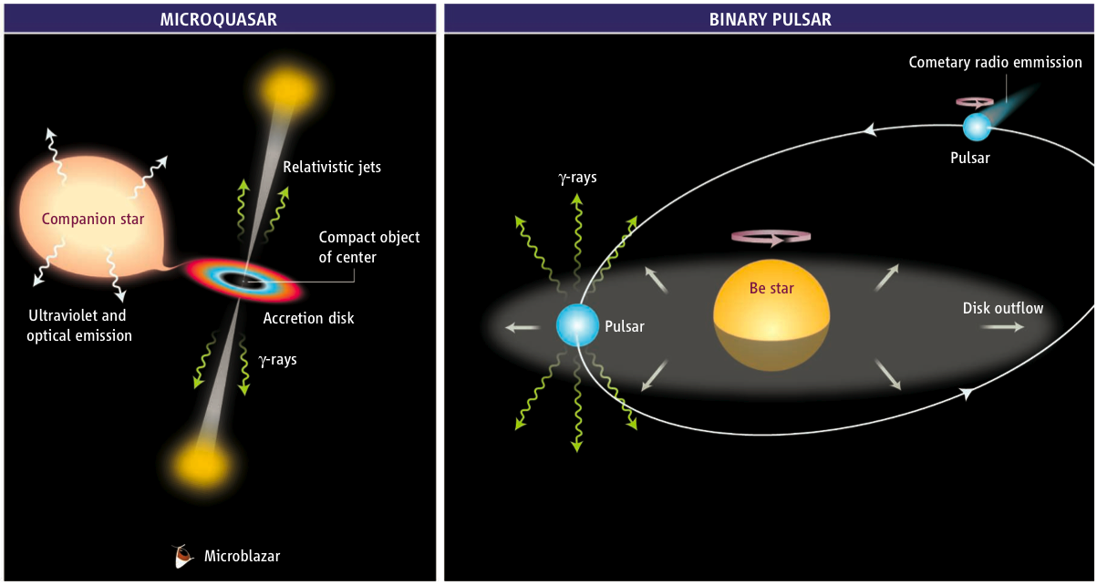
What’s going on?
Accretion powered
Wind-driven
Mirabel (Science 309, 714, 2006)

Slide 25
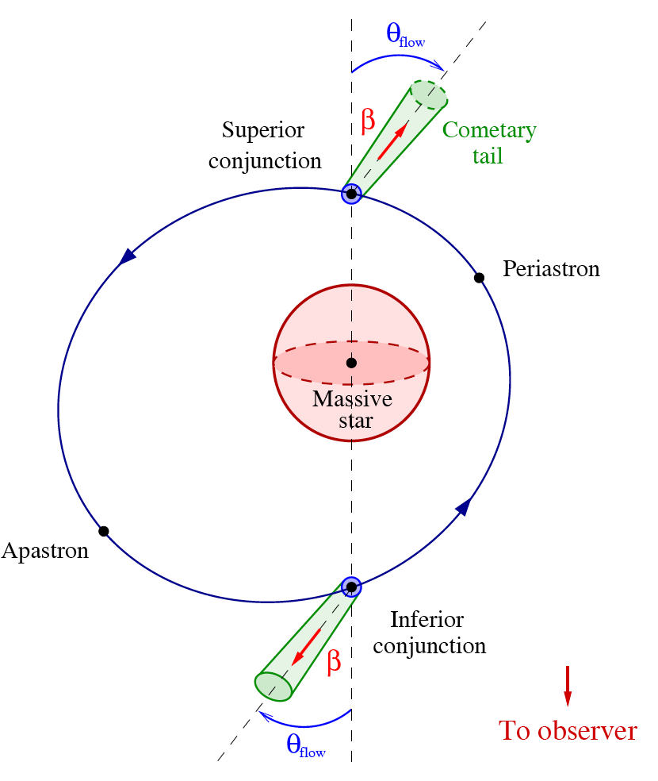
LS I +61° 303
Superior
conjunction
Apastron
0.7 AU
Competing processes
Assuming Inverse Compton production -> high energy electrons boost stellar photons to gamma-ray energies
At superior conjunction, Inverse Compton production peaks over all energies
At superior conjunction, photons > 30 GeV are most heavily absorbed
Doesn’t fit the lightcurves very well
Moderate Doppler boosting helps
Why is there a 6 GeV cut-off?
Different mechanism for GeV and TeV?
GeV emission spectrum looks like a pulsar – but then why is the GeV emission modulated at all? Where are the pulses?
Peri-
astron
0.1 AU
Inferior
conjunction
Aragona et al. ApJ 2009
Dubus et al,
2010

Slide 26
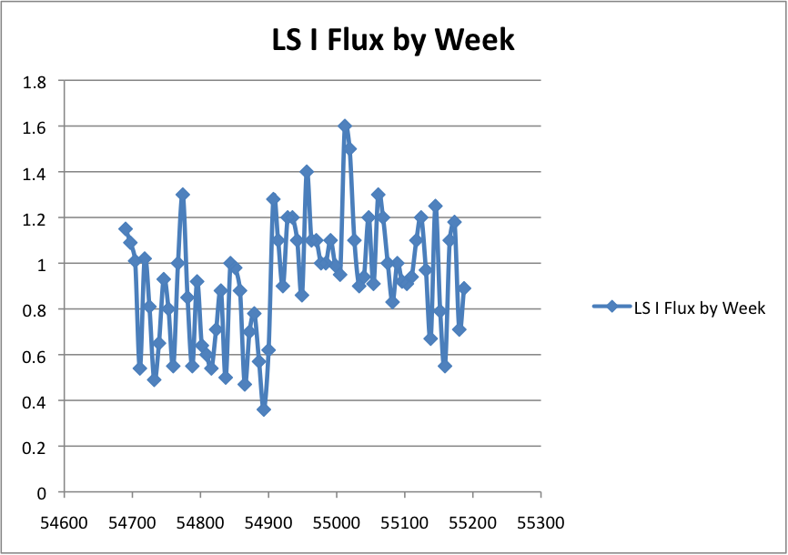
LS I +61° 303
Contemporaneous observations complicate things further
No detection by VERITAS since the launch of Fermi, despite good exposure around apastron – but poor sampling…
New FERMI result (Richard Dubois)
No orbital modulation since March 2009 flux increase!!!
Is it “weather”? Are there longer-term cycles? More data needed!!
2008-2009
covers almost a complete orbit
5% Crab
2009-2010
deep exposure near apastron
5% Crab
MJD

Slide 27
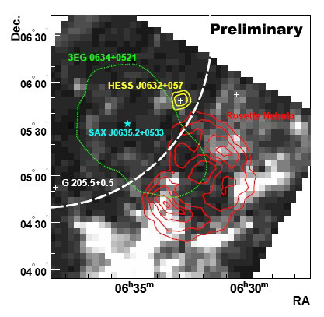
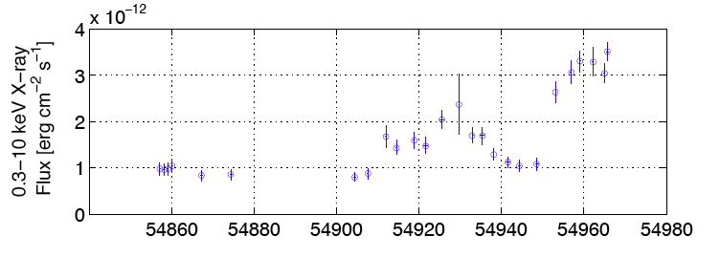
HESS J0632+057
Unidentified TeV HESS source in the Galactic plane (Γ=2.53, Flux~3% Crab)
A rare unresolved source (<2’)
VERITAS non-detection (2006 -2009) implied gamma-ray variability
MWL follow-up shows a hard spectrum X-ray source (Γ=1.2 – 1.9) & faint radio source coincident with a B0pe star (MWC148). Not a Fermi source.
Swift measures long term variability
Falcone et al. ApJ 2010
Swift

Slide 28
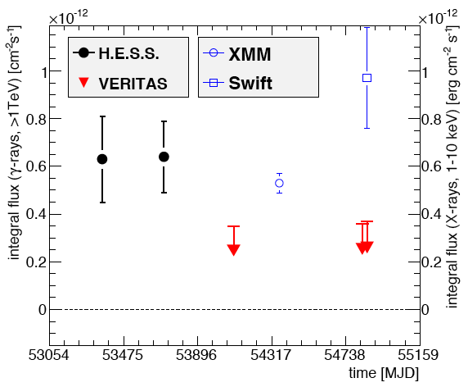
HESS J0632+057
Unidentified TeV HESS source in the Galactic plane (Γ=2.53, Flux~3% Crab)
A rare unresolved source (<2’)
VERITAS non-detection (2006 -2009) implied gamma-ray variability
MWL follow-up shows a hard spectrum X-ray source (Γ=1.2 – 1.9) & faint radio source coincident with a B0pe star (MWC148). Not a Fermi source.
Swift measures long term variability
Falcone et al. ApJ 2010
Swift

Slide 29
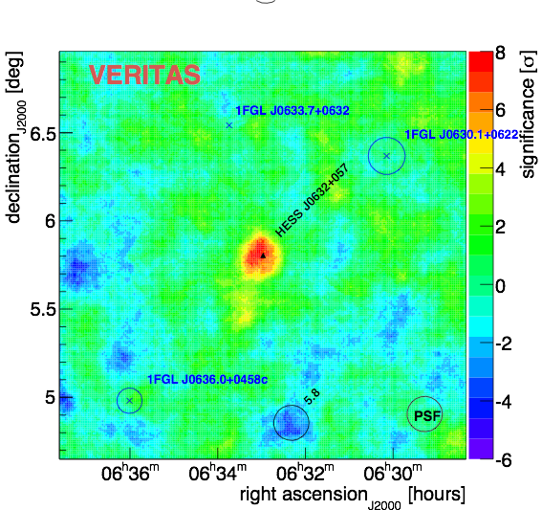
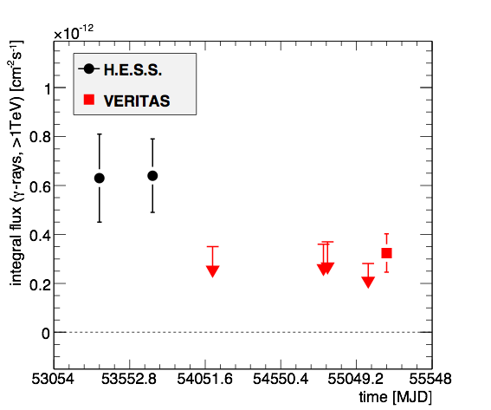
HESS J0632+057
Recent observations show a clear VERITAS detection, at ~50% of the original H.E.S.S. flux (Gernot Maier, Jeff Grube)
Position agrees with HESS J0632+057 and MWC 148
More data needed! Is it a TeV binary? Detection of orbital modulation at any wavelength would be definitive.
preliminary
preliminary
Feb/March 2010

Slide 30
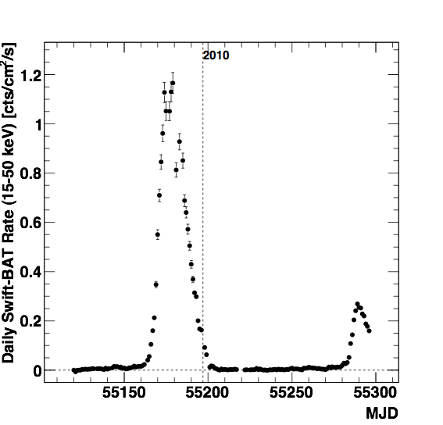
1A0535+262
HMXB, Be-star and X-ray pulsar (PSpin=104s)
Orbital period 110 d, eccentric orbit (e= 0.47)
Distance 2.4±0.4 kpc
Hard X-ray spectra; non-thermal particle populations
Giant outbursts every ~5 years since 1975
VHE emission?: Cheng & Ruderman mechanism; VHE maximum expected about 10-20 days after X-ray flare (Orellana & Romero 2004)
~5 crab
But: no detailed modeling for VHE emission, no flux prediction, SED, etc.

Slide 31
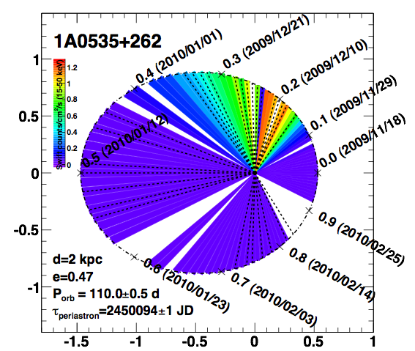
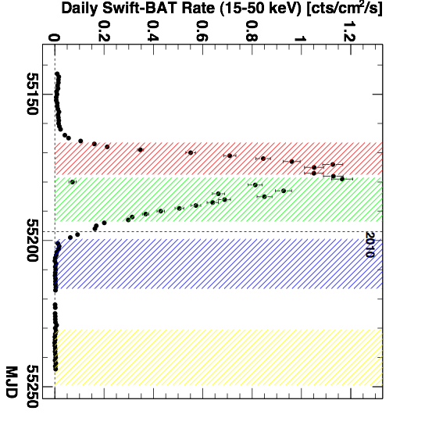
1A0535+262
Dec 2009: ToO triggered on flaring Be/X-ray binaries
23 hours of data with VERITAS, all high elevations: mean ~70º
Good coverage of flare phase (rising/falling edge), apastron and periastron approach
Flare occurred at best time for VERITAS

Slide 32
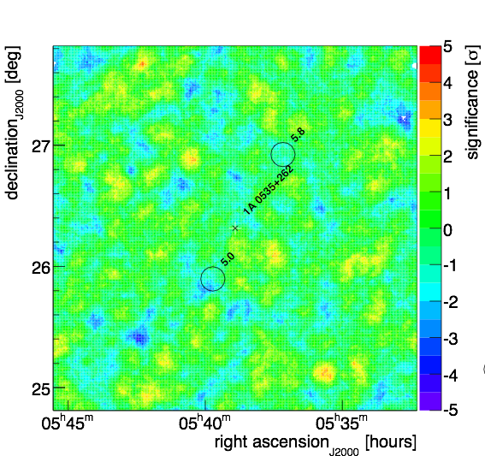
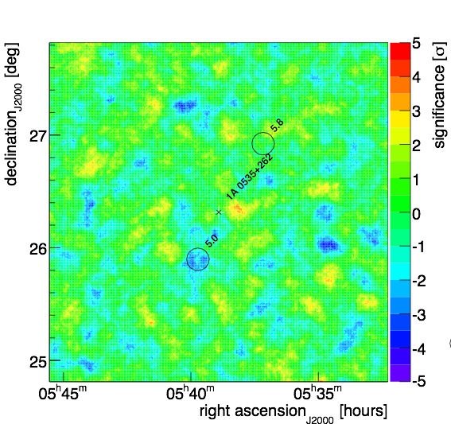
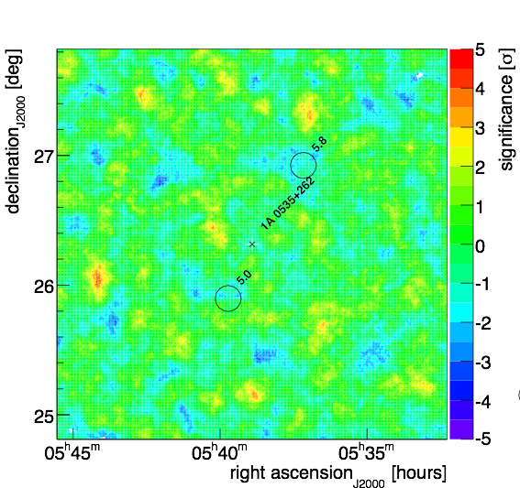
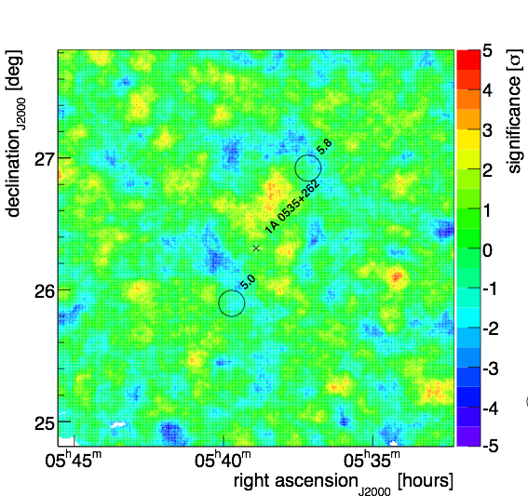
1A0535+262
Flare - rising
Flare - falling
Results still in prep. (Gernot Maier, Angelo Varlotta)
5-8 hours of VERITAS observations in each bin
No VHE emission detected
99% flux upper limits above 300 GeV: 0.5-2% Crab Nebula flux
Lots of data at other wavelengths available
Definitive results with this generation of IACTs
preliminary
preliminary
Apastron
Periastron approach
preliminary
preliminary

Slide 33
Summary
VERITAS is operating well
both surveying and pointed observations have been fruitful, but galactic time is limited. Pointing is the most efficient, especially post-Fermi.
Gamma ray binaries continue to surprise
LSI +61 303 is among the largest VERITAS datasets (~100 hours total)
Not detected in VHE since the Fermi launch, despite reasonable apastron coverage with a much more sensitive instrument
HESS J0632+057 is a variable TeV and X-ray source
VERITAS now confirms the detection
Definitive measurement of 1A0535+262 during a flare state.

Slide 34
Open Questions
Given the constraints on galactic observations with VERITAS, What should we look at?
Binaries:
Is LSI+61303 definitely a pulsar/ Be star wind-driven system?
What are the true observational characteristics of the system?
How to explain these observations with fewest assumptions?
What is HESS J0632+057?
Where are the other binaries? Why no LMXRBs at TeV?

Slide 35
