Slide 1
Massive Stars as the Progenitors of (long) Gamma-Ray Bursts
Davide Lazzati (NCSU)

Slide 2
Outline
Prehistory
History
Modern Age
Future

Slide 3
Prehistory
Woosley 1993 “Gamma-Ray Bursts from stellar mass accretion disks around black holes”
Paczynski 1998 “Are Gamma-Ray Bursts in star forming regions?”

Slide 4
History: Middle Ages
Era of indirect evidence
Host Galaxies
Star forming environments
Location of explosion
Environment density & density profile
Iron lines
GRB980425 - SN1998bw

Slide 5
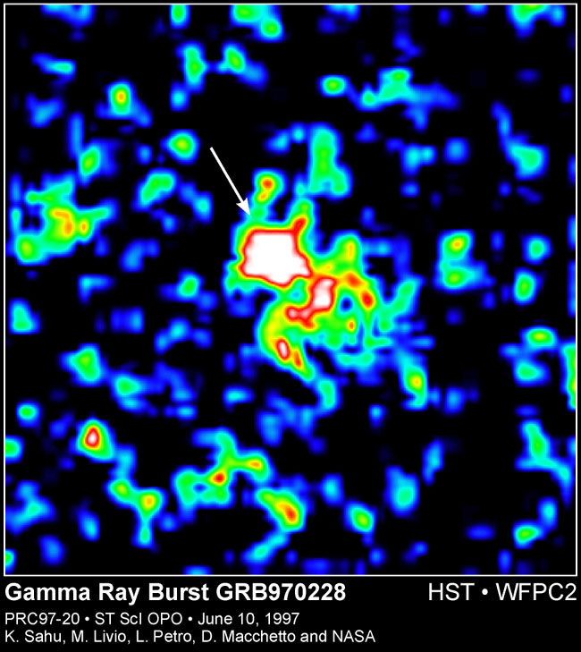
History: Middle Ages
Host Galaxies

Slide 6
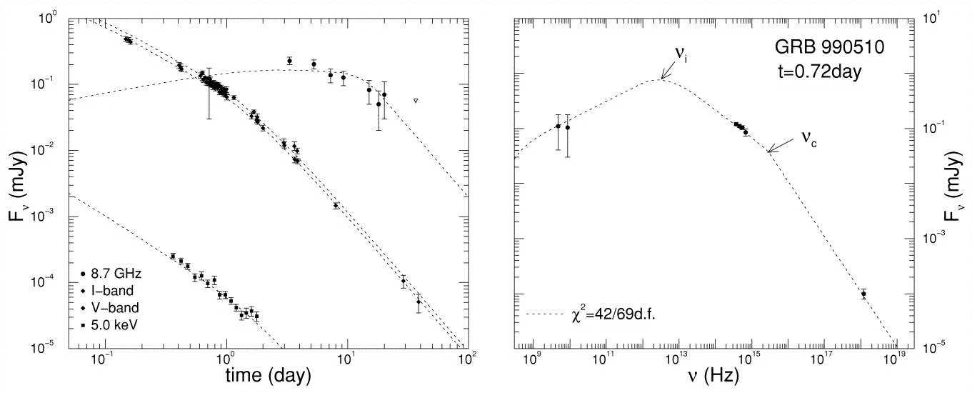
History: Middle Ages
Environment density & density profile
Panaitescu & Kumar 2001

Slide 7
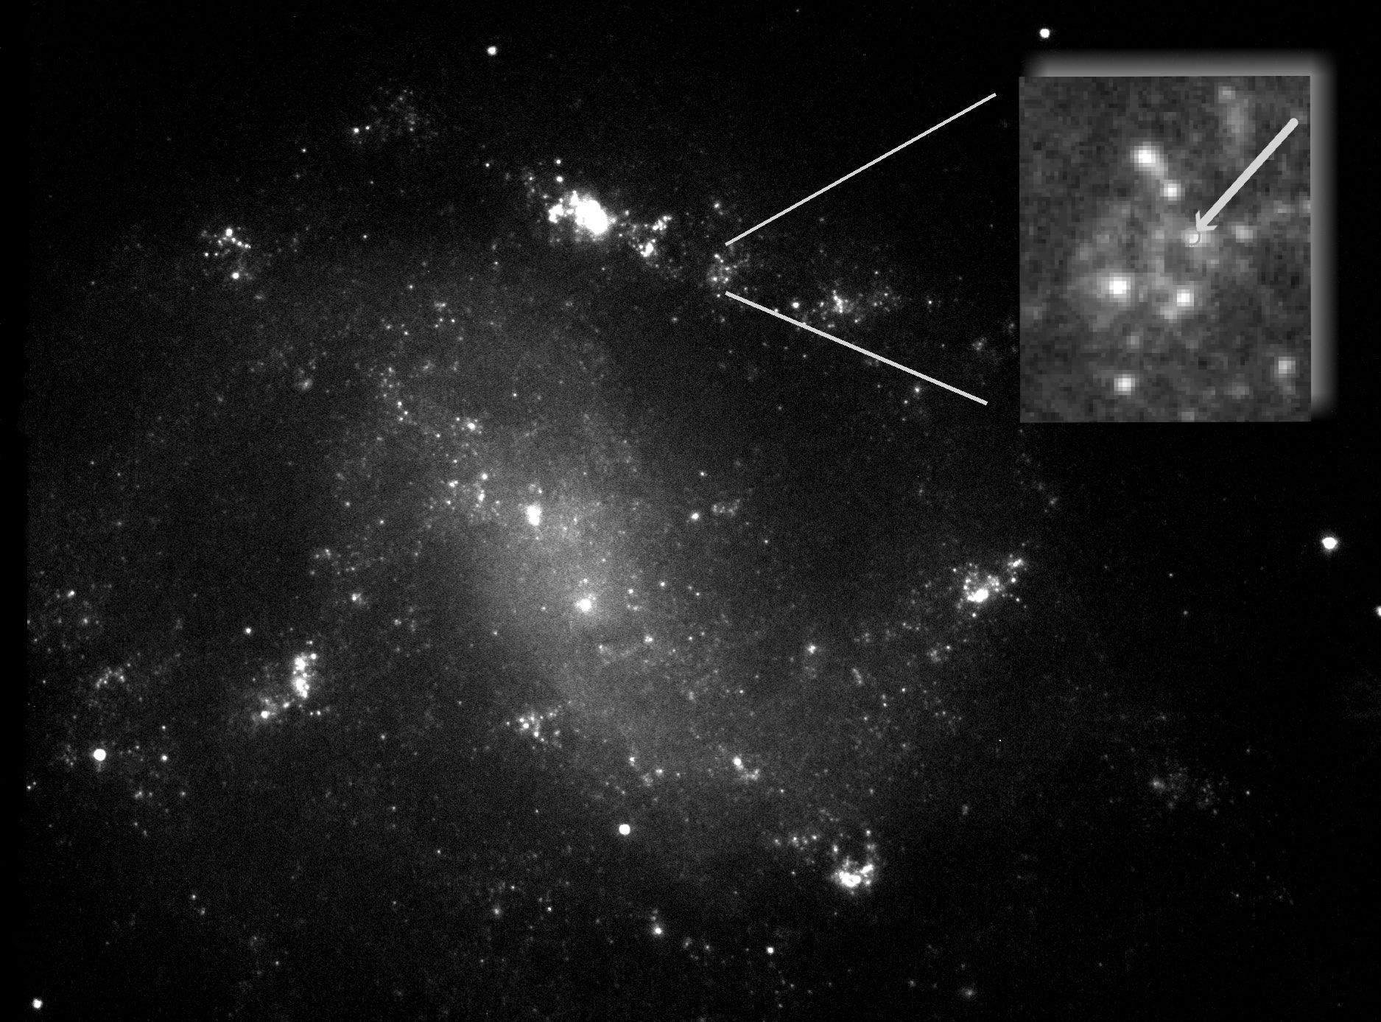
History: Middle Ages
GRB98045 - SN1998bw
Holland et al. 2002

Slide 8
History: Renaissance

Slide 9
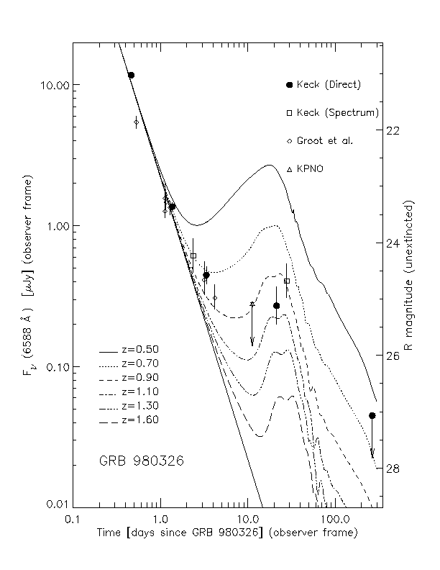
History: Renaissance
SN Bumps
Bloom et al. 1999

Slide 10
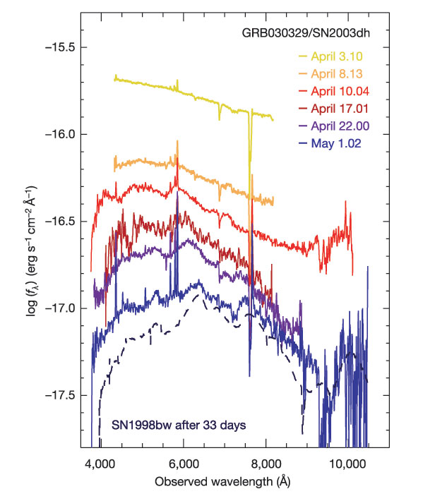
History: Renaissance
GRB030329-SN2003dh
Hjorth et al. 2003
(also Stanek et al. 2003)

Slide 11
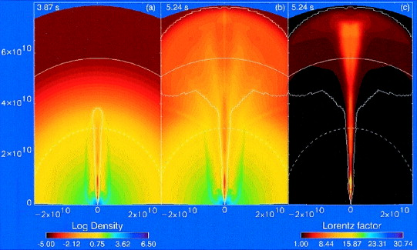
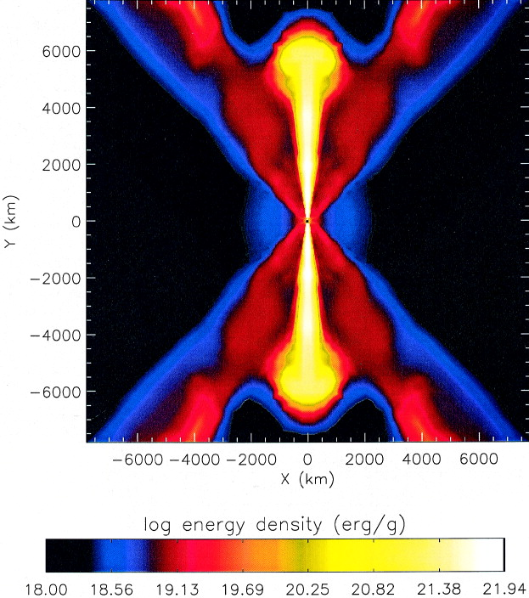
History: Renaissance
MacFadyen & Woosley (1999) and Aloy et al. (2000)

Slide 12
Modern Era

Slide 13
Modern Era: setting the stage
At least some long-duration GRBs are associated to the explosion of massive compact stars.
The two events are coeval to within less than 1 day.
If we release relativistic energy in the core of a massive compact star, we can get a relativistic jet outside of it.

Slide 14
Do all long GRBs have SNe?
Every time we can see one we do see it
But we cannot see SNe at z>1, where most GRBs are observed
At least two long durations GRBs with no SN, but probably misclassification or evidence that the long-short classification is not physical
“No SN” does not necessarily implies “no stellar progenitor” (⁵⁶Ni production issue, see next talk by S. Nagataki)

Slide 15
Nature of the central engine
Two main candidates: Black Hole Accretion Disk system, Magnetar.
All require rotation
How to tell?
Evidence of BH-Sne
e.g. SN1979C, SN2009kf
Associated NRO (Non-Relativistic Outflow) and implications on nucleosynthesis (better seen in No-GRB SNe)
Pre-explosion progenitor properties and/or or late-time engine emission
Very energetic events

Slide 16
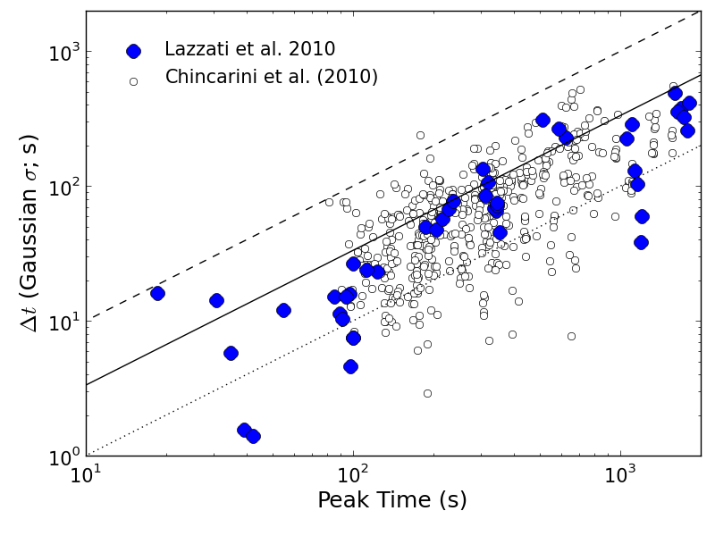
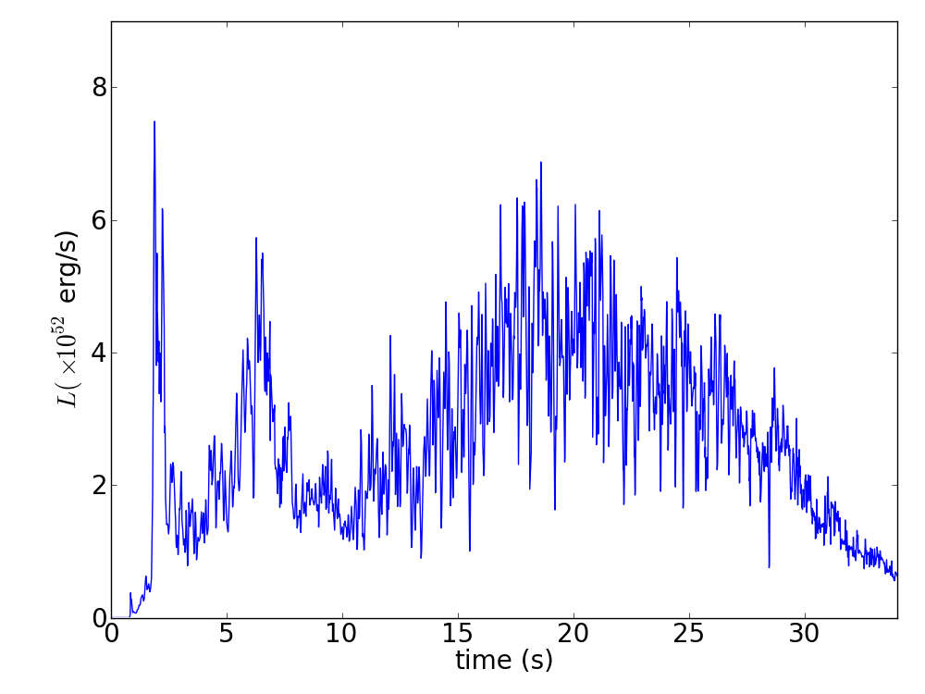
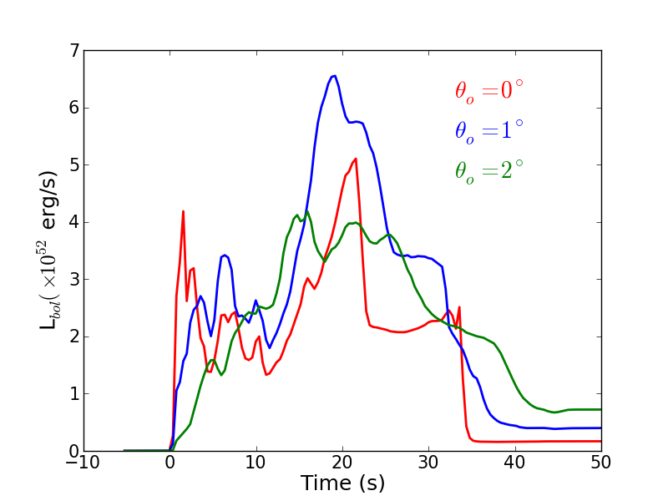
Consequences on the GRB
Morsony et al. 2010
Some 10⁵¹ erg of the true energy are lost in drilling the star
Opening angle evolution
Variability
Increased photospheric emission
X-ray flares
Morsony et al. 2007
Lazzati et al. in prep.

Slide 17
How many WR stars/type Ibc SNe produce GRBs? Why some do and some don’t?
GRBs rate ~1% of type Ibc SNe, 0.2% of all CCSNe (Podsiadlowski et al. 2004, Soderberg et al. 2010)
Special ingredient 1: rotation (for formation of BH)
Special ingredient 2: low metallicity (to keep angular momentum)
Special ingredient 3: binarity? (Controversial)
Best constraints from observations, still too many uncertainties on the theoretical side. Most models predict only a few per cent of SNe to be associated to a GRB

Slide 18
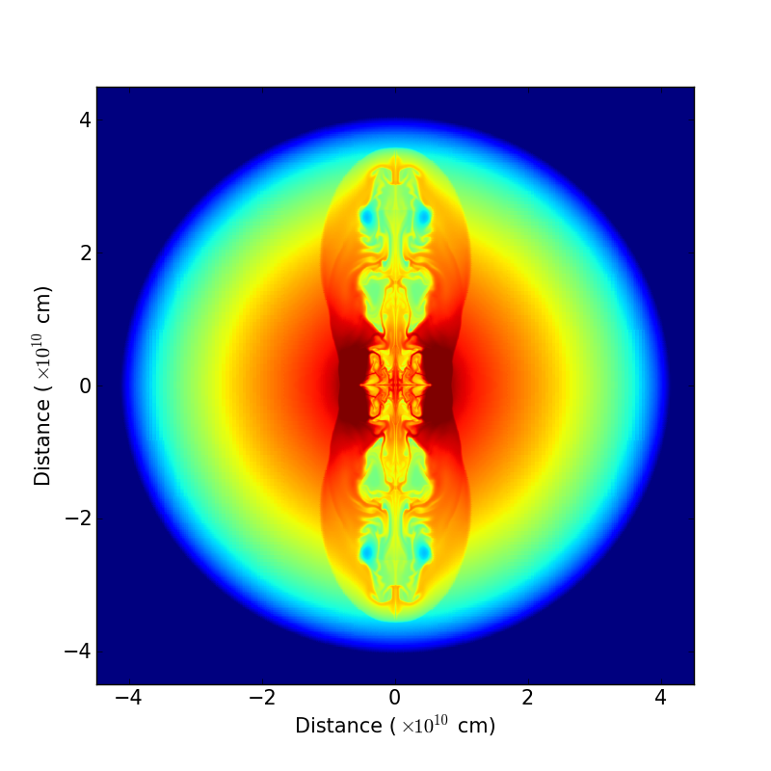
Massive stars & BROs
BROs = Bipolar Relativistic Outflows
Apparently
Normal SN
Any time
E<=10⁵¹ erg
t<4 s
10% of Ibc???
Successful GRB
When engine lasts long enough (t>5 s)
~1% of Ibc
980425-like
Faint GRB
Radio-Bright SN
When the engine barely fails to break out (4<t<4.5s)
~1% of Ibc
When the engine barely makes it to breakout (4.5<t<5 s)
~1% of Ibc
Rates from Podsiadlowski et al. 2004; Guetta & Della Valle 2007;
Soderberg et al. 2010

Slide 19
BROs-induced SNe
ρ
v

Slide 20
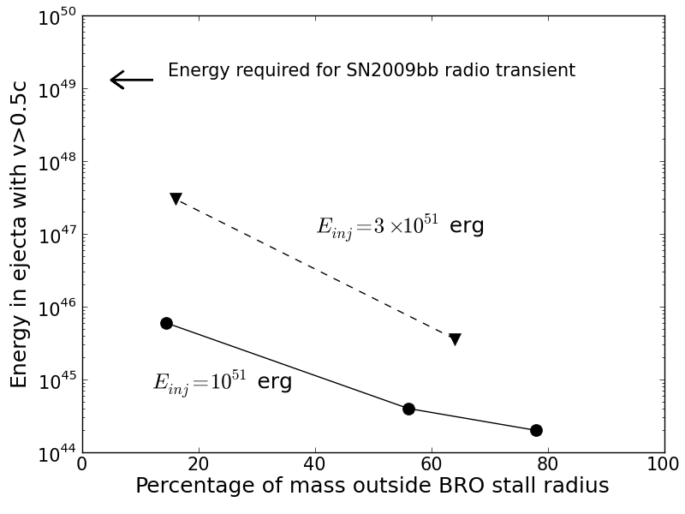
BROs-induced SNe
None of 5 simulations succeeded in reproducing SN2009bb
E_{inj}=10⁵¹ erg
t=1, 3, 6 s
E_{inj}=3x10⁵¹ erg
t=1, 3 s
Lazzati et al. in prep.

Slide 21
BROs-induced SNe
Producing a 2009bb-like SN requires fine tuning
All SNe with detectable BRO effects amount to ~3% of Ibc SNe
Models for the origin of BROs predict only a few per cent (<1%) Ibc with BROs
Are BROs SNe relevant cosmologically (e.g. for heavy elements inventory?)

Slide 22
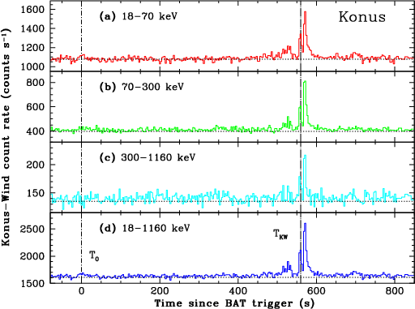
Riddles
GRB 060124
Precursors
Why are short and long GRBs so similar to each other?
Where are the winds?

Slide 23
Conclusions
What are the BROs engines, how they come about, how many of them?
Better observational features to select BROs SNe
Better stellar evolution models to explain high incidence of engines in stripped massive stars
Better engine models (especially for the BH-AD case)

Slide 24
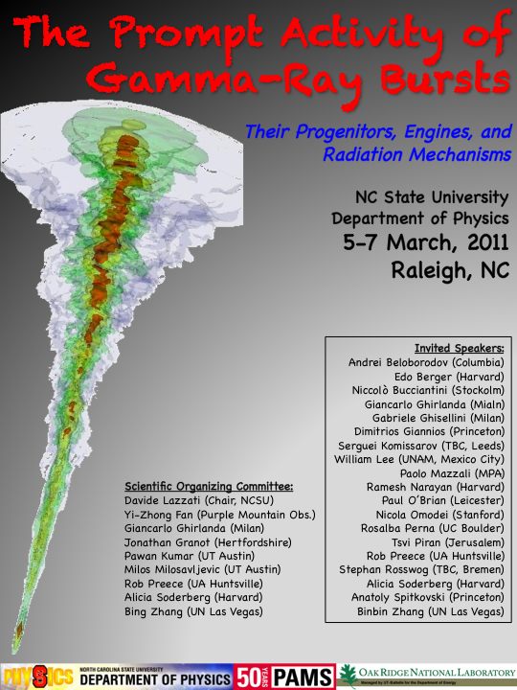

Slide 25
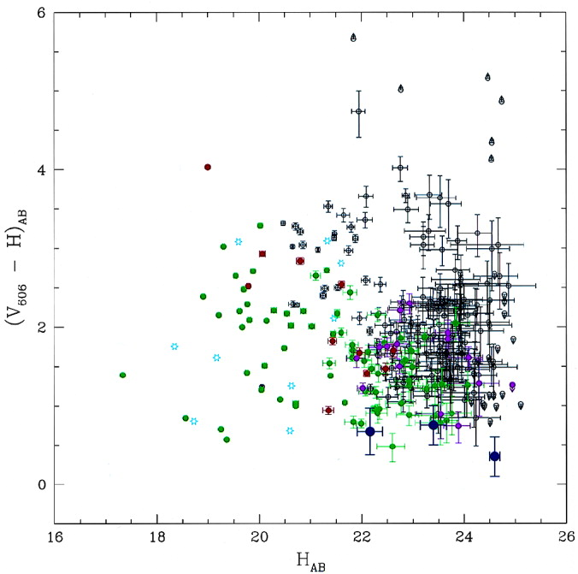
History: Middle Ages
Star forming
environments
Hogg & Fruchter 1999

Slide 26
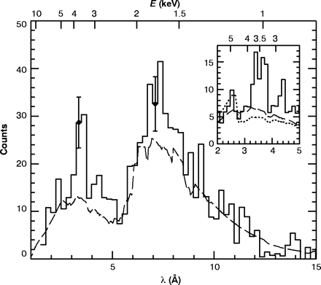
History: Middle Ages
Iron lines
Piro et al. 2000

Slide 27
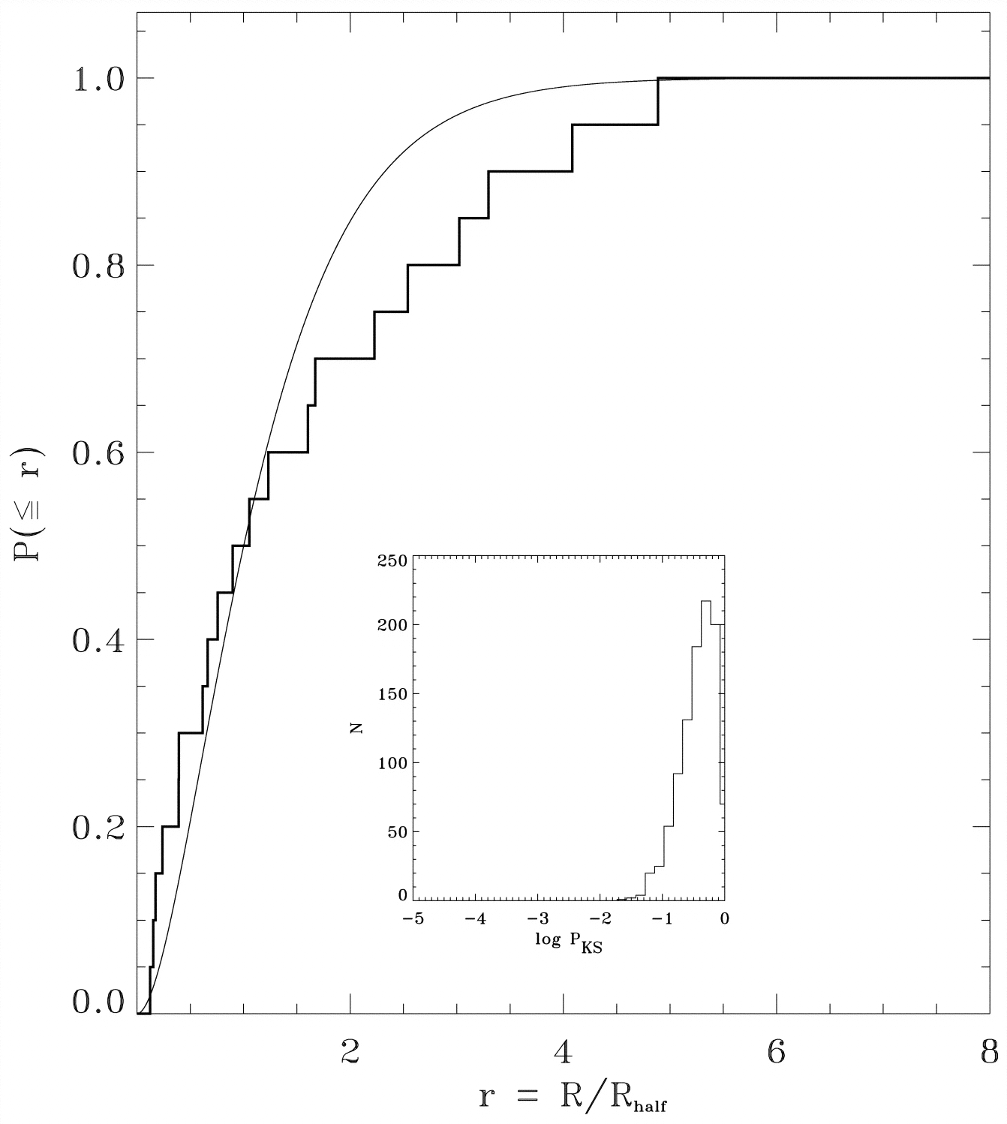
History: Middle Ages
Location of explosion
Bloom et al. 2002

