Slide 1
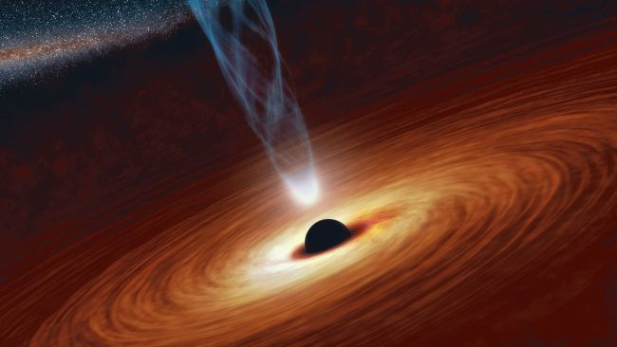
Studying emission mechanisms of AGN
©NASA
Dr. Karsten Berger
Fermi School, June 2013

Slide 2
Motivation

Slide 3
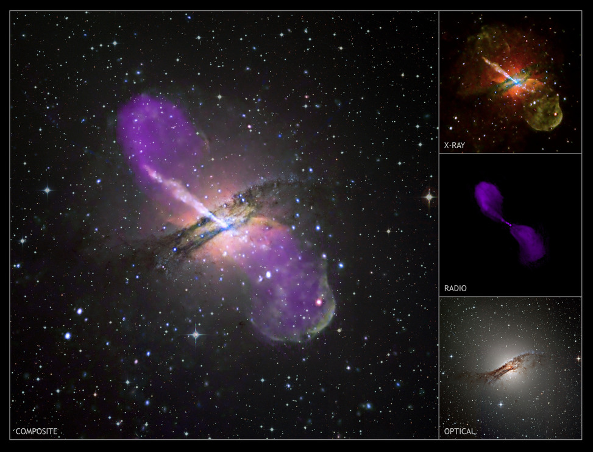
Cen A

Slide 4
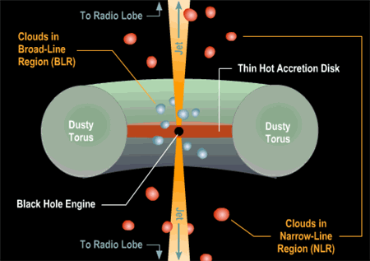
What is an AGN made of?

Slide 5
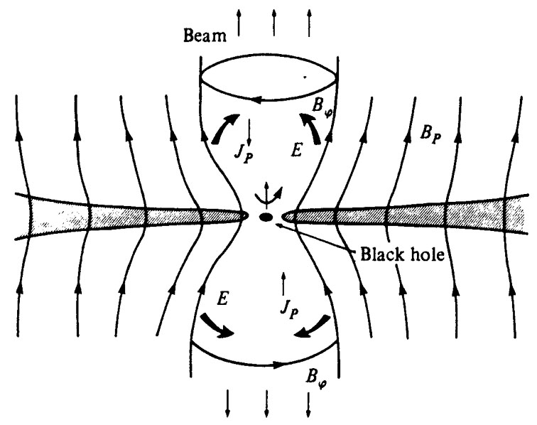
Blandford-Znajek process
Remember: black holes don‘t have hairs!!!

Slide 6
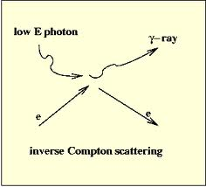
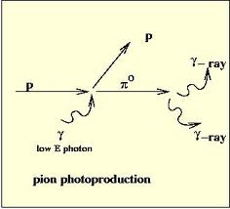
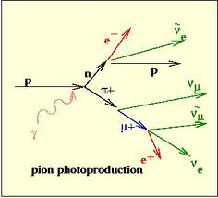
Which particles dominate in the jet?
For simplicity: usually only leptons are considered in the models
Should include protons, and thus also Muons, Pions…
Synchrotron radio from e+/e-, µ+/µ-
Inverse compton, external compton
Pion decay…
The exact jet composition is still under study

Slide 7
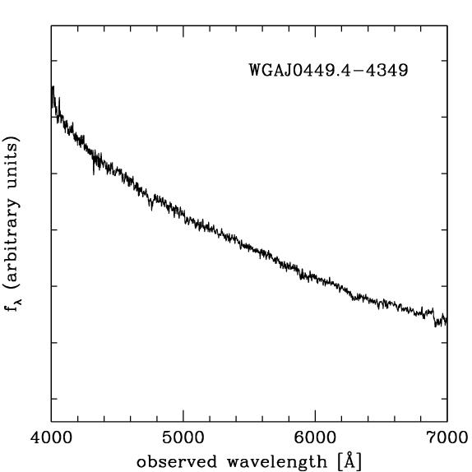
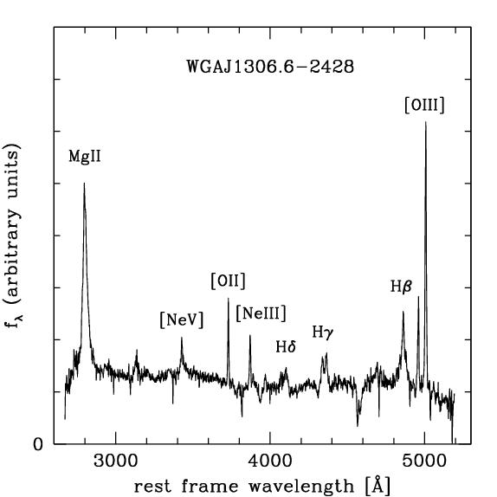
Two Blazar classes
BL Lac object
Flat spectrum radio quasar

Slide 8
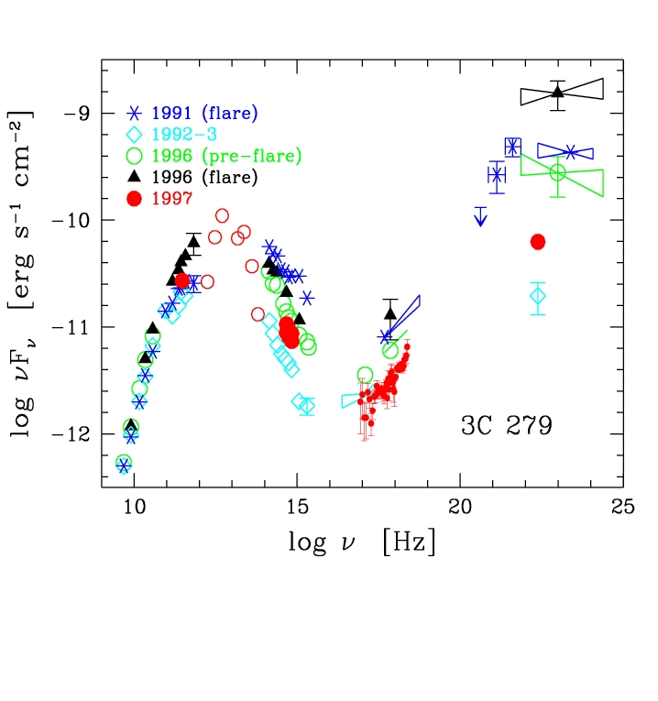
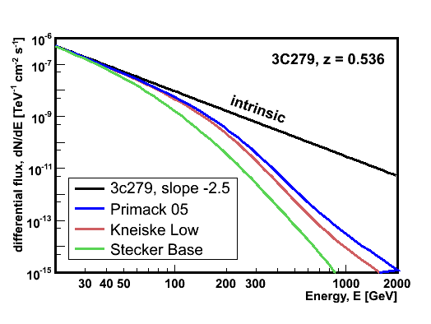
3C279 (z = 0.536)
Flat spectrum radio quasar (FSRQ)
Brightest AGN detected by EGRET (but see Fermi)
Very strong flares in 1991 and 1996
low states in 1992 and 1997
Variable on a scale of ~100
Apparent luminosity ~ 10⁴⁸ erg/s
Fast time variation ΔT ~ 6hr in 1996
Strong absorption in
very-high-energy (VHE): E_{γ} > 100 GeV:
VHE discovery by MAGIC in 2006
Second flare in 2007
Wehrle et al. 1998
x100

Slide 9
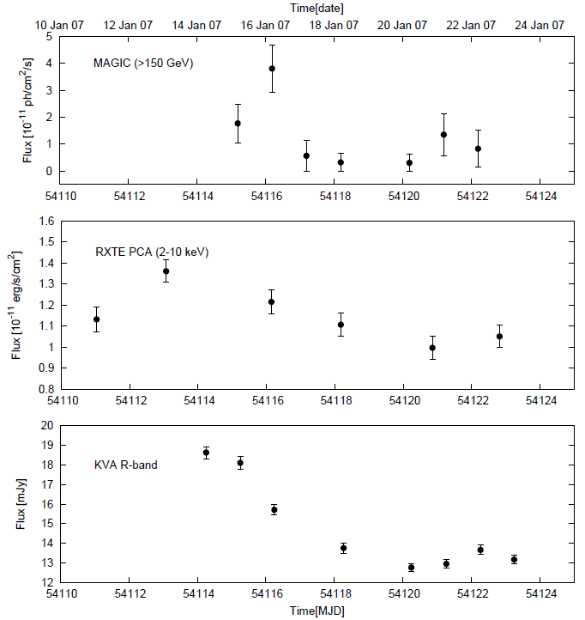
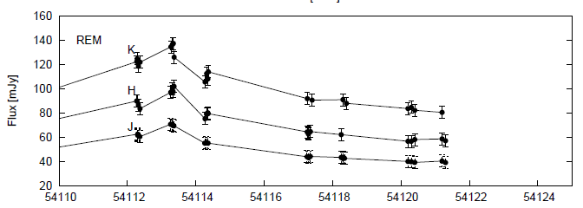
Light curve 2007:
Again no direct
correlation, but
delayed emission.
Different emission
regions?

Slide 10
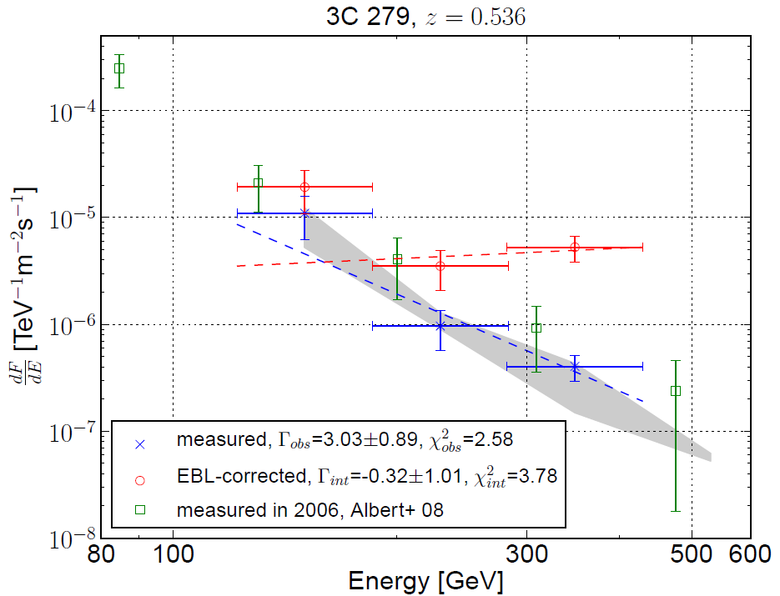
Spectrum 2007
Very hard spectrum confirmed, photon index consistent with 2006 observations within errors (grey band corresponds to varying cut efficiencies)

Slide 11
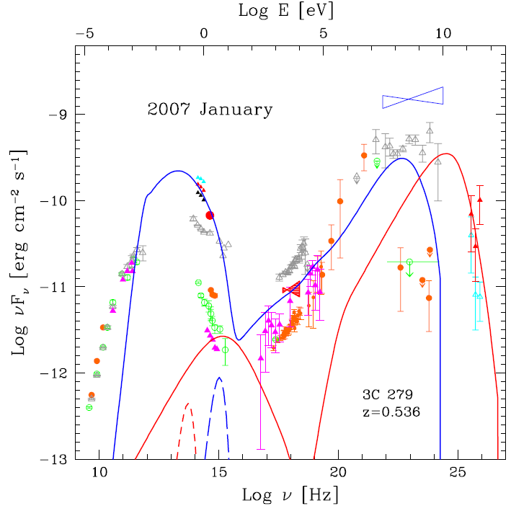
SED 2007: two zone SSC model
Unfortunately no FERMI data yet
Blue line: emission inside the BLR
Red line: external compton emission outside the BLR
Pro: acceptable fit to the data, VHE emission region outside of dense photon fields: no problems with absorption
Con: twice the number of model parameters, more freedom

Slide 12
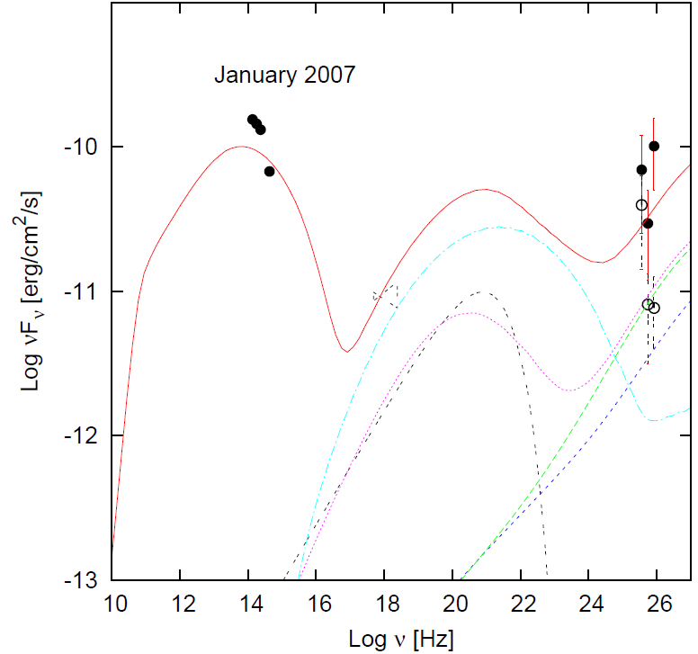
SED 2007: lepto-hadronic model
Considers not only leptons but also protons in the jet
Synchrotron emission from electrons/protons
γ-rays from pion decay (p-p-collisions)
Pro: can also reproduce the data
Con: again large number of free parameters, many emission components

Slide 13
Model results
Results are rather different depending on the model
A general trend: hadronic models have lower B and higher doppler factors
This leaves us the problem that we still cannot precisely determine the physical properties in the AGN, since several solutions are viable
More observations are needed, especially short term variability can help

