Slide 1
Search for TeV Emission from Geminga by VERITAS
Payel Kar
University of Utah
Fermi Summer School 2013

Slide 2
Geminga
Its is close about 200pc
First detected >20MeV by SAS-2 and then in X-rays by CosB
Period detected by EGRET to be about 237 ms
EGRET also measured the period derivative from which the age was calculated to be 300,000 years

Slide 3
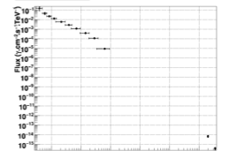
Energy Spectrum of Geminga
Pulsed radio emission from Pushchino Radio Observatory at 102.5MHz
X-Rays in XMM-Newton
High Energy Gamma in LAT
VHE in MILAGRO

Slide 4
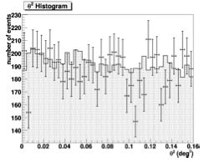
Histogram of squared angular distribution of ON phase and OFF background
ON-OFF data is consistent, no significant excess
Notes:
The data from the wobble mode obser- vations were analyzed using a point source analysis using the reflected region background method (Aharonian et al. 2001) and the ring background method (Berge et al. 2007). A significance is determined using the likelihood ratio method from

Slide 5
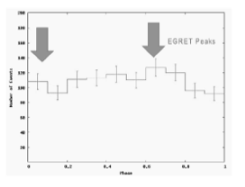
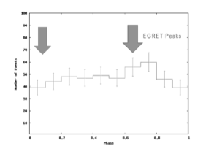
Periodicity analysis , similar to steady point source analysis done on same data.
Histogram of the phase distribution for all ON events in the data.
Notes:
Figure 5 shows a histogram of the phase distribution for all ON events in the data. Figure 6 is similar to Figure 5 but for energies less than 200 GeV.
The arrows represent the peak locations in the EGRET phase plot. No correlation was found with the VERITAS data and the pul- sar phase distribution of Geminga.

Slide 6
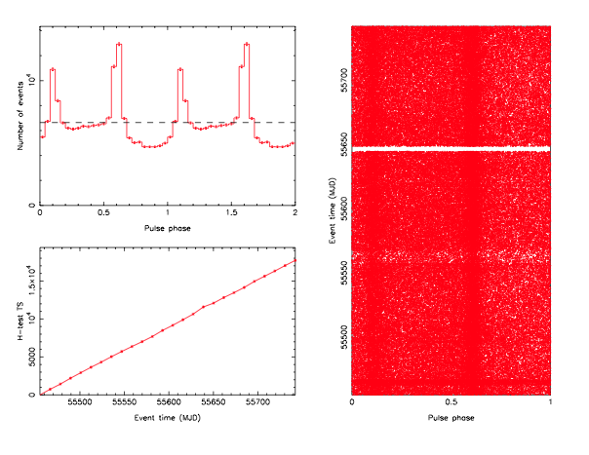
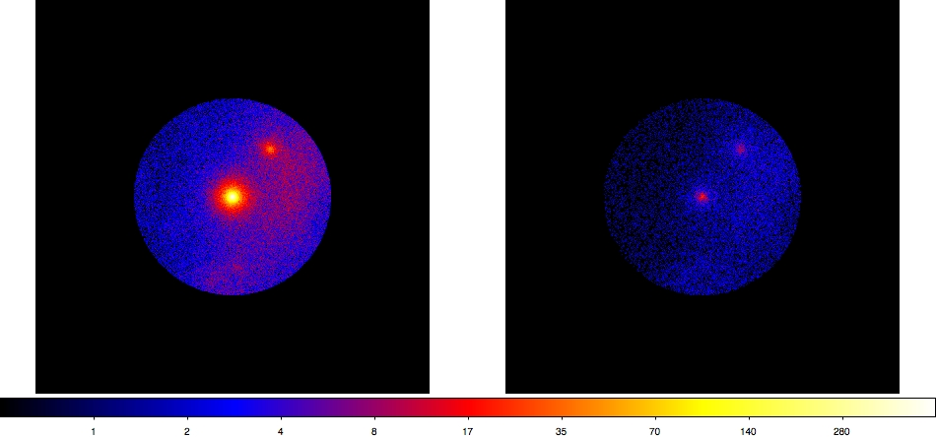
Thank You for your attention

