Slide 1
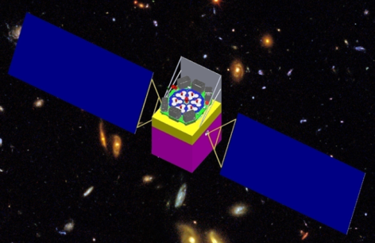

中国科学院高能物理研究所
INSTITUTE OF HIGH ENERGY PHYSICS
Constraints on the cross-section of dark matter annihilation from Fermi observation of M31
Zhengwei Li
Payload working Group of HXMT

Slide 2
Evidence of dark matter
Rotation curve of galaxy
van Albada et al. (1985)
Structure formation
Gravitational lensing
Clowe et al. (2006)
Cosmological measurement (WMAP7)

Slide 3

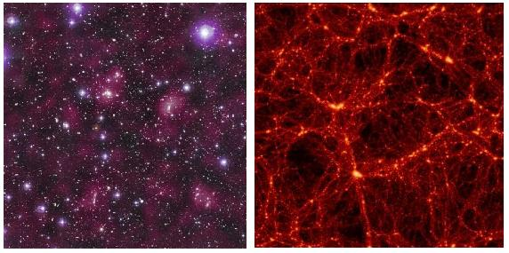
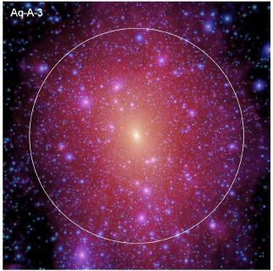
中国科学院高能物理研究所
INSTITUTE OF HIGH ENERGY PHYSICS
Dark matter structure (observation + simulation)
Large scale baryon distribution traces dark matter distribution.
Springel et al. 08
STAGES: Abell901/902
At galactic level, dark matter distribution is in the form of extended halo, with sub and sub-sub halos (hierarchy).

Slide 4

中国科学院高能物理研究所
INSTITUTE OF HIGH ENERGY PHYSICS
Beyond standard particle physics: no matching standard particles
Gondolo, P. (TeVPA08)

Slide 5
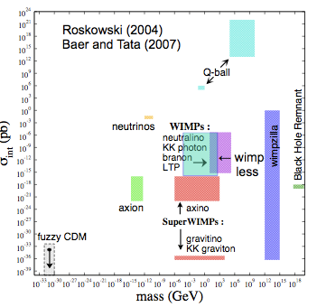
中国科学院高能物理研究所
INSTITUTE OF HIGH ENERGY PHYSICS
Particle candidate of dark matter

Slide 6
中国科学院高能物理研究所
INSTITUTE OF HIGH ENERGY PHYSICS
Detection of particle dark matter

Slide 7

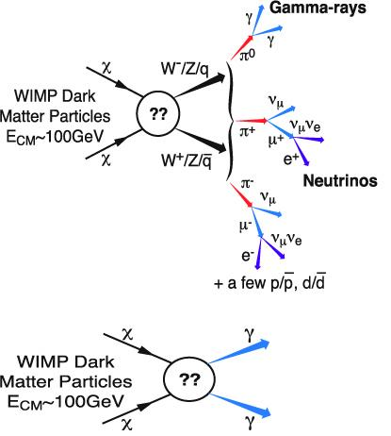
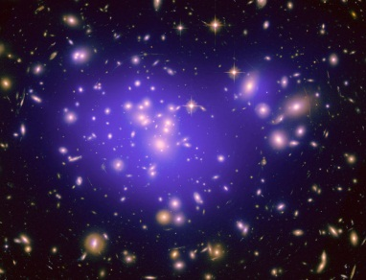
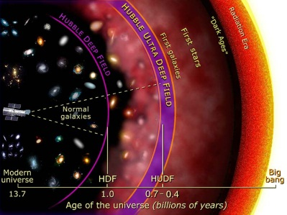
中国科学院高能物理研究所
INSTITUTE OF HIGH ENERGY PHYSICS
Indirect detection of dark matter
Sun
Galaxy
Cluster
Deep extragalactic space and early Universe
Baltz et al. 2008

Slide 8



中国科学院高能物理研究所
INSTITUTE OF HIGH ENERGY PHYSICS
Annihilation scenario of dark matter
Observed flux:
particle physics factor (from DM particle model)
density distribution (from gravitational observation and/or numerical simulation)
J-factor:

Slide 9
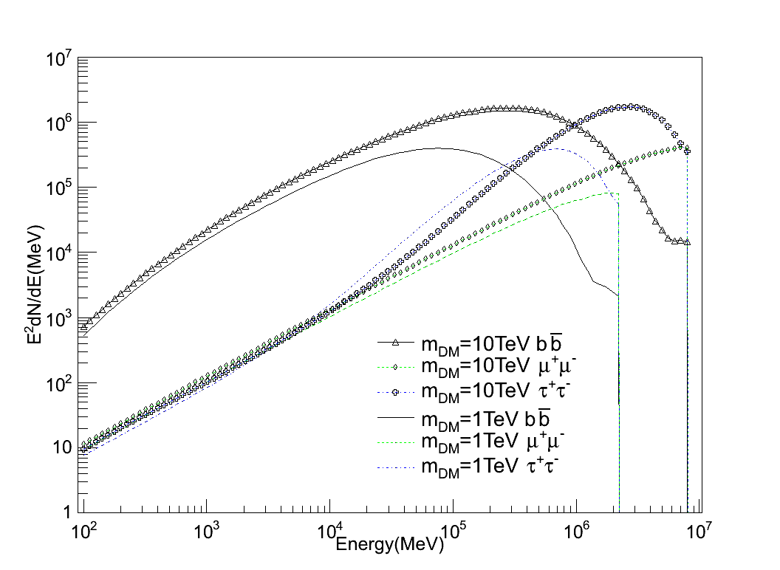
中国科学院高能物理研究所
INSTITUTE OF HIGH ENERGY PHYSICS
Some preliminary work
Final state radiation
No Inverse compton scatter
Cut-off at mass of dark matter

Slide 10
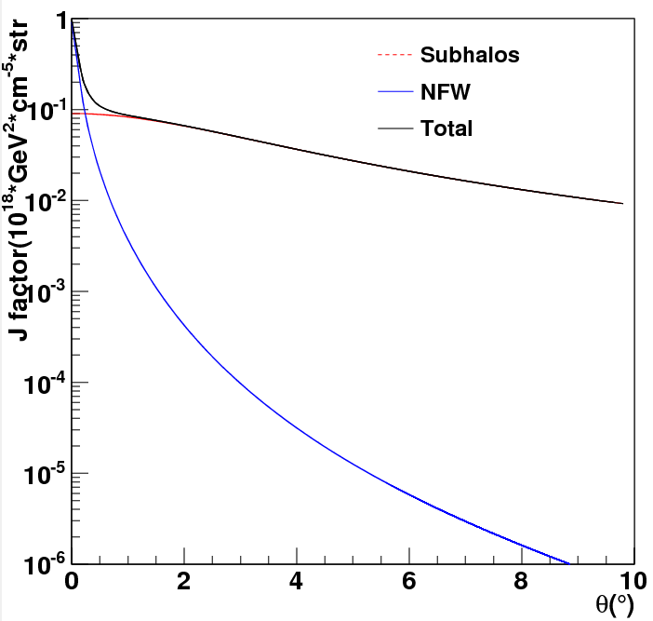



中国科学院高能物理研究所
INSTITUTE OF HIGH ENERGY PHYSICS
J-factor of galaxy M31:
Dark matter distribution:NFW
Subhalo boost factor:
J-factor from subhalo:
Jiaxin Han et al, 2012

Slide 11
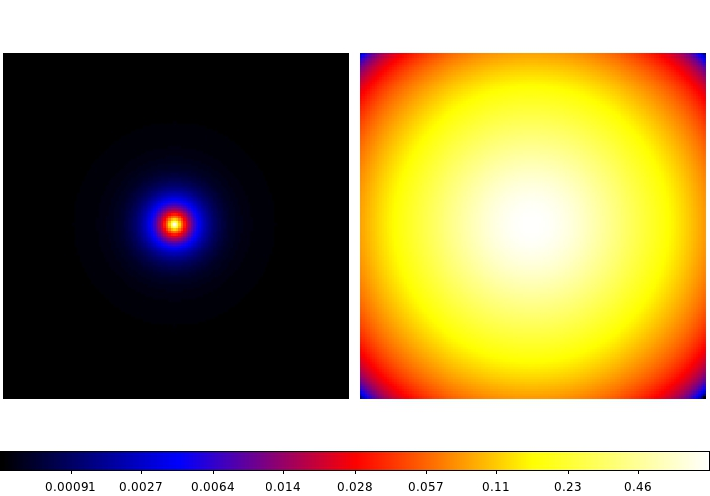
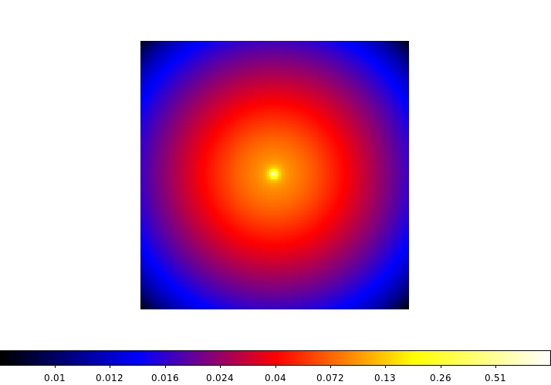
Spatial distribution of J-factor:14º*14º
NFW halo
Subhalo

Slide 12
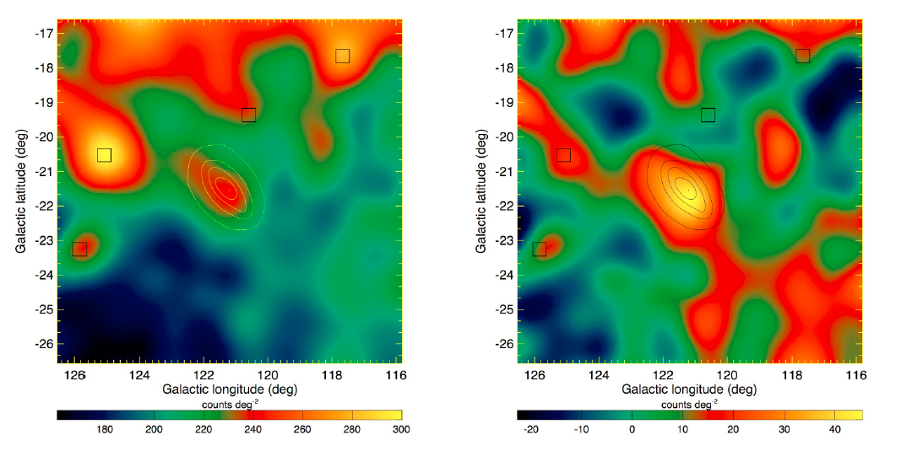
Gamma ray in M31
Abdo et al, 2010
Four point sources in the model
Gamma detection: 5σ significance in 200MeV – 20GeV
Flux(>100MeV):( 9.1±1.9stat±1.0sys) ×10⁻⁹ phcm⁻²s⁻¹

Slide 13

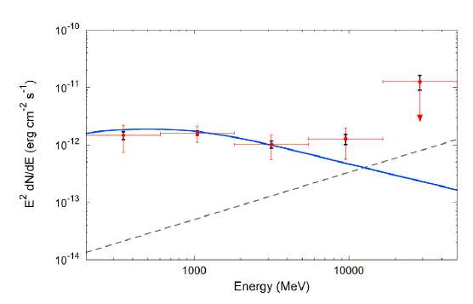
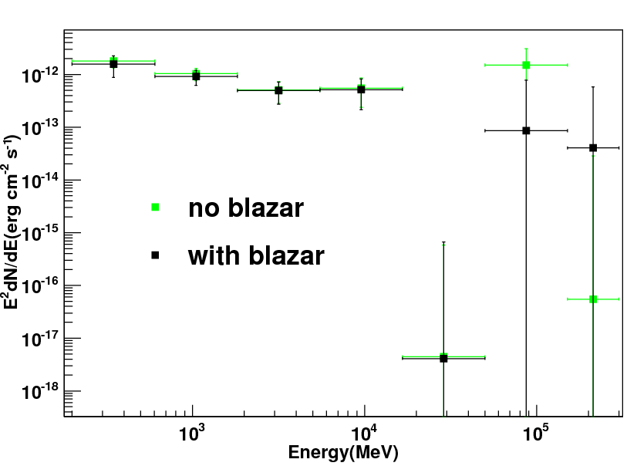
中国科学院高能物理研究所
INSTITUTE OF HIGH ENERGY PHYSICS
Abdo et al, 2010
Using 2FGL catalog with more sources in the model
Model the M31 as a point source with power-law spectrum
BL Lac 1ES0037+405 affect the energy spectrum when energy > 70GeV

Slide 14
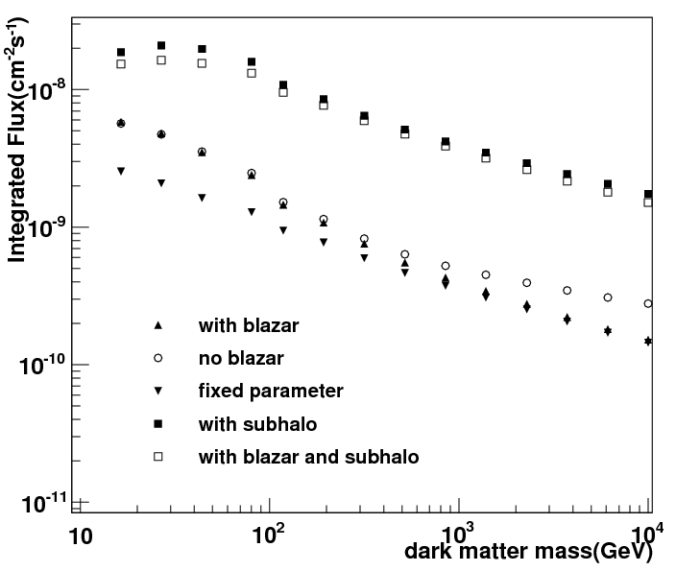
中国科学院高能物理研究所
INSTITUTE OF HIGH ENERGY PHYSICS
DM annihilation flux upper limits
Model the M31 as a point source with power-law spectrum
Free the normalization parameter of the sources in the ROI
With subhalos , the 1ES0037+405 do not effect the uppler limit

Slide 15

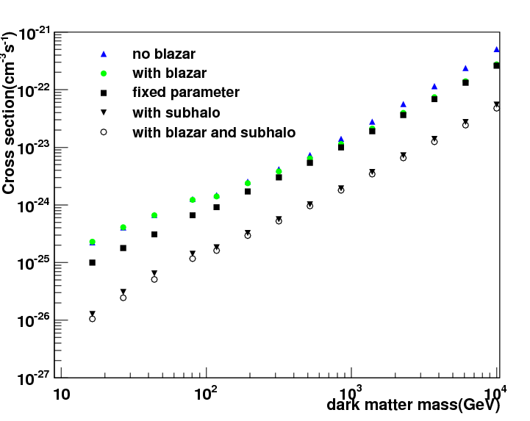
中国科学院高能物理研究所
INSTITUTE OF HIGH ENERGY PHYSICS
Upper limits for the DM annihilation cross-section
Cross-section drop below the thermal cross –section of 3×10⁻²⁶cm³s⁻¹when dark mass <20GeV

Slide 16
中国科学院高能物理研究所
INSTITUTE OF HIGH ENERGY PHYSICS
Summary
Subhalos give strong limits on the cross-section of dark matter annihilation
Model the dark matter distribution in Einstao, isothermal profile
Consider the effect of inverse compton scatter of the secondary particles from annihilation

