Slide 1
Space-based Gamma-ray Astronomy
Liz Hays
(NASA Goddard Space Flight Center)

Slide 2
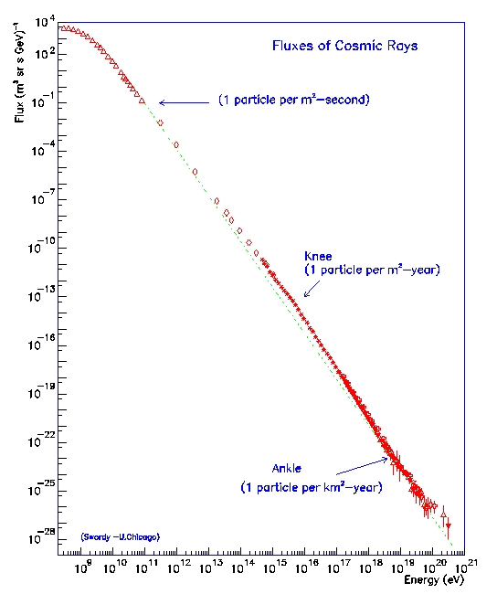
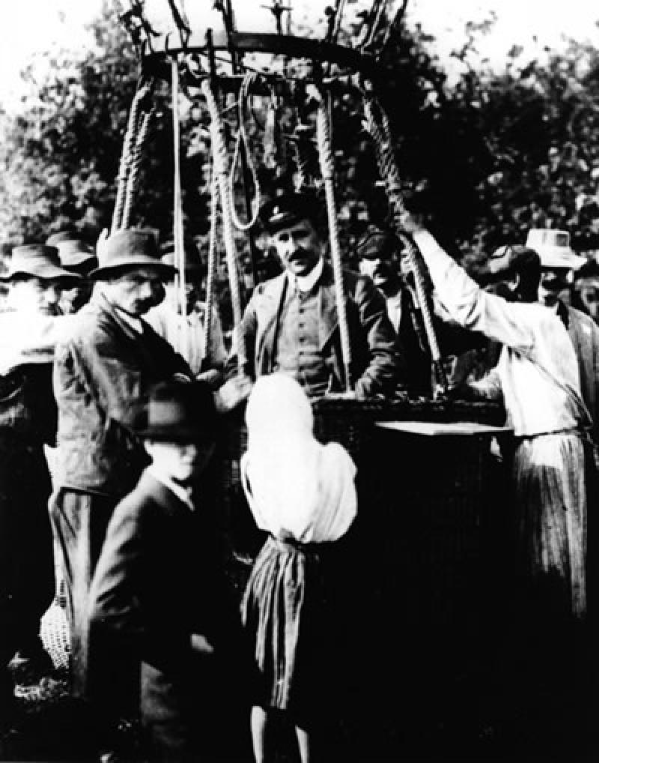
The Origin of Cosmic Rays
Victor Hess and his “Flight Ops Team”, 1912
Credit S. Swordy

Slide 3
How to make gamma rays
From protons
Pion decay
Accelerated protons (p) interact with matter
p p → X + π₀ → γ γ
Proton Synchrotron Emission
Depends on magnetic field strength (not dominant under typical conditions)
γ’s
p
B

Slide 4
How to make gamma rays
From electrons
Inverse Compton Scattering
Collide highly relativistic electrons with photons from stars or the microwave background
Scattered γ
e⁻ + γ_{Low E} → e⁻ + γ
E_{γ} ∝ (γ_{Lorentz})² E_{γ Iow E}
γ_{Lorentz} = 1/√(1 - v_{e}²/c²)
e⁻

Slide 5
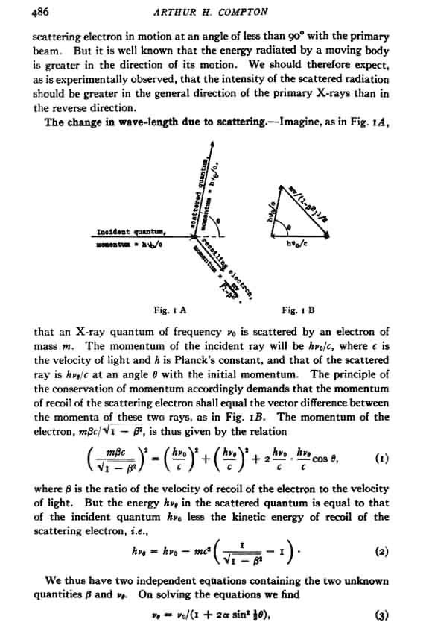
Arthur Holly Compton
Nobel Prize in Physics 1927
Scattering of photons by electrons demonstrated the particle nature of electromagnetic radiation
This and inverse mechanism are responsible for much of gamma ray production and detection
AIP Center for History of Physics
http://www.aip.org/history/

Slide 6
How to make gamma rays
From electrons
Brehmsstrahlung (deceleration radiation)
Electron deceleration by a nucleus
Highly relativistic electrons emit gamma rays in atomic or molecular material
Energy_{γ} ~ Energy_{e}
Brehmsstrahlung γ
e⁻
Nucleus

Slide 7
Other ways to make gamma rays?
Topological defects left over from the Big Bang?
Hypothesis: Black holes formed with the early Universe decay
By-product of dark matter interactions?
Hypothesis: weakly interacting massive particles (WIMPs) interact to produce gamma rays: DM + DM → γ γ
WIMP + WIMP → γ + γ

Slide 8
Why look for cosmic gamma rays?
Supernova explosions release radioactive isotopes
Cosmic rays are mostly protons
Radio and later X-ray observations
Synchrotron emission from populations of accelerated electrons
Infrared, optical, and UV observations
Target material and low energy photon populations

Slide 9
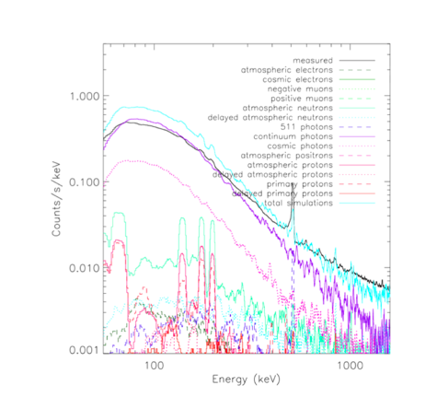
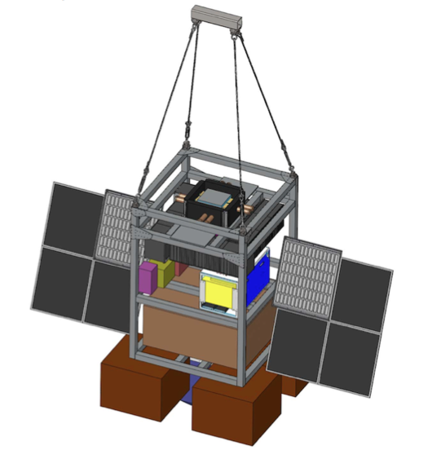
NB: we still use balloons, too
Nuclear Compton Telescope. Credit: S. Boggs/NCT collaboration

Slide 10
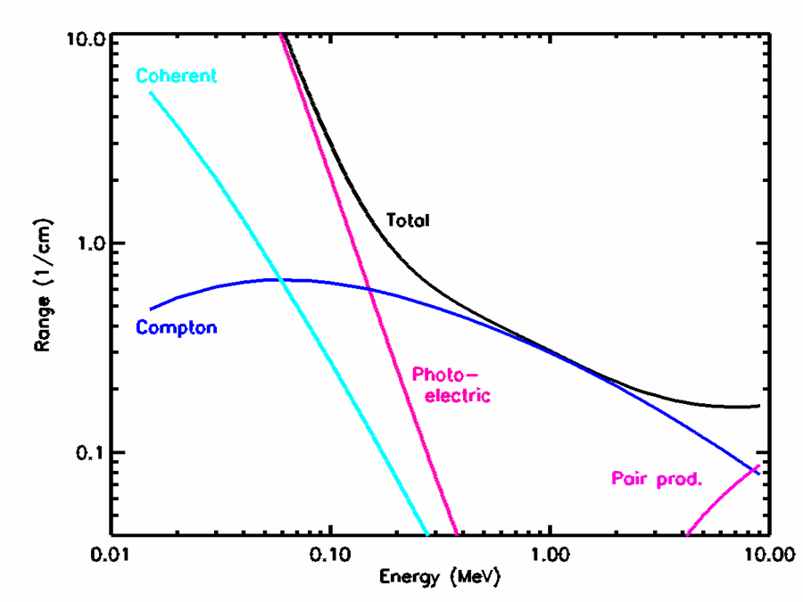
How to “see” gamma rays
Gamma rays are scattered and absorbed in matter (troublesome for standard focusing techniques)
Cross section depends on material and energy
Coherent Scattering (electron remains bound to atom)
Photoelectric Effect
Compton Scattering
e⁻ e⁺ Pair Production
Gamma rays in Germanium
Credit: Richard Kroeger
Notes:
For some additional info on the Compton technique and detector physics see http://heseweb.nrl.navy.mil/gamma/detector/tracking/GRTatNRL.html

Slide 11
Pair production
Gamma ray energy is converted to an electron and positron in the presence of a nucleus
e⁺
γ
e⁻

Slide 12
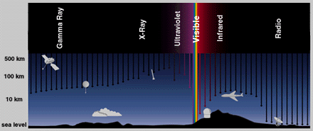
A problem for astronomy
It’s actually pretty hard to observe from the ground.
Black arrows indicate average depth for wavelengths across the electromagnetic spectrum.

Slide 13
Several solutions
Solution I: put detectors in the upper atmosphere or above it
Balloons and rockets
Space probes
Solution II: this is not a problem; it’s a detector!
Build instruments on the ground that collect the absorption by-products

Slide 14
Solution I
Gamma rays with energy below ~50 are detected in space
Using the Compton Effect: keV – MeV
Below a few hundred keV can used X-ray techniques, such as coded masks
Using pair production: MeV – GeV
Above ~50 GeV there are so few gamma rays that satellite detectors, area ~ m², are too small

Slide 15
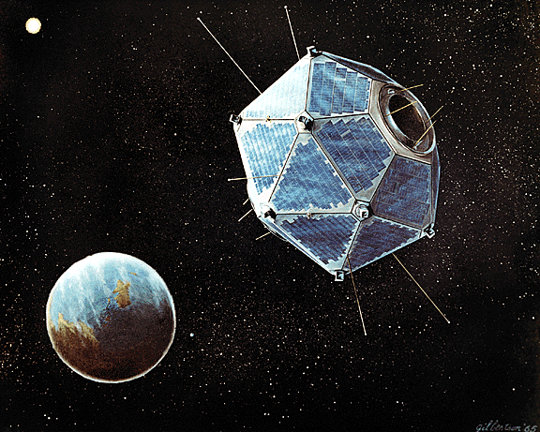
Historical note: Discovery of GRBs by the Vela satellites
Nuclear weapons test monitoring satellites
>70 bursts in the 1960’s
First indication of powerful, very short timescale cosmic explosions
Neutron stars in our Galaxy? Not clear until later that these were extragalactic
Vela 5B Credit: NASA HEASARC
Notes:
http://heasarc.gsfc.nasa.gov/docs/observatories.html

Slide 16
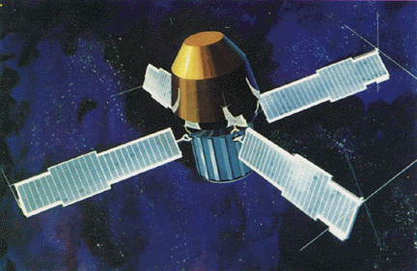
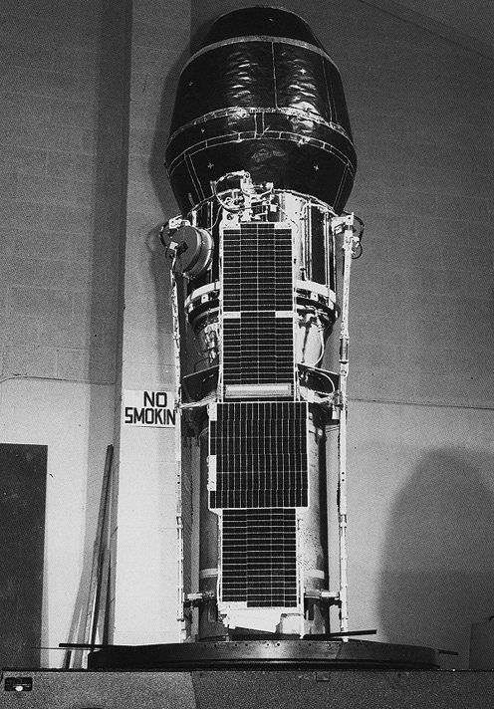
SAS 2 mission
Small Astronomy Satellite
November 1972 - June 1973
Mapped the high energy gamma-ray sky in detail
Measured high energy gamma-ray background
Confirmed that gamma rays come from dense regions of the Galaxy
Credit: NASA HEASARC
Notes:
http://heasarc.gsfc.nasa.gov/docs/observatories.html

Slide 17
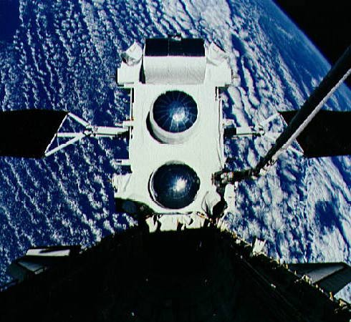
The Compton Gamma Ray Observatory
1991-2000
4 instruments span 30 keV - 30 GeV
Deployed by the space shuttle
High energy detector, EGRET
Pair conversion
>270 sources (many unidentified)
Medium energy, COMPTEL
Compton technique
Gamma-ray burst detectors, BATSE
2704 γ-ray bursts
Credit: NASA
Notes:
http://heasarc.gsfc.nasa.gov/docs/observatories.html + various instrument references

Slide 18
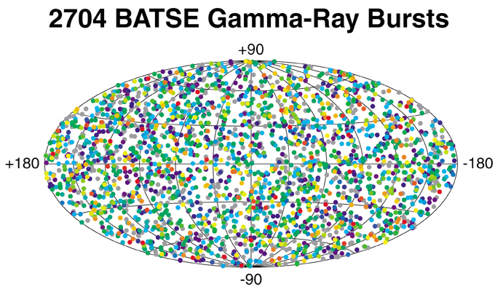
CGRO Gamma-ray Bursts
Color indicates fluence (energy flux integrated over duration of burst). Red are for long/bright bursts, purple are for weak/short. Gray do not have a calculated fluence.
Credit: NASA/BATSE

Slide 19
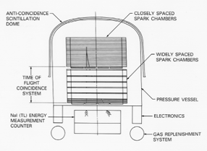
A close-up of EGRET
γ
Tracking Layers
Detecting a gamma ray
Tantalum Foil
Direction
Energy
Time
Gas (e.g. Neon ethane mix)
e⁻
e⁺
Calorimeter: 8 radiation lengths of NaI(Tl)
From CGRO Science Support Center
Notes:
Nice public site about spark chambers: http://www.hep.phy.cam.ac.uk/~lester/teaching/SparkChamber/SparkChamber.html
You can find a more technical write-up here:

Slide 20
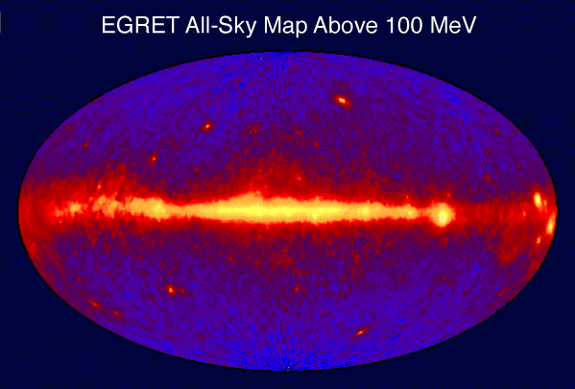
The High Energy Sky circa 2000

Slide 21
Summery
Gamma rays below ~50 GeV must be detected in space
Gamma ray interactions are better suited to tracking detectors than conventional optics
Increasing detector area and resolution provide increasingly detailed maps of the sky and catalogs of sources

Slide 22
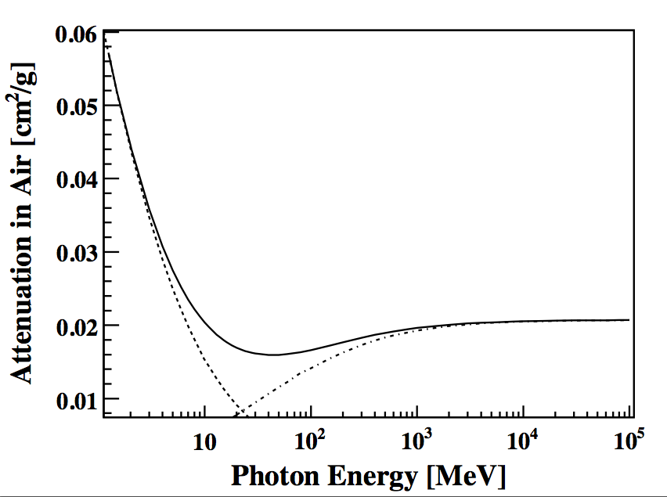
Gamma-ray cross sections
In Air
Compton
Pair production
NIST database of photon cross sections: M.J. Berger,1 J.H. Hubbell, S.M. Seltzer, J. Chang,3 J.S. Coursey, R. Sukumar, D.S. Zucker, and K. Olsen
Notes:
See NIST database of photon cross sections
http://www.nist.gov/pml/data/xcom/index.cfm

