Slide 1
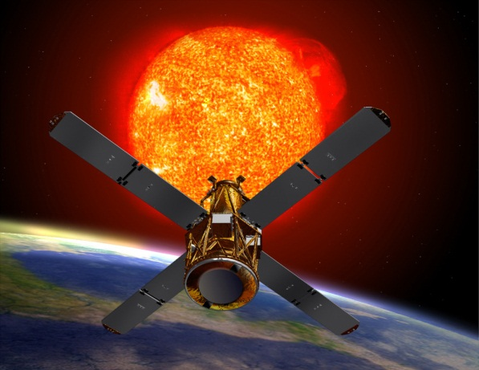
Solar Physics with X-ray Observations
RHESSI
Fermi Gamma-ray Burst Monitor
Gordon D. Holman Solar Physics Laboratory (Code 671) NASA Goddard Space Flight Center
Notes:
Focus on topics directly relevant to Fermi
For X-rays, Fermi GBM is the relevant instrument

Slide 2
Synopsis of Presentation
Brief history of solar flare X-ray studies with emphasis on hard X-ray light curves and spectra
Hard X-ray spectral analysis models
Physical interpretation of hard X-ray spectra
What does a flare look like? The Standard Model for Solar Eruptive Events (flare + CME)
Notes:
Emphasis on spectra, because GBM obtains hard X-ray light curves & spectra

Slide 3
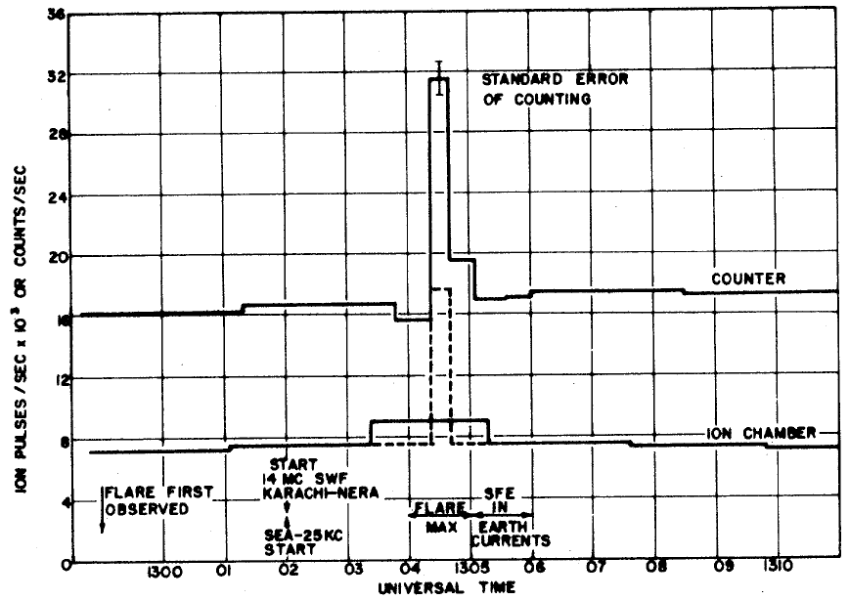
First Detection of Hard X-rays/ Gamma-rays from a Solar Flare
Balloon flight from Cuba
Two instruments:
Integrating Ion Chamber
Geiger Counter
Duration < 18 s
From count ratio:
cosmic ray protons
γ-ray spectrum peaked in the 100 – 500 keV range
1958 March 20
Peterson, L., & Winckler, J. R. 1958, Phys. Rev. Lett. 1, 205
Peterson, L., & Winckler, J. R. 1959, J. Geophys. Res. 64, 697
Notes:
Nearly 55 years ago
18-s integration time

Slide 4
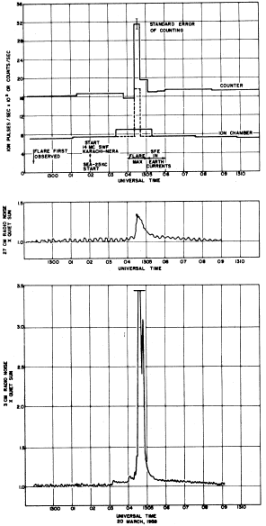
Peterson & Winckler concluded:
Radiation mechanism: Nuclear reaction in photosphere Betatron radiation Bremsstrahlung (free-free emission) from electrons “slowing down and stopping” (thick target)
Electron energies: 500 keV – 1 MeV
10,000 more 1 MeV electrons required for γ-ray burst than for radio burst
1% of flare energy in 10³⁴ 1-MeV electrons
The electrons were accelerated in a volume “near the top of the flare”
27 cm radio
3 cm radio
Notes:
Consistent with light curves observed in radio emission
Now typically find 10% of flare energy in accelerated electrons
Basic picture has not changed

Slide 5
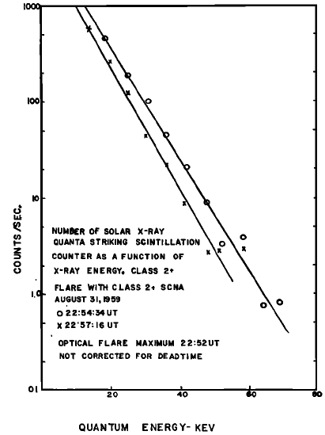
First Hard X-Ray Spectra
1959 August 31 Rocket Flight
Scintillation spectrometer
20 – 70 keV photons detected
Spectrum softened with time
Deduced exponential spectral shape
Conclusion: bremsstrahlung from thermalized electrons
Chubb, T. A., Friedman, H., & Kreplin, R. W. 1960, J. Geophys. Res. 65, 1831
Notes:
Requires 100 MK – 1000 MK plasma!

Slide 6
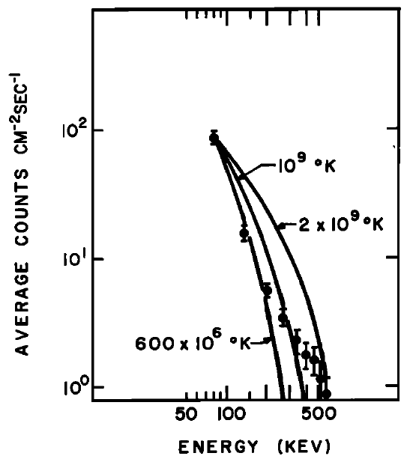
Spectral Evidence for Bremsstrahlung from Non-thermal Electrons
CsI crystal spectrometer on OGO 3
80 keV – 1 MeV, 16 energy bands
Spectrum hardened with time and photon energy
Spectrum inconsistent with bremsstrahlung from an isothermal plasma
1966 July 7
Cline, T. L., Holt, S. S., & Hones, E. W. 1968, J. Geophys. Res. 73, 434
Notes:
Spectral flattening exceeding that expected from relativistic flattening and electron-electron bremsstrahlung sometimes seen above a few hundred keV

Slide 7
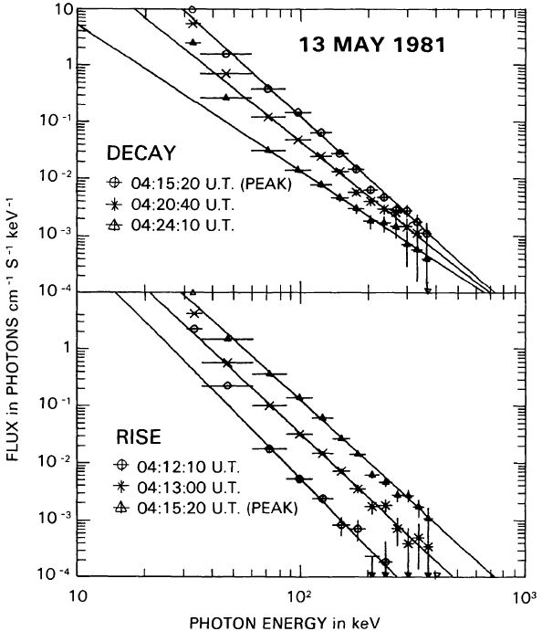
Spectra from the Hard X-Ray Burst Spectrometer (HXRBS) on the Solar Maximum Mission (SMM)
15 energy channel, 128-ms read-out CsI (Na) scintillation spectrometer
Observations of over 7,000 flares
Spectra typically follow soft-hard-soft evolution
May 13 flare spectrum hardened with time above 60 keV
Dennis, B. R. 1985, Solar Phys. 100, 465
Notes:
Hardening (instead of S-H-S) associated with SEPs

Slide 8
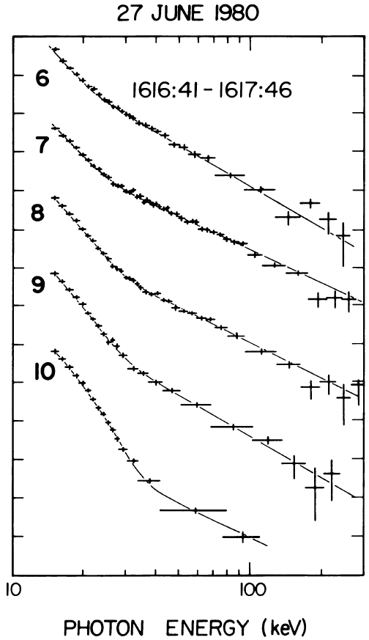
Hot Isothermal + Double-Power-Law Spectral Fits
Balloon-borne array of cooled germanium detectors
30 MK isothermal component below ≈ 35 keV
Double-power-law spectra above 35 keV (Schwartz et al. 1987)
Only high-resolution spectra until 2002 launch of RHESSI !
Lin, R. P., Schwartz, R. A., Pelling, R. M., & Hurley, K. C. 1981, Ap. J. 251, L109
Notes:
First spectra to clearly show both thermal & power-law components together
Temperatures up to ~50 MK have been deduced from spectral fits

Slide 9
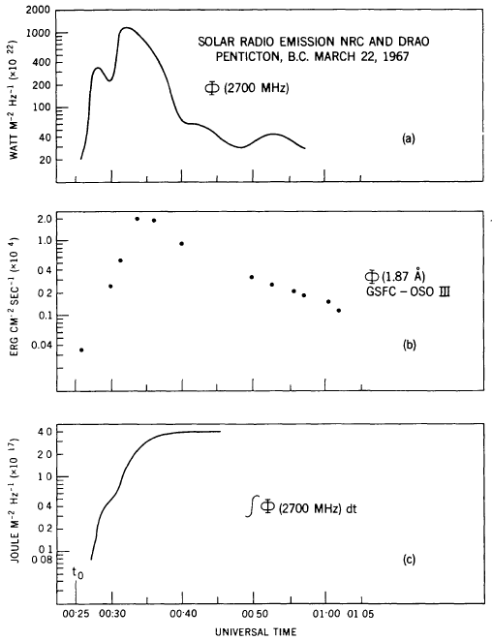
The Neupert Effect and Chromospheric Evaporation
Time integral of cm-λ radio light curve (hard X-ray light curve) correlated with rise of soft X-ray light curve
Collisional energy losses by energetic electrons in thick target heat and ionize chromospheric plasma
Chromospheric plasma expands upward into corona
Neupert, W. M. 1968, ApJ 153, L59
Notes:
Seen in most flares

Slide 10
From Photon Spectrum to Accelerated Electron Distribution: Analytic Results
Brown, J. C. 1971, Solar Phys. 18, 489
Assume injected power-law electron flux distribution: F(E) = AE^{−δ} electrons s⁻¹ keV⁻¹
Assume collisional energy losses: dE/dx = −Kn(x)/E keV cm⁻¹
Assume Bethe-Heitler bremsstrahlung cross section:
Photon spectrum has a power-law form: I(ε) = I₀ ε^{−γ} photons cm⁻² s⁻¹ keV⁻¹
Thick target: γ = δ − 1
Thin target: γ = δ + 1
Notes:
Collisional losses flatten the spatially integrated electron distribution

Slide 11
The Low-Energy Cutoff and the Total Energy in Accelerated Electrons
Power-law electron flux distribution: F(E) = AE^{−δ} electrons s⁻¹ keV⁻¹ = F₀ (δ−1) E_{c}^{δ−1} E^{−δ} , for E > E_{c}
E_{c} is the low-energy cutoff to F(E).
F₀ is the integrated electron flux in electrons s⁻¹ above E_{c}.
Thick-target emission does not depend on the plasma (target) density.
From spectral fit, can determine total accelerated electron number flux (F₀) and energy flux above energy E = ε !
Time integration gives total number and energy of electrons above energy E = ε !
Notes:
High-energy cutoff physically interesting, but difficult to identify and generally does not affect deduced total electron flux
What fraction of flare spectra are consistent with a high-energy cutoff?

Slide 12
Modeling Spectra in the Object Spectral Executive (OSPEX)
Count spectra to photon spectra using RHESSI response matrix and model photon spectra
Bremsstrahlung and line emission from isothermal and multi-thermal models
Single and multiple power-law photon spectrum models
Albedo correction
Model photon spectra computed from model electron distributions and relativistic bremsstrahlung cross section
thick and thin target
double power-law electron distribution with low- and high-energy cutoffs
Notes:
Other models available or can be added
Model independent spectral inversion to Mean Electron Flux electron distribution also available

Slide 13
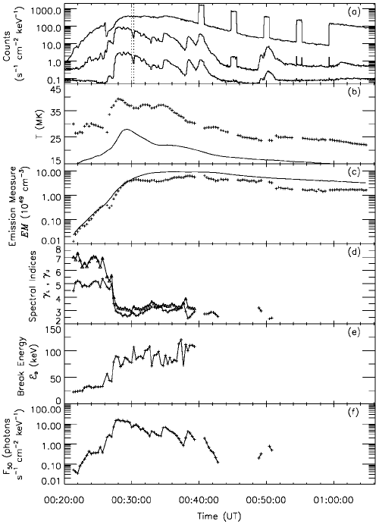
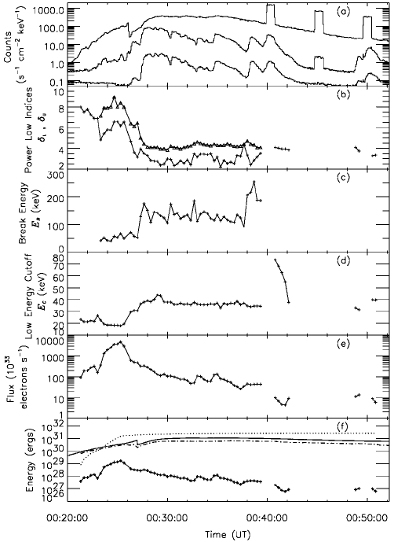
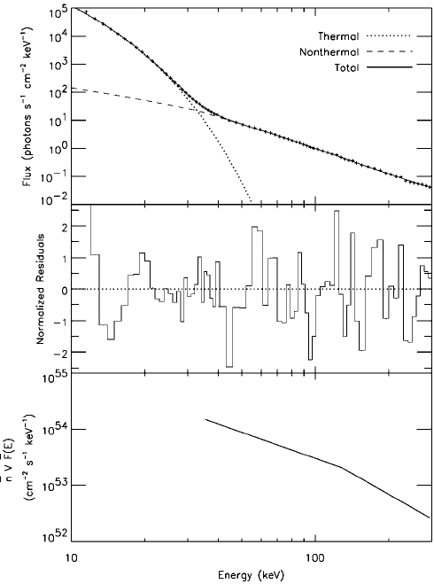
Modeling the Spectral Evolution in a Large Flare: 2002 July 23
Time Evolution of Photon Spectral Fits
Time Evolution of Electron Distribution Fits
12 – 40 keV
Sample Spectral Fit
40 – 100 keV
100 – 300 keV
Double power law, Thick Target
Double-power-law fit
Low-Energy Cutoff
Electron Number Flux (x 10³³)
Double power law, Thin Target
Photon Flux at 20 keV
Accumulated Energy in Electrons
Electron Energy Flux
Holman, G. D., Sui, L., Schwartz, R. A., & Emslie, A. G. 2003, ApJ 595, L97
Notes:
High values for the low-energy cutoff found late in flare
Two-thirds of nonthermal electron energy deposited BEFORE impulsive rise of hard X-rays

Slide 14
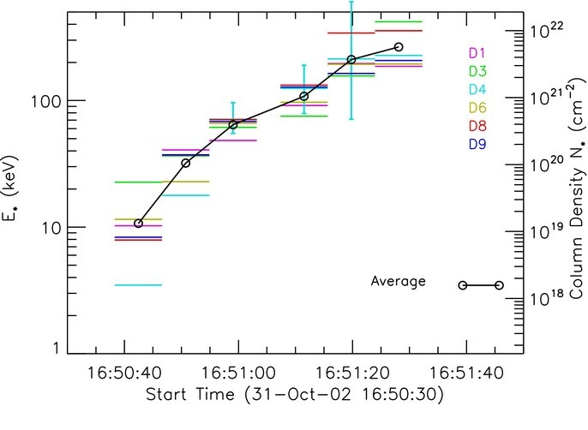
Example of a Fit of a Physical Model to Hard X-ray Spectra
Transition from fully ionized to neutral plasma in the thick-target region introduces a mild “kink” into the hard X-ray spectrum
Time-evolution of kink indicates column density of fully ionized plasma increased by at least two orders of magnitude in impulsive phase
Su, Y., Holman, G. D., & Dennis, B. R. 2011, ApJ 731, 106
Notes:
Evolution of column density can be compared with numerical chromospheric evaporation results using injected electron distributions deduced from spectral fits

Slide 15
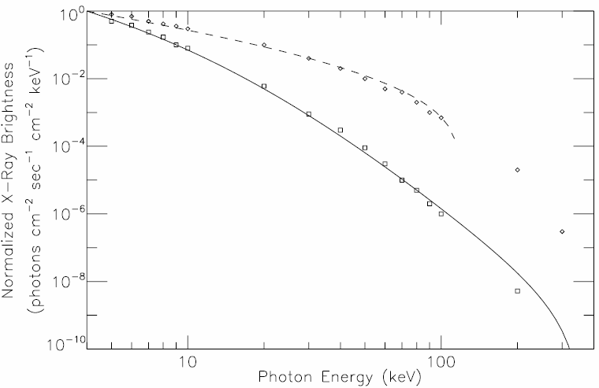
Example 2: Injected Power-Law Electron Distribution with Return-Current Losses
Fit of a return-current loss model to “data” from numerical simulations (Zharkova, V. V., & Gordovskyy, M. 2006, ApJ 651, 553)
A return current maintains charge neutrality, resupplies electrons to the acceleration region, and stabilizes the electron beam.
The electric field driving the return current also decelerates the electrons in the primary beam of accelerated electrons.
δ = 3 V = 130 kV
δ = 7 V = 14 kV
Injected electron distribution: Single power law Low-Energy Cutoff at 8 keV High-Energy Cutoff at 384 keV
Holman, G. D. 2012, ApJ 745, 52
Notes:
Flat low-energy cutoff below electron energy V = potential drop in loop

Slide 16
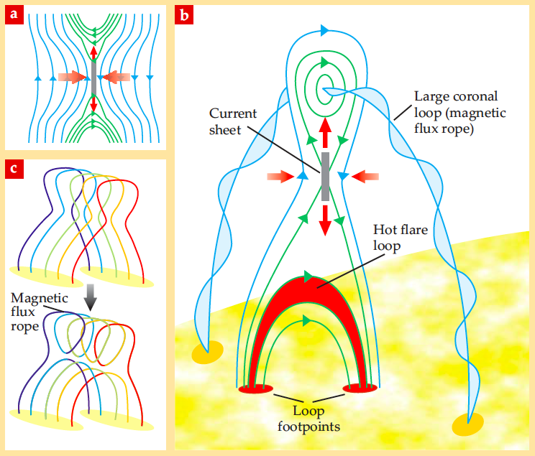
The Standard Model for Solar Eruptive Events
Electron Acceleration
Electron Propagation
Thick-Target Bremsstrahlung X-Rays
Holman, G. D. 2012, Physics Today, April issue
Notes:
Downward ejected, reconnected magnetic field becomes flare arcade
Upward ejected magnetic field (light-blue flux rope) becomes CME
Electrons most likely accelerated in “jet” region below current sheet Accelerated electrons stream from reconnection region to arcade loop foot points to produce thick-target X-rays

Slide 17
High-Energy Aspects of Solar Flares: A RHESSI-Inspired Monograph
Space Science Reviews Vol. 159, Issues 1 – 4 2011
Preface Overview of Volume 7 Review Articles Summary and Future Prospects ∼ 55 authors!
“Implications of X-Ray Observations for Electron Acceleration and Propagation in Solar Flares”, Holman, G. D., Aschwanden, M. J., Aurass, H., Battaglia, M., Grigis, P. C., Kontar, E. P., Liu, W., Saint-Hilaire, P., and Zharkova, V. V., 2011, Space Science Reviews, 159, 107
“Deducing Electron Properties from Hard X-Ray Observations”, Kontar, E. P., Brown, J. C., Emslie, A. G., Hajdas, W., Holman, G. D., Hurford, G. J., Kasparova, J., Mallik, P. C. V., Massone, A. M., McConnell, M. L., Piana, M., Prato, M., Schmahl, E. J., and Suarez-Garcia, E., 2011, Space Science Reviews, 159, 301
Notes:
Two review articles from the SpSciRev volume most relevant to the analysis and interpretation of hard X-ray spectra

