Slide 1
Alternative Observation Strategy for the Fermi Mission -
A Recommendation

Slide 2
Motivation
5th anniversary of the science phase of the Fermi mission
Continued evolution of Fermi science program and…
With eye to the future extended Fermi mission phase (i.e. SR)
Due consideration should be given to alternative observing strategies

Slide 3
Process
White papers were solicited from the community
began 17 January 2013
ended on 27 March 2013.
5 WPs, including 1 each from the Fermi GBM and LAT teams
From the beginning this was viewed as a collaborative process. Teams helped any groups requested information
A one-time committee was formed. Two meetings
One telecon in early July. Decided to review 3 or 5 WPs in detail
A face-to-face meeting with committee, LAT team, GBM team, FSSC, NASA HQ, and Fermi Project+Deputy Scientists

Slide 4
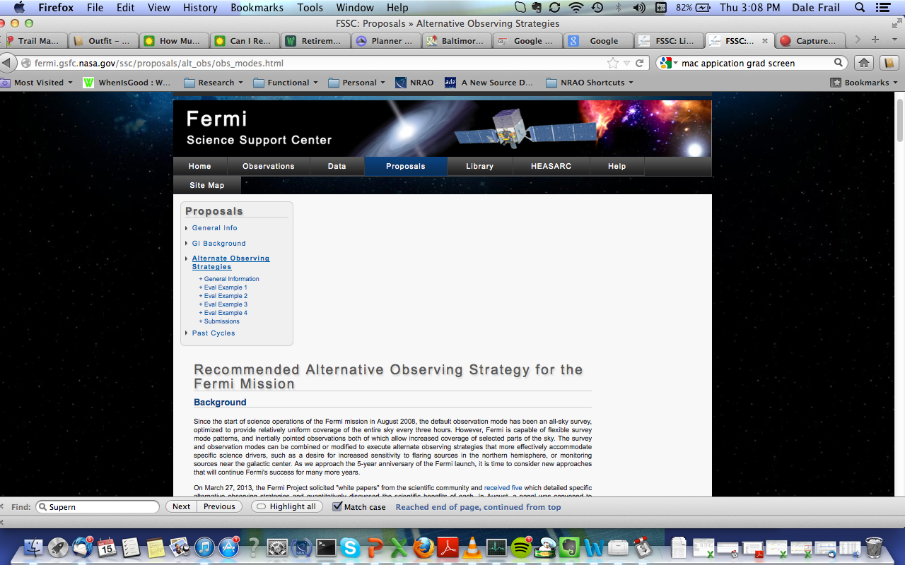
http://fermi.gsfc.nasa.gov/ssc/proposals/alt_obs/obs_modes.html

Slide 5
Committee
Eric Charles (KIPAC/SLAC)
Seth Digel (KIPAC/SLAC)
Douglas Finkbeiner (Harvard University)
Dale Frail (NRAO)
Gino Tosti (Universita di Perugia)
Scott Ransom (NRAO)
Christoph Weniger (University of Amsterdam)

Slide 6
Committee Recommendation
We recommend that the Fermi mission undertake a new observing strategy that emphasizes coverage of the Galactic center region (i.e. “Option 4” or similar). This recommendation should be adopted with the following conditions:
Implementation should occur by December 2013. The time between now and then is needed to solicit community comment on the recommendation and to run some observatory thermal modes to better understand the impact of this new observing strategy.
The modified observing strategy should run for one year.
After one year is up, the Fermi Project Scientist will organize a review to decide whether to maintain the modified observing strategy or return to survey mode.

Slide 7
Motivation for a Revised Science Program
G2 cloud encounter of Sgr A*
The world’s observatories have dedicated programs
Search for young, energetic Pulsars
Increased sensitivity to these PSRs
Confirm/refute candidate 130 GeV gamma-ray line
A signal for the annihilation of dark matter particles or a statistical fluke?

