Slide 1
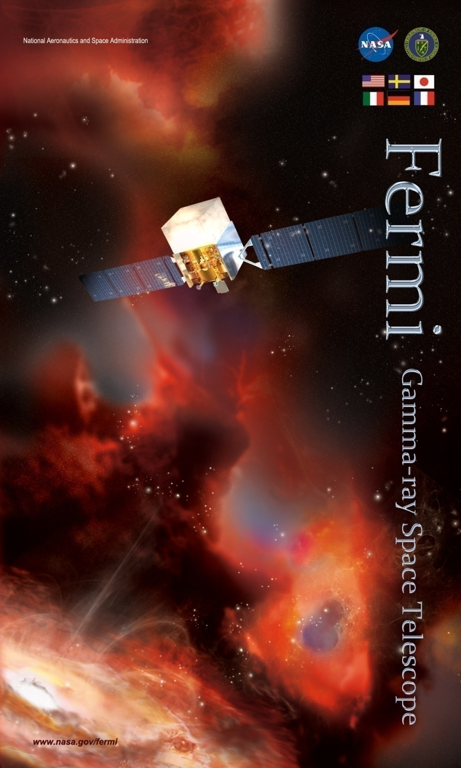
Fermi LAT Report
Fermi User Group meeting
August 16, 2013
Peter Michelson
LAT Principal Investigator and
Spokesperson, Fermi LAT Collaboration
peterm@stanford.edu
on behalf of the Fermi LAT collaboration

Slide 2
Outline
Fermi LAT status
  Instrument operations
  Data processing pipelines
LAT catalog releases
Upcoming P7REP Data Release
  Data, IRFs updates
Future plans
  Pass8 status
  working with FSSC, better optimize data release process

Slide 3
Fermi LAT status
The LAT continues to operate well with no degradations in science performance.
  310 billion LAT triggers since launch
  281.4 million photons available at the FSSC
The international Fermi LAT Collaboration continues to provide excellent coverage for all LAT instrument operations and data processing/analysis needs
  good coverage in all areas due to multitasking by many collaboration members
  collaboration actively engaged in improving instrument performance: e.g. Pass 8 is a key focus; re-processing underway (more about this later)
  key commitments from DOE-SLAC and international partners for extended operations remain firm

Slide 4
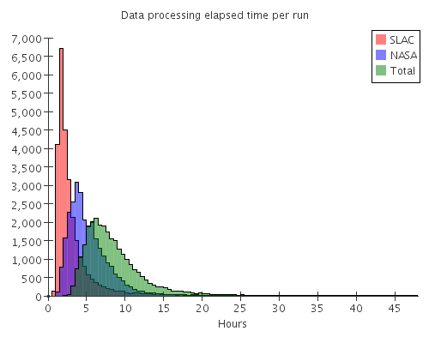
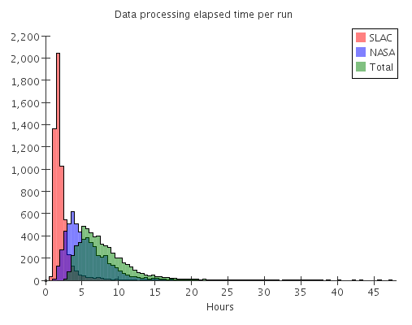
ISOC: Data Processing Latency
ISOC
NASA
Total
From start of Science Mission – 14 August 2013
From start of 1 August 2012 – 14 August 2013
Time from end of run onboard Fermi to delivery of photon list to FSSC
NASA = Hours elapsed between end of data taking for run and ALL data for that run arriving at LAT ISOC.
ISOC = Hours elapsed between ALL data for that run arriving at SLAC and data being registered in data catalog.

Slide 5
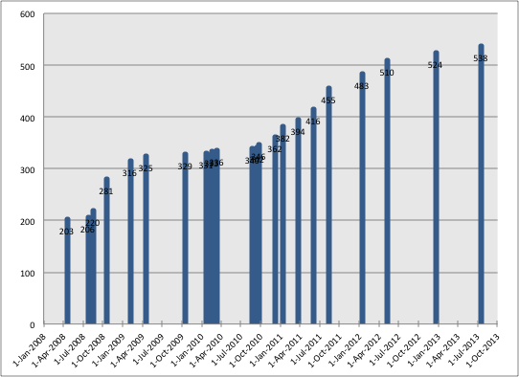
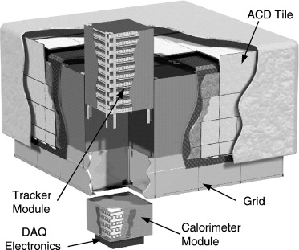
LAT Tracker Hot Strips
LAT tracker:
880,000 Si-strip channels
14 strips added on 15 July 2013; 538 total strips masked
9 for T3L35 (7 hot + 2 gap strips); 2 for T7L33; 2 for T10L35; 1 for T11L1

Slide 6
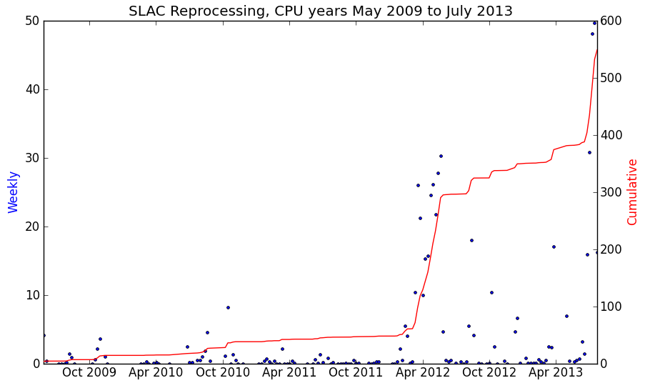
LAT data pipeline
~ 400,000 lines of code generated and maintained by the LAT Collaboration
L1 processing typically requires 2 to 3 CPU years per week
- to date, 560 CPU years
- reprocessing has also used ~560 CPU years

Slide 7
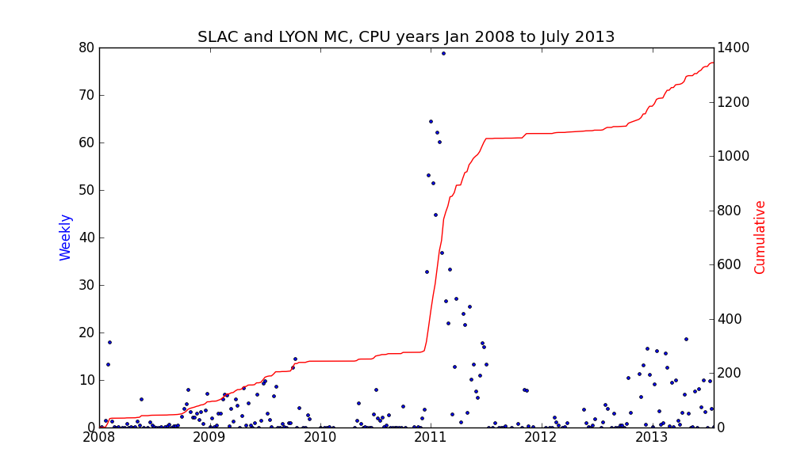
LAT Monte Carlo processing

Slide 8
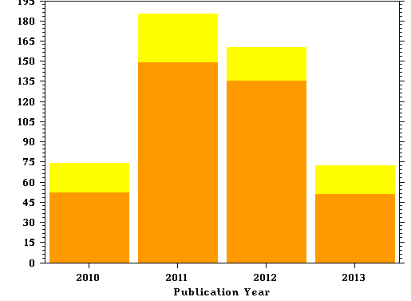
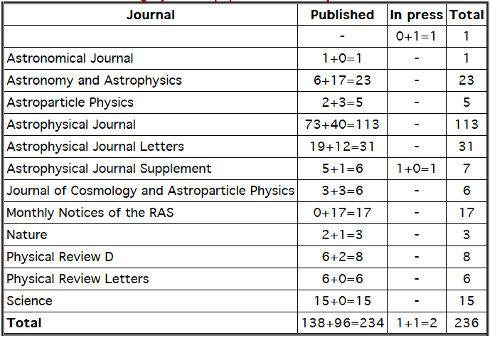
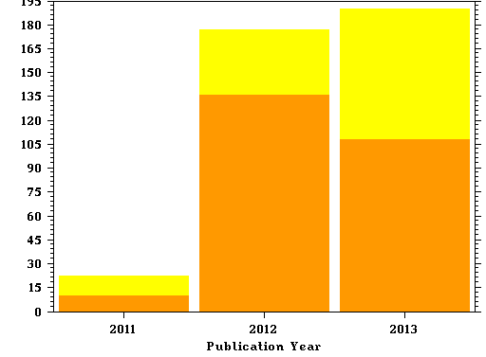
Many LAT team papers out…
Fermi Large Area Telescope First Source Catalog
Ap J Suppl 188, 405 (June 2010)
LAT Collaboration papers
491 citations in 37 months
NASA ADS
published in both physics and astrophysics journals, reflecting broad interest
Fermi Large Area Telescope Second Source Catalog
Ap J Suppl 199, 31 (April 2012)
389 citations in 21 months
http://fermi.gsfc.nasa.gov/ssc/library/pubs/
http://www-glast.stanford.edu/cgi-bin/pubpub

Slide 9
LAT catalogs
In addition to the LAT source catalogs, the LAT team produces several more specialized catalogs:
The Second Catalog of Active Galactic Nuclei Detected by the Fermi Large Area Telescope
ApJ, 743, id. 171, (2011)
The Second Fermi Large Area Telescope Catalog of Gamma-ray Pulsars
ApJ Suppl, accepted, in-press
The First Fermi LAT Gamma-ray Burst Catalog
submitted
The First Fermi LAT Catalog of Sources above 10 GeV
submitted
The First Fermi LAT Supernovae Remnant Catalog
in preparation

Slide 10
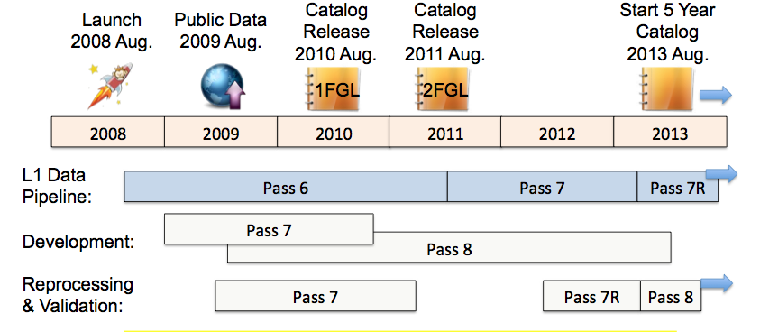

Still improving the LAT Performance
Continuous effort to improve performance and release improved datasets
  Pass6: pre-launch recon and event selection, optimized post-launch IRFs (to describe effect of ghosts)
  Pass7: pre-launch recon, optimized post-launch event selection and associated IRFs
  Pass8: post-launch recon, event selection and IRFs
4
3FGL
Pass 7
Pass 7R
Pass 8

Slide 11
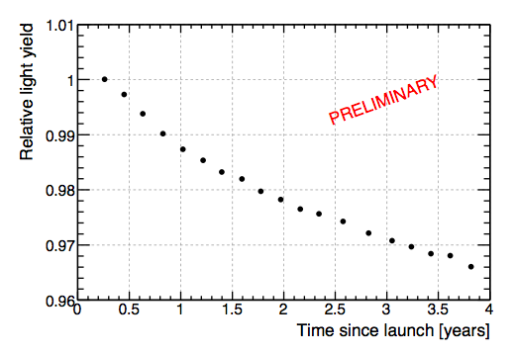
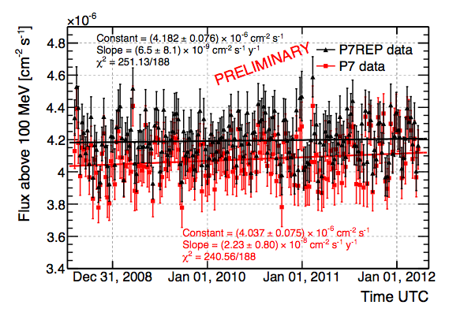
P7REP Data - overview
average CAL log yield
Updated LAT calibrations & CALRecon
  Map ~1%/year CAL light yield decrease from irradiation
  CAL logs light collection asymmetry
  TKR routine updates
  Improved CAL moment analysis
Main effects
  Few % upward energy shift
  Improved high-energy PSF
Data Releases
  Full FT1 release targeted for week of Sep.4
Geminga flux
arxiv:1304.5456

Slide 12
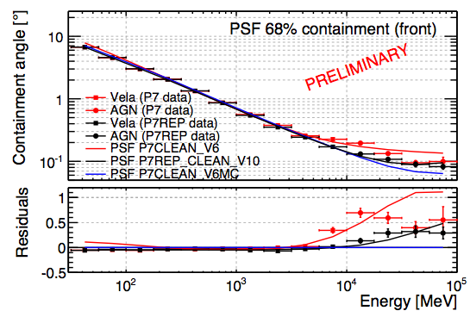
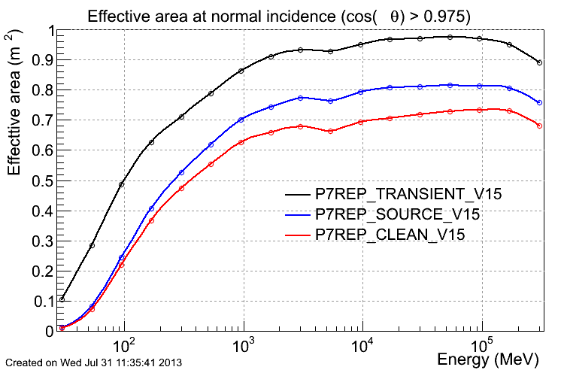
P7REP Instrument Response Functions
Improved Point Spread Function > few GeV
Flight PSF parameterization retains MC dependence on inclination angle
Front/Back scaled effective area
Better systematic uncertainties (final numbers TBD)
IRF Releases
  V10 with pre-release and DM line analysis (1305.5597)
  V15 final set uses improved instrument simulation

Slide 13
future (reprocessed) data release planning
Pass 7REP has suffered delays in release:
  initially because of delay in optimization of diffuse emission model;
  however, problems with IRF generation:
    found a ~4% difference in A_{eff} between data and MC for 600 MeV < E < 3 GeV
    realized that the simulations were produced with reconstruction code slightly different from code used to reprocess data;
    because of infrastructure software upgrades, building a new version of the simulation code took much more time than expected
    eventually, with the new IRFs, the difference in A_{eff} between data and MC disappeared
The LAT team and the mission/FSSC will look at lessons learned and work to better optimize the release process and release criteria for the future; will revisit this topic with the FUG.

Slide 14
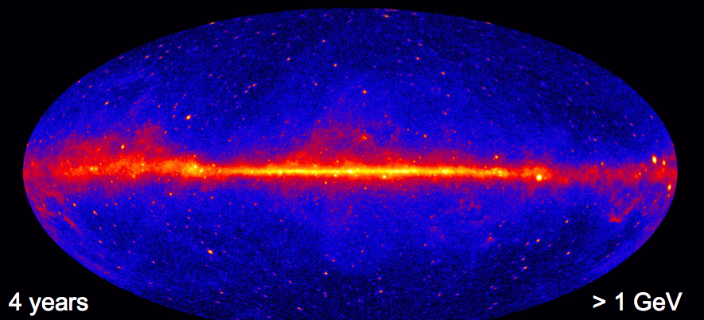
Towards 3rd Fermi Catalog (3FGL)
4 years P7REP data, V15 IRFs and associated diffuse models
Significantly deeper than 2FGL (threshold from 5 to 3 erg/cm²/s)
More than 2500 sources, ~30% unidentified

Slide 15
Pass8 event reanalysis
first comprehensive (and most significant) event level reanalysis since launch. Development underway for past 3.5 years; first step of implementation (reprocessing) now underway.
involves all area of event analysis
  Event reconstruction;
  Overall event structure;
  Energy analysis;
  PSF analysis;
  Background rejection
currently estimate Pass8 may be ready for release towards end of 2014

Slide 16
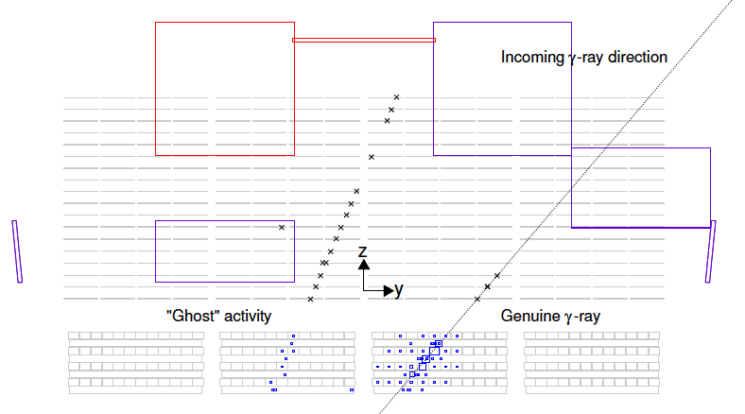
Pass8: Key Motivations
LAT event-level analysis largely developed before launch
considerable insights gained during the prime phase of the mission
  e.g. instrumental pileup is one of the original and main motivations for starting Pass8 development
Use this insight to maximize the instrument performance for science analysis

Slide 17
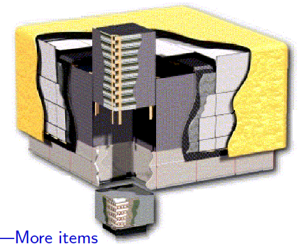
Pass 8: Overview of Development Areas
-- Tracker
Kalman fit measurement errors, Point Spread function analysis, Tracker buffer truncation, tree-based pattern recognition, cosmic-ray tracking, neutral energy and vertexing, …
-- Anti-Coincidence Detector
Error propagation, , track-tile association finding and sorting, …
-- Calorimeter
Crystal simulation and reconstruction, clustering, cluster classification, moments analysis and direction reconstruction, failure mitigation, crystal saturation and energy reconstruction beyond 1 TeV,…
-- More items
periodic trigger event overlays, GEANT4 update, background rejection, extended analysis classes, tools for validation and analysis, …

Slide 18
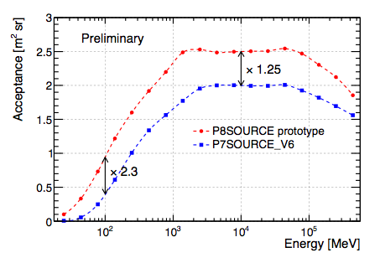
Pass8 Status
Subsystems recon frozen, prototype gamma-ray selection in place
Running massive data reprocessing (~30% data in 2 months)
will be used for 5 year catalog starting 2014
Arxiv 1303.3514

Slide 19
Summary
LAT continues to perform well; science performance upgrades will result from ongoing work on Pass 8 reprocessing;
Science reach of LAT remains high;
Key LAT LAT partners, DOE & international, remain committed for extended operations phase

Slide 20
Backup

Slide 21
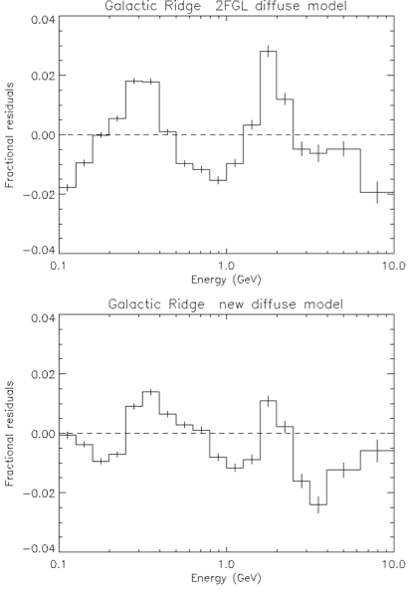
Diffuse emission models for P7REP data
Same method as 2 FGL
  Rings of HI, CO, dark gas are fit to gamma-ray data
  Inverse Compton from Cosmic-Ray data (GALPROP)
  Isotropic emission fit to gamma-ray data
Improvements wrt 2FGL
  Physical spectral shapes
  Extended structures (Loop I, Fermi bubbles) from large scale positive residuals
Results
  Smaller fractional residuals
  Ideal for catalog analysis (→ 3FGL)
  Not suited for extended regions
2FGL Residuals
3FGL Residuals
preliminary

